Slide 1
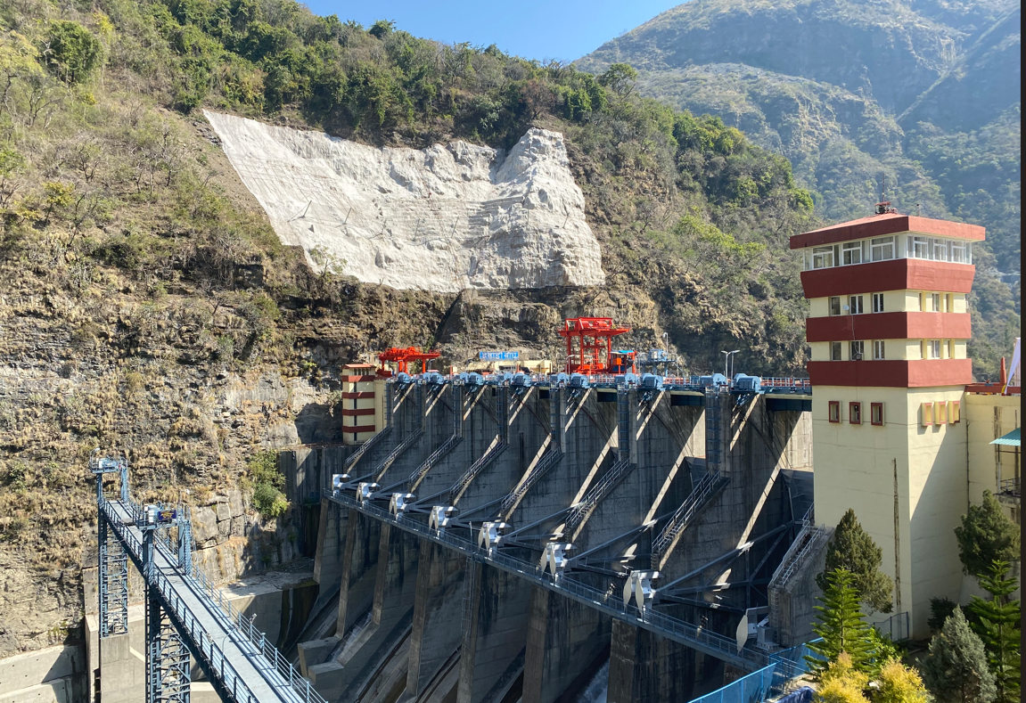
INDIA – Rapid Risk Screening Tool
Ichari dam circa March 2024

Slide 2
Introduction
Workshop on dam safety risk screening – Day 1 Introduction
Notes:
Contents of the presentation and brief description of the subjects that will be presented and discussed during the presentation.

Slide 3
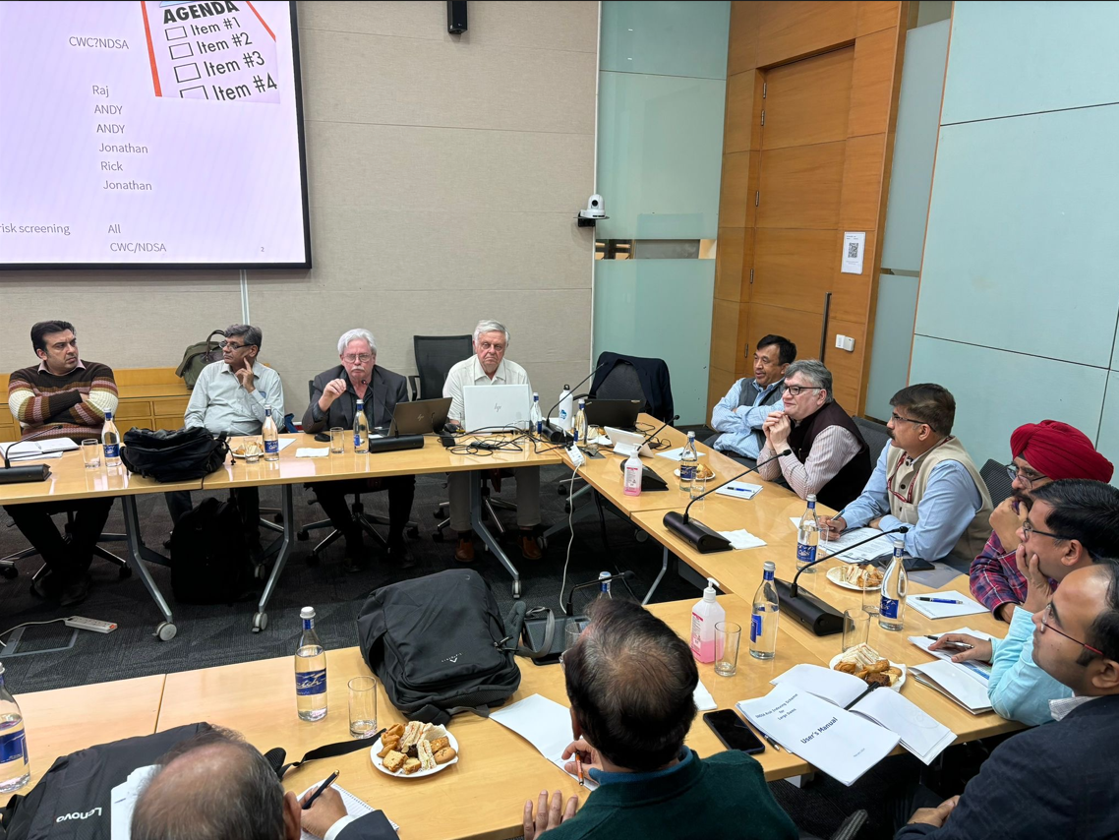
Overview
This workshop represents the first step in the training needed to allow trainers from CWC/NDSA/States and SMEC to fully understand the INDIA tool in order to train engineers from the states in how to populate the tool for their dams
Roll out workshop March 2024

Slide 4

Key Understandings
The workshop is designed to provide some key understandings
  Risk screening is NOT risk assessment. It is the first step in a three-tiered risk assessment process
  The tool is a simplification anchored in risk assessment theory
  The tool is intentionally qualitative. Proxies are used in place of actual probability and consequence estimates such that the tool can be applied to 5700 dams in the time frame available
  The fragility and impact proxy scores used to establish the risk index were carefully established by means of expert solicitation involving experts from CWC, the States and the World Bank.
  The tool has undergone extensive validation and international experts have commented that it is the best of its kind in the worlds
  The tool is currently being upgraded to a web-based data base that will enhance data storage and management capabilities. This doe not impact the data requirements
  Estimates of on of the Potential impacts (PAR) is currently being automated

Slide 5

Agenda
Days 1 – 4
  Introduction of the tool, theory, validation, data availability, Example application
Day 5
  Presentation by each group on the results of risk screening
  Introduction of DRIP 1 dams for screening
Day 6
Understanding score elicitation, tool enhancements, Breakout sessions – Apply the tool to DRIP 1 dams
Days 8 -10
  Breakout sessions – Apply the tool to DRIP 1 dams
  Presentation by each group on the results of risk screening for DRIP 1 dams
Day 10
  Presentation by each group on the results of risk screening for DRIP 1 dams
  Workshop wrap-up and future training
  Closing remarks

Slide 6
Registration
DRIP INDIA Training Registration - Google Forms

Slide 7
Workshop materials
2024_INDIA - Google Drive

Slide 8
Day 1
Agenda

