Slide 1

Biases in Engineering Decisions (Including Risk Practice)
Eric Halpin

Slide 2
Topics
Why Discuss Biases Now?
Who Manages Biases?
What Kinds of Biases Exist and How Do We Manage Them?
An Example

Slide 3
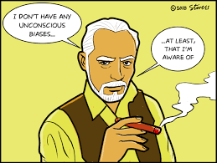
What is a Bias in Risk Assessment
Probabilities are necessary for risk analysis and assessment. They can be derived from:
  Empirical and Statistical Relationships
  Mathematical and Physics Based models
  Subjective, “Degree of Belief” Probabilities
Biases can affect subjective probability estimates and How We Interpret Empirical and Model-Based Probabilities

Slide 4


Who’s Responsible for Managing Biases?
Risk Facilitators
Risk Estimators
Owners
Technology

Slide 5

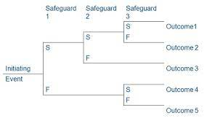
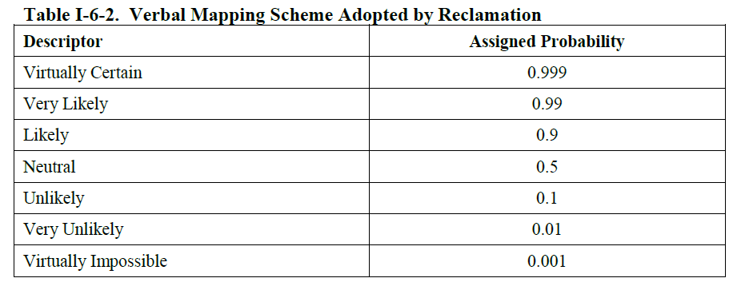
Tools to Assist in Managing Biases
Technology – Blind Elicitation Applications like Socrative
Verbal Mapping of Subjective Probabilities – between descriptors and assigned probabilities
Relative Frequency – the objective observed frequency of events
Decomposing Failure Modes – as a means to understand where uncertainty dominates
Presenting Key Evidence – weighing evidence of “more likely” and “less Likely” factors for probabilities

Slide 6


Overconfidence Bias
The Tendency for People to be More Confident than the Evidence Warrants
The Most Common Bias
More Expertise and Knowledge means?
Ways to Combat Overconfidence Bias:
  Exercises which estimators to known and unknown events
  Self-Correlate
  Listen First
Who is More Likely to Be Over-Confident?

Slide 7
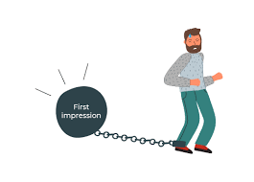
Anchoring Bias
This is the tendency for estimates to not vary much from values that are initially presented to the group, either from base-frequency information or other sources.
Often relates to a single piece of information.
Frequency should be appropriate to the problem being estimated.
Ways to Combat:
  Discuss Extreme Values Before settling on a “best estimate”.

Slide 8
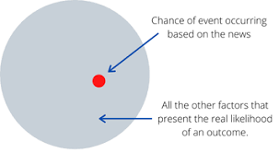
Availability Bias
Results from over-emphasizing the most recent, most easily recalled, or most vivid evidence.
Often comes from most recent discussion such as a case history or failure.
Ways to Combat:
  Examine Relevance of evidence to the problem being evaluated.

Slide 9
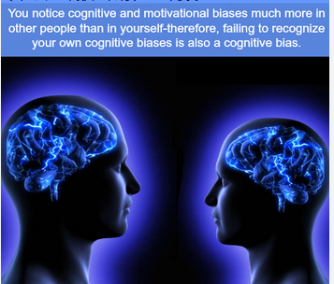
Motivational Bias
Results when one or more of the members making estimates have a vested interest in the outcome.
Could be the result of the dam designer being in the room, or the owner, or an engineering firm that needs work.
Ways to Combat:
  Monitor who is in the room and who participates in estimation of risks
  Bring out opposing views.

Slide 10

Representativeness Bias
Results from overemphasizing similarities and neglecting other information.
The probability of B, given A is not equal to the probability of A, given B.
Ways to Combat: challenge the correlation of events.

Slide 11


Questions?

