Slide 1

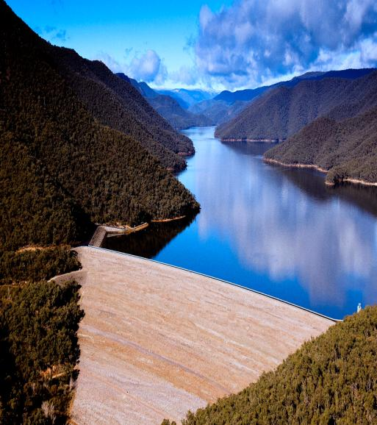



DAM REHABILITATION AND IMPROVEMENT PROJECT II & III
Consequences of Delay in Procurement Process & poor contract management
(10-04-2024)
Santosh K Singh
9899866627, santoshkumar.singh@smec.com

Slide 2


Procurement Process
Procurement process starts with creation and approval of the procurement package for the item to be procured.
At the time of creation of pp IA enters planned date of bid floating.
Other dates are calculated automatically by STEP/MIS depending upon the nature of the procurement.
Normally procurement process for goods/works/ncs should be completed within 4 months (NCB) and for consultancy with eoi within 6 months.
But it is observed that procurement processes are being delayed by more than a year.
This will hamper the progress of the project.
Dam Rehabilitation And Improvement Project II & III

Slide 3
SPECIFIC CONCERNS
Delays in bid evaluation and award of contracts
Some agencies are asking for only online transfer of Bid Security. The WB allows BG and DD as standard form of Bid Security.
Bid Security deposited as Bank Draft should be deposited in the project account
Delays in signing of contracts after obtaining no objection from the Bank
Inadequate engineering (in Works) leading to wide variations at the time of implementation and consequent disputes
Delay in handing over the site/land acquisition
Weak monitoring of construction program & Sub-contracting
Weak contract administration; Need for enforcing specifications
Delays in resolving issues during implementation
Failure to keep Performance Security valid till contract completion
Dam Rehabilitation And Improvement Project II & III

Slide 4
Delay in Floating of bid document
  Delay in floating the bid document will ultimately delay the completion of the procurement process/contract at least by that time.
  In case of substantial delay market rate will increase considerably than the estimated rates, Resulting in higher cost and sometimes cancellation of the bidding process due to higher rates.
  If estimate is prepared one or two year back the same cannot be compared with the current market rates at the time of financial evaluation.
  Ideally all estimates are required to be updated but states have their own process with the result that ultimately bids get cancelled due to higher rates.
Dam Rehabilitation And Improvement Project II & III

Slide 5
Delay in issue of Minutes of pre-bid meeting and amendments
  Normally around 10 days’ time is given between issue of MoM/amendments and last date of bid submission. If MoM/amends are not issued before that IA will have to extend the last date of submission which will ultimately delay the completion of the procurement process/contract.
  It is being observed that IAs are extending bid submission dates several times. Sometimes extensions go up to 90 days. This will ultimately delay the whole process.
Dam Rehabilitation And Improvement Project II & III

Slide 6
Unreasonable time taken in Technical bid evaluation
It delays whole procurement process.
As per ITB IA must request for extension of bid validity as well as extension of validity of bid security from all the bidders. In case they forget to ask for the same and select L1 and issue LoA. The selected bidder may decline to accept it, as his bid validity has expired, and rebidding will be the only alternative.
In case some bidders don’t agree to extend it they will be out of race. This will narrow down the competition which may result in awarding the work at higher rates or rejecting the bid due to higher rates.
As per ITB, If the award is delayed by a period exceeding fifty-six (56) days beyond the expiry of the initial Bid validity period, the Contract price shall be determined by adding interest @3-5% per annum.
Dam Rehabilitation And Improvement Project II & III

Slide 7
Financial Opening and Evaluation
  It has been observed that some IAs are taking more than 60 days for issuance of LoA after approval of technical evaluation report whereas It should not take more than 15 days.
  Bid validity period is counted till issuance of LoA and if the same is not issued within that period L1 may refuse to accept the offer.
Dam Rehabilitation And Improvement Project II & III

Slide 8
Signing of contracts
  As per the procedure within twenty-one (21) days of receipt of LoA, the successful Bidder shall furnish performance security and sign the contract.
  If successful bidder fails to (i) sign the Contract in accordance with ITB Clause; or (ii) furnish a Performance Security in accordance with ITB Clause, bid Security may be forfeited. Failure of the successful Bidder to submit the above-mentioned Performance Security or sign the Contract shall constitute sufficient grounds for the annulment of the award and forfeiture of the Bid Security.
  In that event the Purchaser may award the Contract to the next lowest evaluated Bidder, whose bid is substantially responsive and is determined by the Purchaser to be qualified to perform the Contract satisfactorily.
  In case there is only one bidder or competent authorities of the IA do not allow to award the work to L2, whole process has to cancelled and IA has to invite tenders again.
  This will delay the procurement process by more than 5 months.
Dam Rehabilitation And Improvement Project II & III

Slide 9
Running bills - Works
Payment Certificate:
The Contractor shall submit monthly bills along with details of measurement of the quantity of works executed in a tabular form.
The Project Manager shall check the details given in the Contractor’s monthly statement and within 14 days and certify the amounts to be paid to the Contractor.
Payments: Payments shall be adjusted for deductions for advance payments, retention, other recoveries. The Employer shall pay the Contractor the amounts certified by the Project Manager within 28 days of the date of each certificate. If the Employer makes a late payment, the Contractor shall be paid interest on the late payment in the next payment. Interest shall be calculated from the date by which the payment should have been made upto the date when the late payment is made at the rate stated in the PCC.
Dam Rehabilitation And Improvement Project II & III

Slide 10
misprocurement
At any time, the Bank: (i) determines that the procurement of any contract to be financed out of the proceeds of the Loan is inconsistent with the procedures set forth or referred to in the Legal Agreements;
If the Bank determines that the Borrower has not complied with the procurement requirements set out in the Legal Agreement, the Bank may, in addition to exercising the legal remedies set out in the Legal Agreement, take other appropriate actions, including declaring misprocurement.
Even once the contract is awarded after obtaining a no objection from the Bank, the Bank may still take appropriate actions and exercise legal remedies, regardless of whether the project has closed or not, if it concludes that the no objection or the notice of satisfactory resolution was issued on the basis of incomplete, inaccurate, or misleading information furnished by the Borrower or the terms and conditions of the contract had been substantially modified without the Bank’s no objection.
Dam Rehabilitation And Improvement Project II & III

Slide 11
Disallowed Expenditure
As per the Financial Manual of the Bank applicable to DRIP following types of expenditures are disallowed:
Any interest during construction;
expenditures not in line with the Project description in this Agreement;
procurement not in line with agreed procurement procedures;
expenses disallowed by auditors and not resolved adequately, and expenses found ineligible during Bank review;
Government staff who are in supervisory roles or who work part time / full time in DRIP II and III, cannot charge their salaries to this project.
Penalties / Liquidated damages / amount withheld for poor workmanship has to be adjusted against the expenditure and claims;
Payments related to Land
Dam Rehabilitation And Improvement Project II & III

Slide 12
Disallowed Expenditure
Items of expenditure not related to the Project components as defined by the legal agreements.
Payments made or due for goods, works and services provided after the closing date.
Late payment penalties that were incurred in connection with a disputed payment which was under arbitration.
Advance payments other than secured mobilization
retention money/security deposit retained (till the time it is not released);
Dam Rehabilitation And Improvement Project II & III

Slide 13

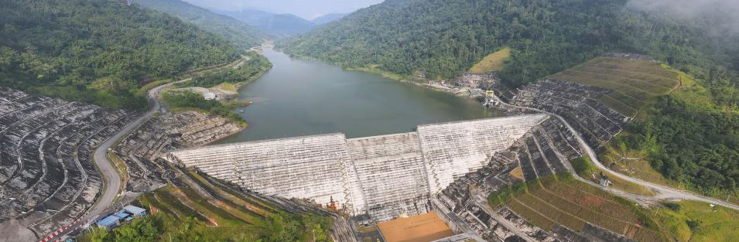
THANK
YOU
Dam Rehabilitation And Improvement Project II & III
0x

