Slide 1
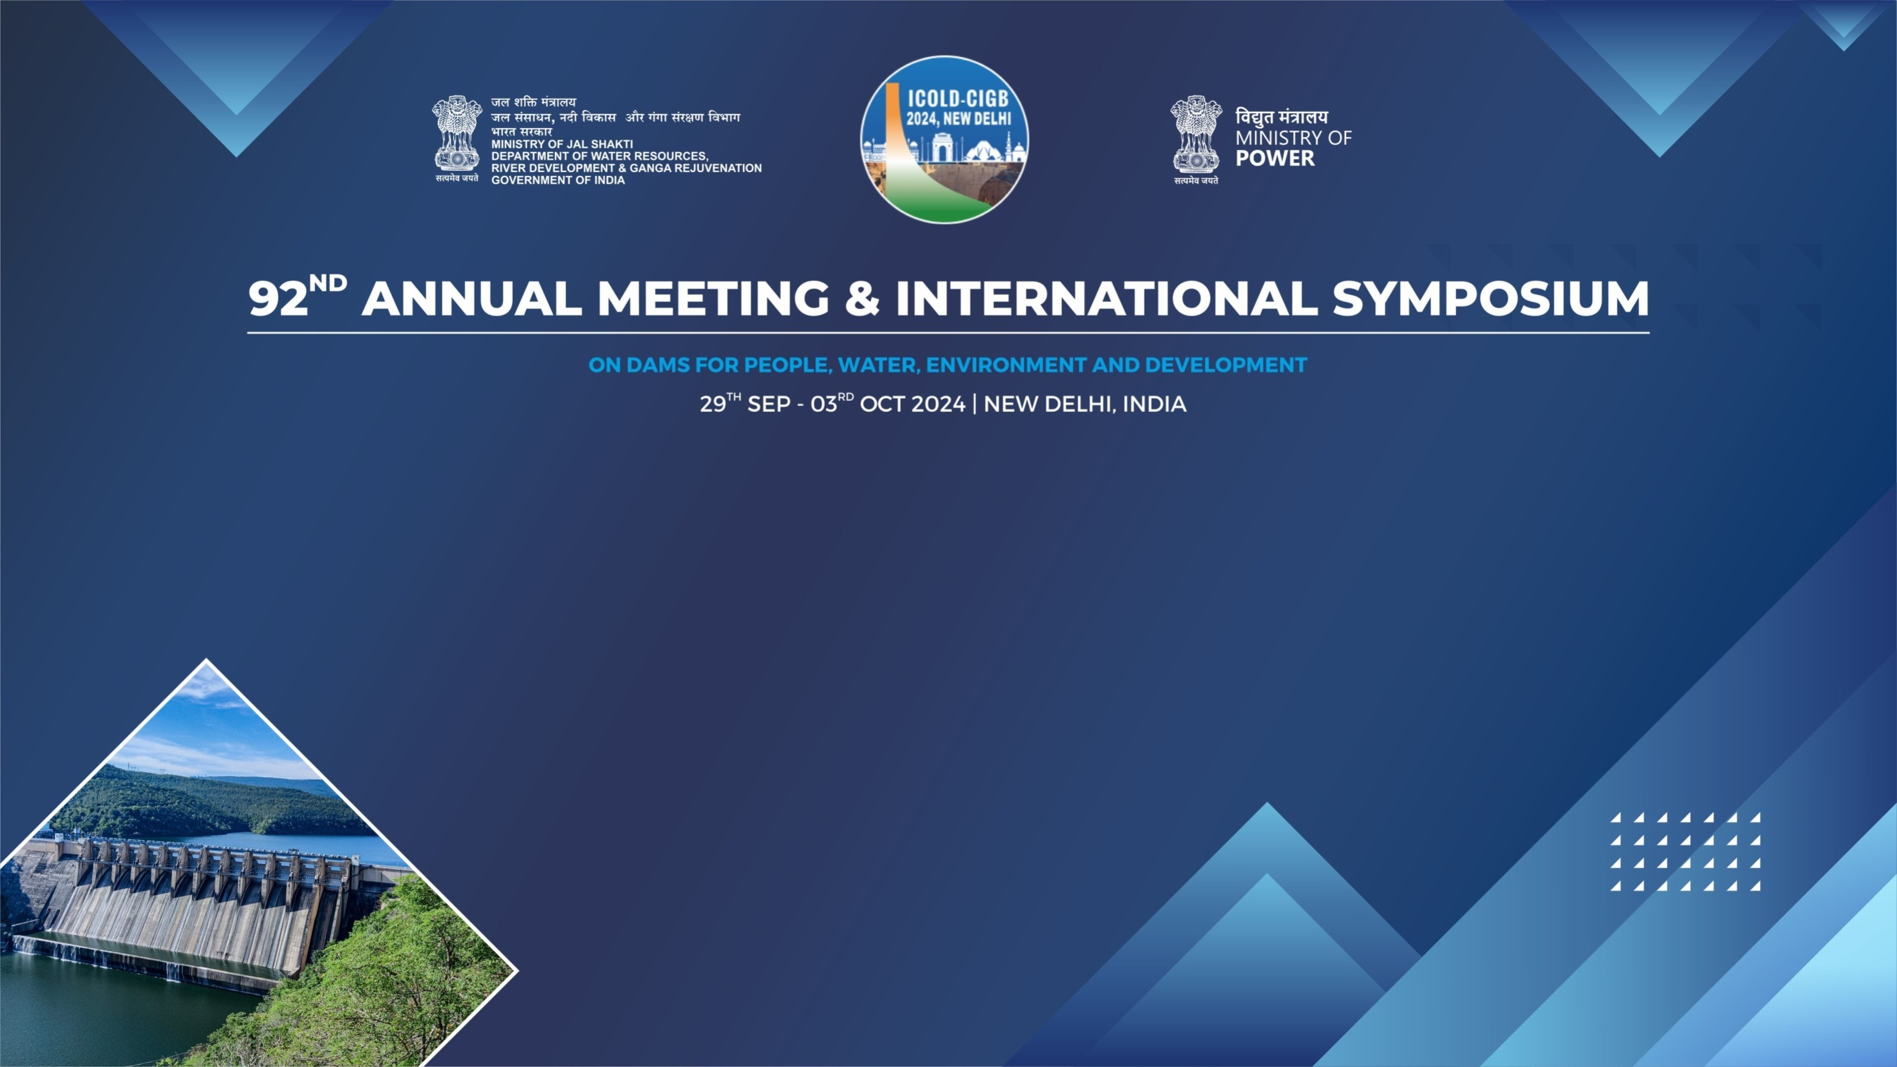
Experience of TANGEDCO in Geomembrane lining works in Servalar dam
Tmty.M.RANI,EE/CIVIL, TANGEDCO, Tamil Nadu, INDIA

Slide 2
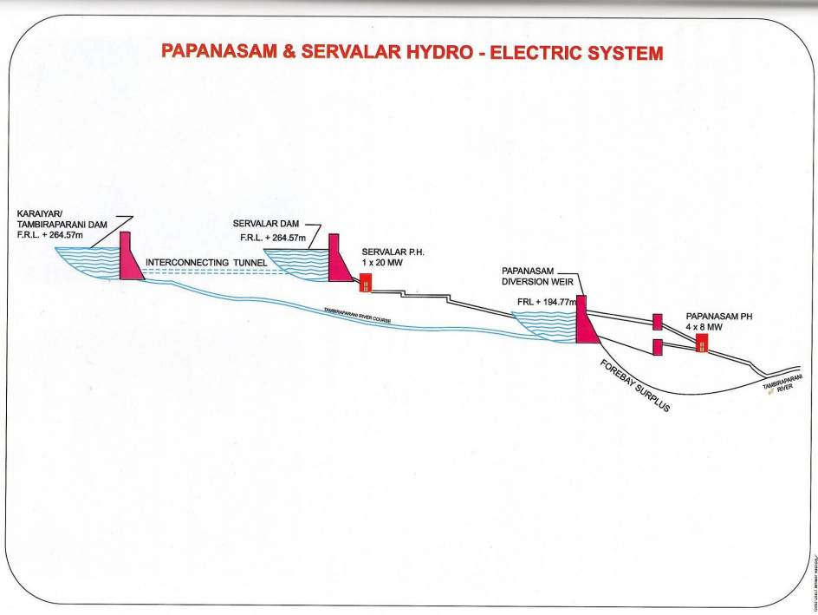
Servalar dam layout

Slide 3
Salient Features Of Servalar Dam
Type of dam Stone Masonry
Height of dam 57.10 m
Year of construction 1978 – 1986
Length of Masonry dam 465 m
Reservoir Capacity 1292 Mcft
Catchment area 106.10 Sq.km
Water spread area 1.51 Sq.km
Full Reservoir Level 264.57 m

Slide 4
Purpose of Servalar dam
Power generation of 20MW capacity
Drinking water needs of Tamil Nadu Water supply and Drainage Board (TWAD)
Irrigation needs of Public works Department of Tamil Nadu.

Slide 5
Need for geomembrane in Servalar Dam
Left flank upstream face masonry joints were found to be weak. Raking & packing, guniting done earlier did not control seepage. Max. seepage was 743 LPM @263m
Choked Vertical Shafts and Foundation drains resulting in saturation of dam body and leakage observed on the downstream side of the dam.

Slide 6
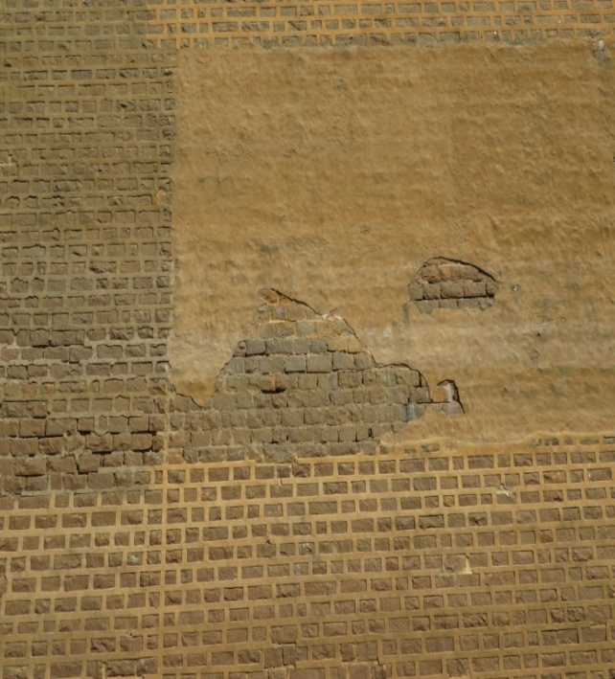
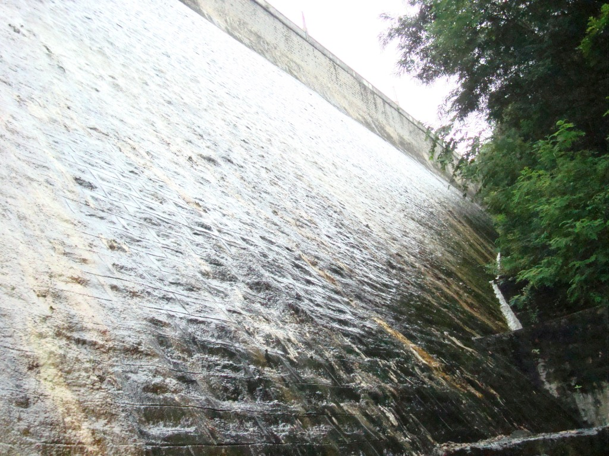
weak joints (u/s) and leakages in (d/s)

Slide 7
Factors influencing DRIP works
External Factors
  Changing weather pattern (extended monsoon)
  Rain causing heavy inflow
  Wind above 45 KmPh
  Public interference
Internal Factors
  Getting clearances/ concurrence from various Departments (Forest Dept., LC from TANGEDCO, District Administration, TNPWD, TWARD Board)
  Contractor’s cooperation

Slide 8
Initial Schedule of Work
Silt Removal (4500 Cum) - 2 Months
Cavity Filling,
Racking,Packing Re-pointing (3000 Sqm) - 3 Months
Geomembrane Works (10200 Sqm) - 4 months
Overall From January 2017 to October 2017
Due to so many challenges, the works were carried out in Two Phases ( Phase I and Phase II ).

Slide 9
PHASE I CHALLENGES
Delay in Depletion of Dam
Acute water shortage in the district resulted in delay in depletion of the reservoir for beginning of work (especially desilting) .
Finally the approval was accorded in the first week of April 2017 to open up the sluice gates for depletion.
(a promising 3 months time lost)

Slide 10
CHALLENGE CONTINUES
Continuous Inflow
Carpi mobilized the civil crew in Feb 2017 even before the dam was depleted. But desilting could not proceed as planned as continuous inflow into the reservoir hampered desilting process.
The bund constructed to prevent inflow of water, got breached twice as there were many sudden inflows which breached the bunds and resulted in more accumulation of silt.

Slide 11
Challenges in Desilting
The scope of Desilting is to remove deposited silt near the upstream face of the dam till the bottom most portion of the dam (Foundation or Rock Line)
Desilting on the Left flank was carried out from Feb ‘17
In some stretches, desilting to depth of more than 12 meter was done to reach the rock line

Slide 12
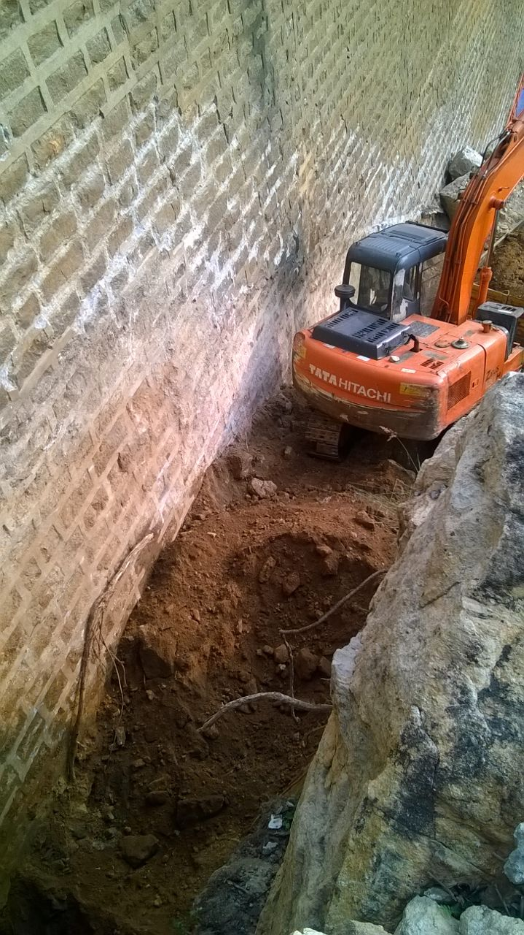
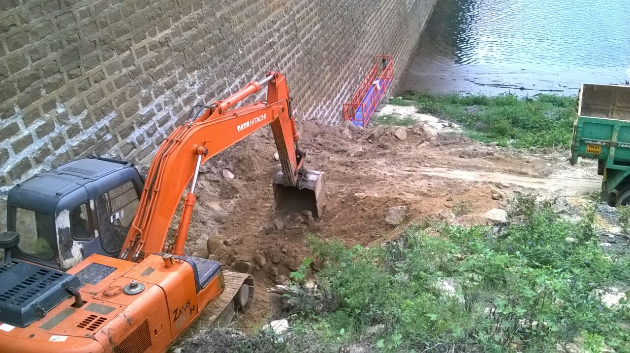
Pictures showing desilting

Slide 13
Challenge Continues
Erratic Behavior of South West Monsoon
Monsoon arrived in the first week of June and due to heavy inflow breached the bund and accumulated near the scourvent gate, thereby raising the water level and making it really difficult for the excavators to scroll.
Intermittent rains in the entire month resulted in a heavy rain in the last week of June and it was decided to close the gates to save water.
This resulted in yet another huge desilting effort. The public agitation was cited as a reason for the district administration to give the gate closure order.

Slide 14
Challenge Continues
Wind (As high as 50 Kmph was a regular phenomenon in Servalar)
Rain (Intermittent Rains every 4-5 Days)
Dust Storm (Especially in April and May months)

Slide 15
Challenge Continues
First Phase – Delay in Depletion and Monsoon
Heavy rains hampered the desilting works and it was decided to suspend the desilting work.
The geomembrane crew began lining the upstream face from the left flank. The work could proceed only for 10 days and again heavy rains and heavy winds disturbed the momentum of geomembrane works. In 10 Days, around 770 Sqm of geomembrane was installed.
It was decided to restart the work in the next season from Jan 2018 before the onset of the monsoon in June 2018

Slide 16
Phase II - Challenges
Meticulous planning by the DRIP authorities /Generation Wing of TANGEDCO and the State Government, permission was accorded to deplete the dam in the end of January 2018 for restarting the work.
In Feb 2018, the desilting and preparatory civil works were carried out on a war footing basis with huge work force at site.
The weather again continued to trouble. In March, there was again a heavy rainfall, making us even more determined to brave the weather and continued the desilting works.The Geomembrane Crew began the installation works.

Slide 17
Phase II Challenges in Silt Removal
On an average every 3-4 days there was a small rain making it slushy for movement of excavators
A strong and desilting team consisting of 2 and occassionaly 3 large excavators combined with 6 trucks / 10 tractors were involved in the movement of excavated silt to the designated areas. The silt was so slushy that we had to face situations of the excavator and trucks getting stuck in the slushy soil.
Depth of Silt Removal more than expected. In some places the silt removal was more than 10 meter which challenged the excavators.

Slide 18
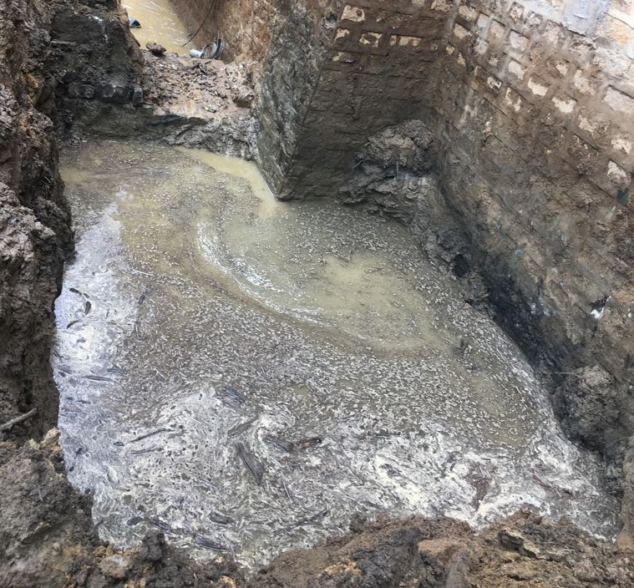
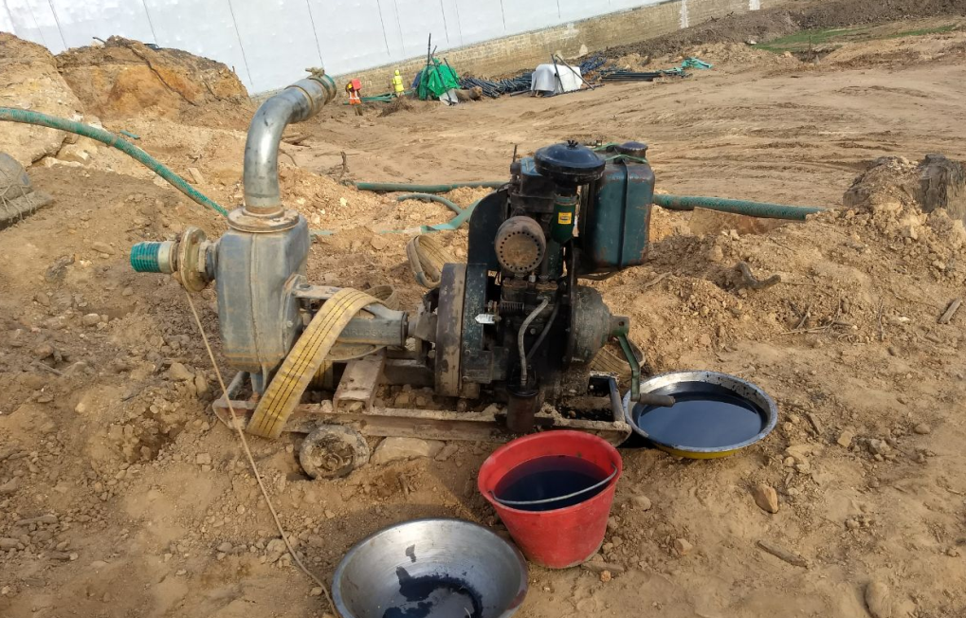
Challenges in Silt Removal
In regions where we had to go below the bed level, there was continuous water oozing which made it mandatory for continuous dewatering mechanism. Heavy dewatering pumps (close to 40 HP were used at various locations in the spillway zone)

Slide 19
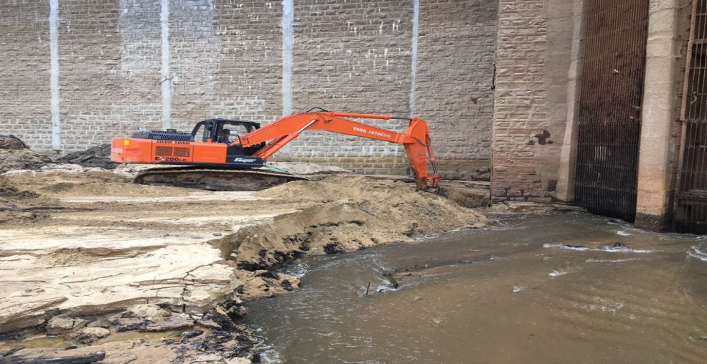
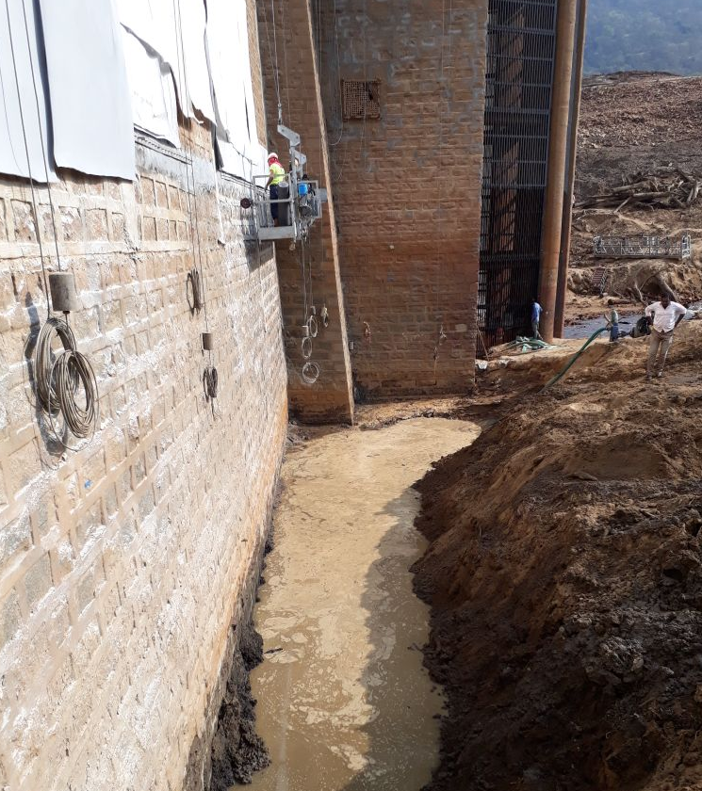
  Silt Removal near Sluice Gates
The biggest challenge is the silt removal near the Sluice Gates. Thamiraparani stream being a perennial river had a 365X 24X7 inflow of 40-50 cusec , making it a challenging task to remove silts near the gate region. Meticulous planning and small bunds were formed around the gates to complete the job in this critical regions.

Slide 20
Geomembrane Works
Levelling Mortar for Top and Bottom Seals
Marking Vertical Tensioning Profiles
At every 5.7 meter spacing vertical lines were marked from Top till bottom for fixing of the Tensioning Profile. This tensioning profile is the major fixation element that holds the geomembrane intact and prevent from getting removed due to wind and other external forces
Top Seal Preparation ,Bottom Perimeter Seal, Laying of Geo Textile, Laying Geo Composite, Welding, Fixing cover strips, Providing drainage holes, etc.,

Slide 21
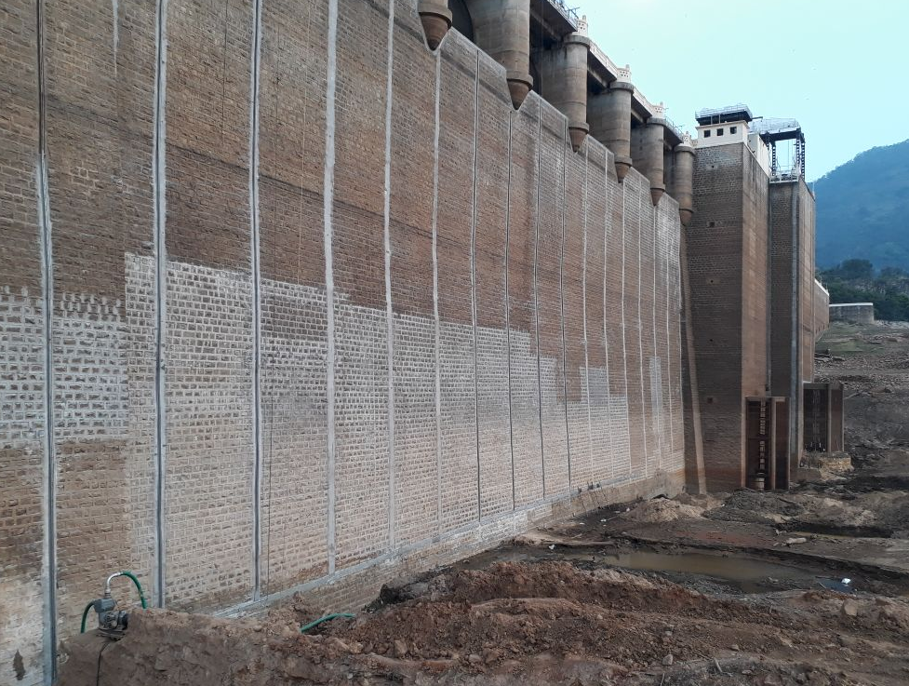
Picture of verticl strips

Slide 22
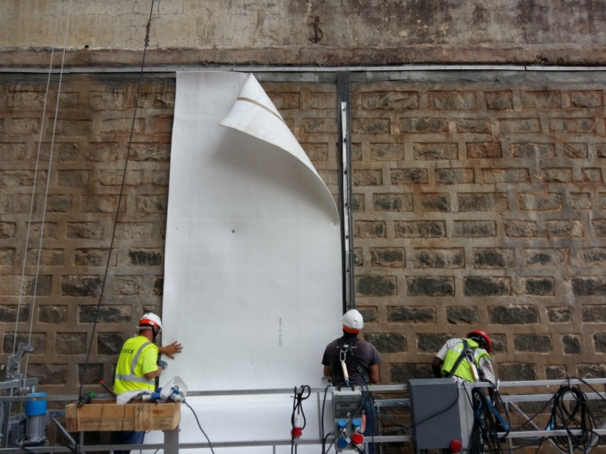
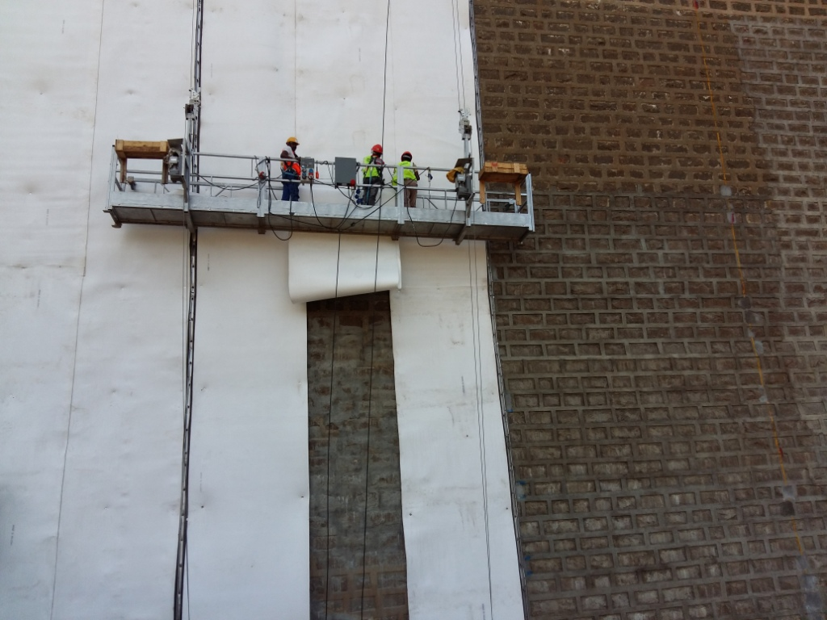
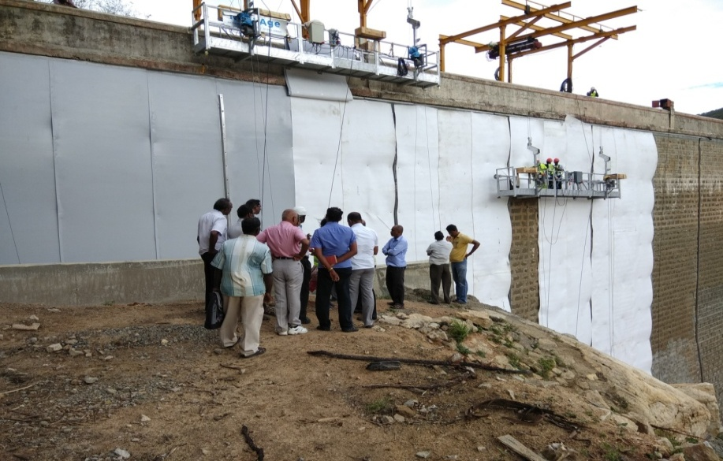
Fixing of Geotextile

Slide 23
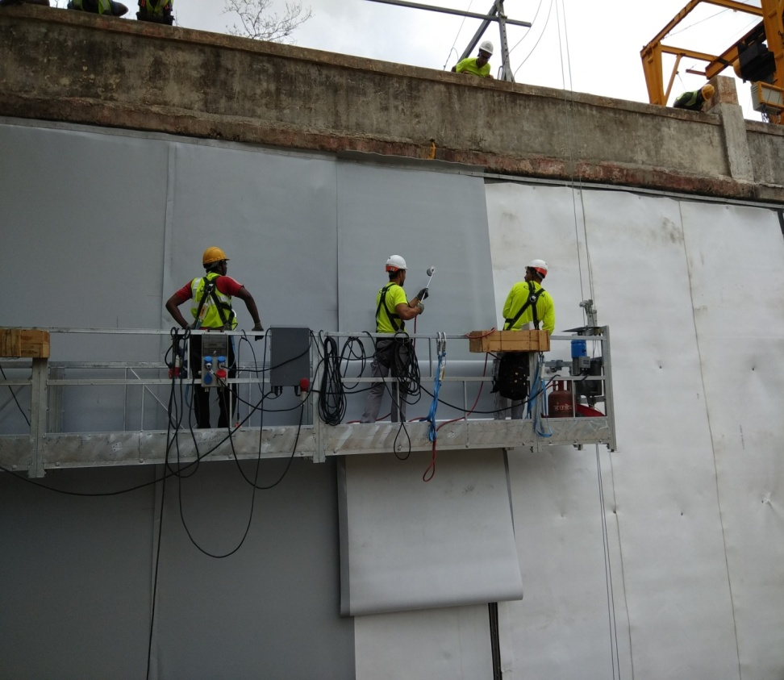
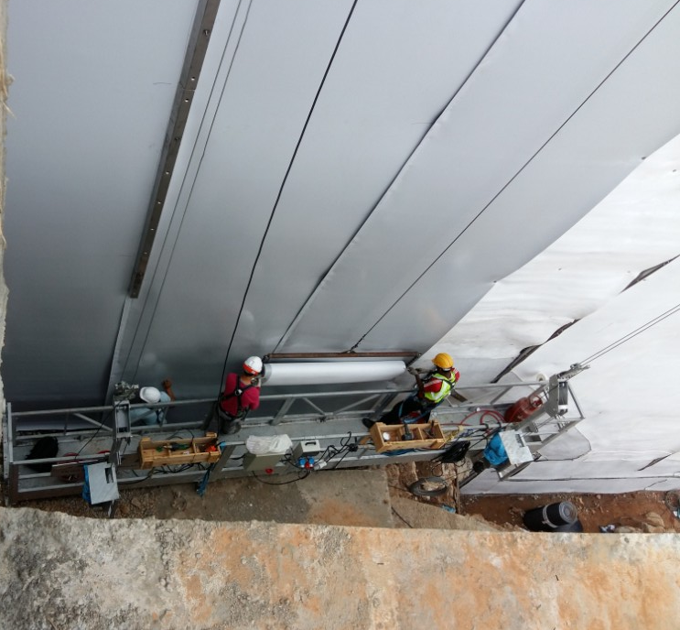
Geocomposite Welding

Slide 24
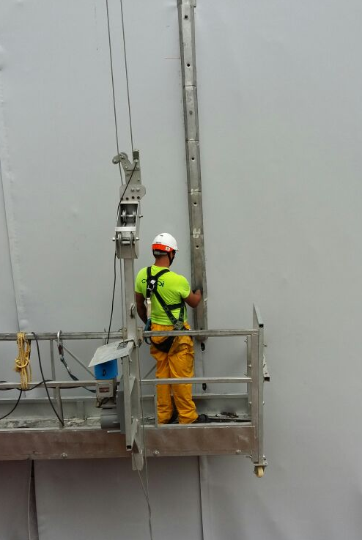
Fixing of Upper Tensioning Profiles
The Upper Tensioning profile is fixed over the lower tensioning profile and adequate torque is provided to tighten.
The tightening of the screw is done to ensure there are no formation of any slacks or wrinkles

Slide 25
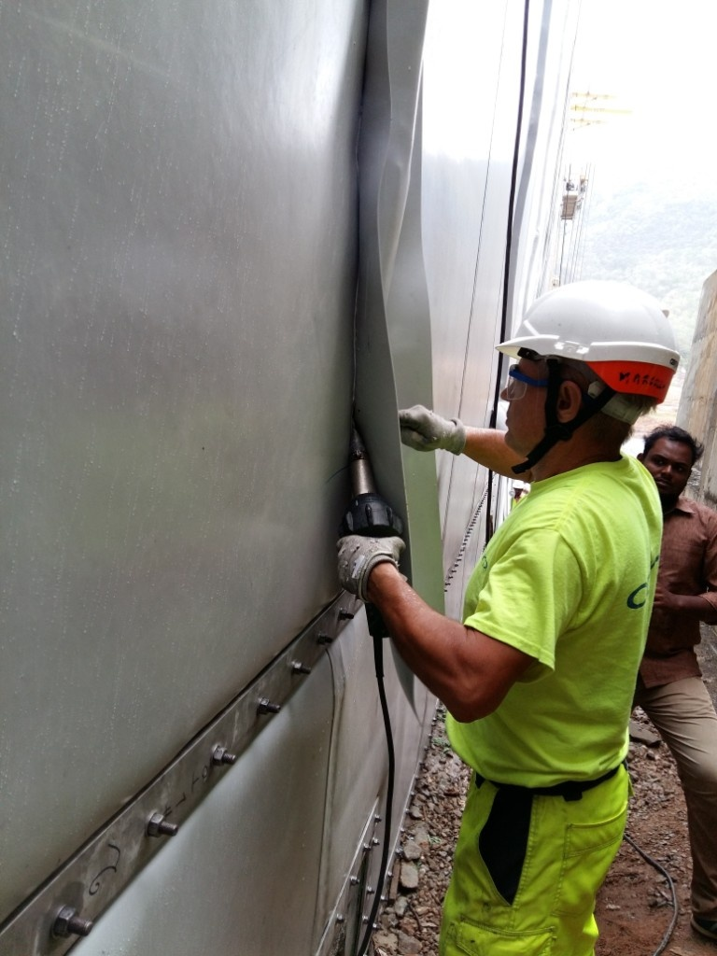
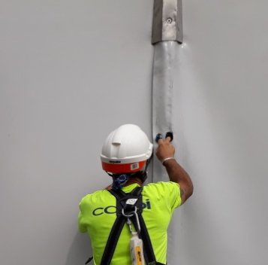
Fixation of Cover Strips
The Upper Tensioning Profile is further covered with PVC Geomembrane Cover strip.

Slide 26
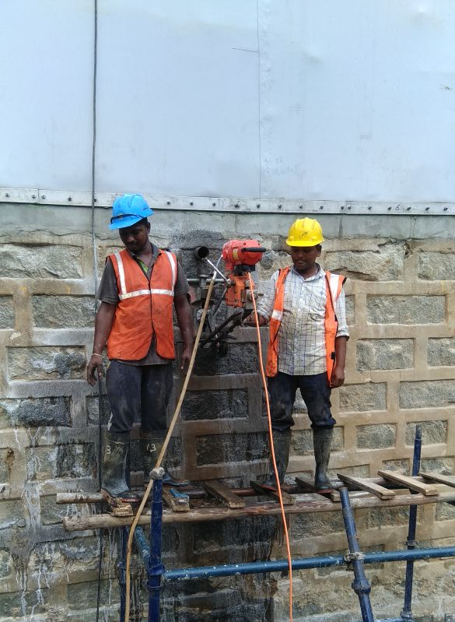
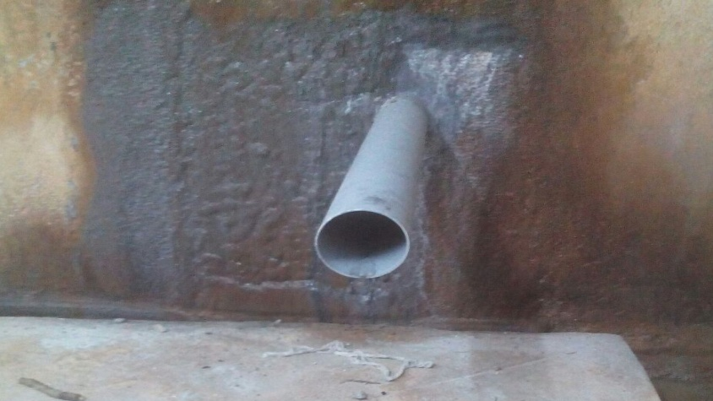
Drainage Holes
6 No of Drainage holes were drilled from the upstream face of the dam upto the gallery. The drain holes consists of PVC pipe grouted around the pipes. The drain holes convey the water collected behind the membrane and discharge it into the gallery

Slide 27
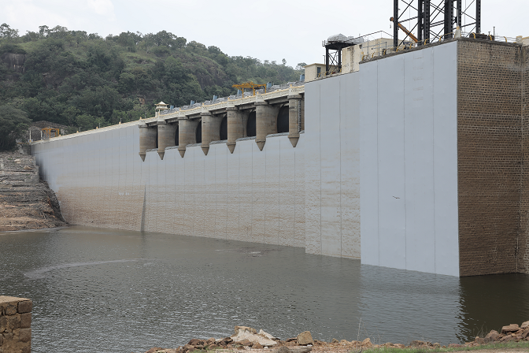
Final Phase of Installation

Slide 28
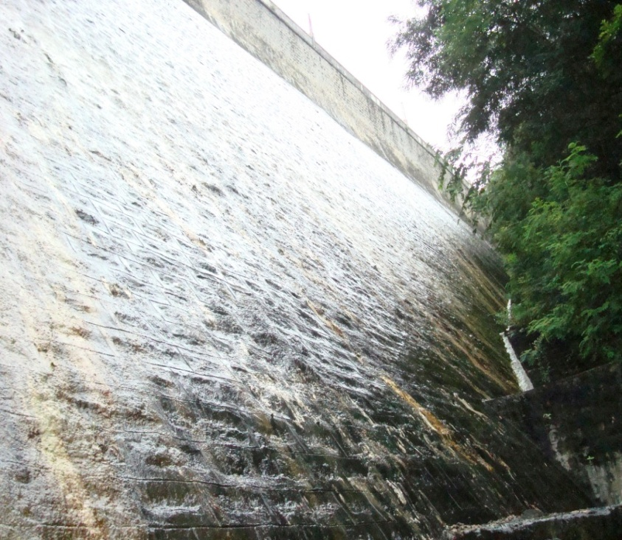
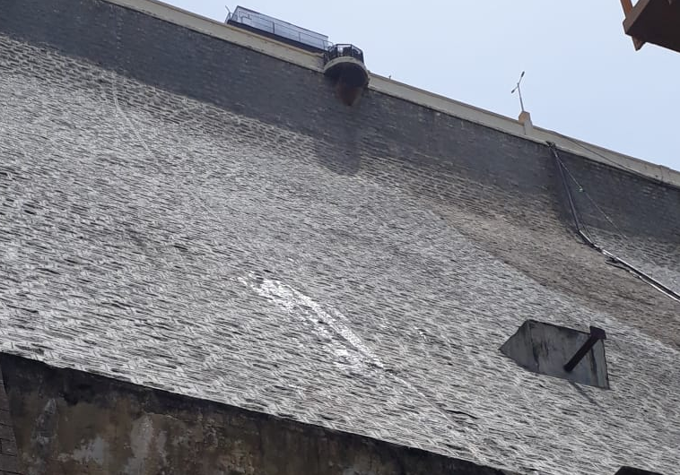
Results of Geomembrane Waterproofing System
Before Geomembrane Installation – In 2014
After Geomembrane Installation – In Aug 2018

Slide 29
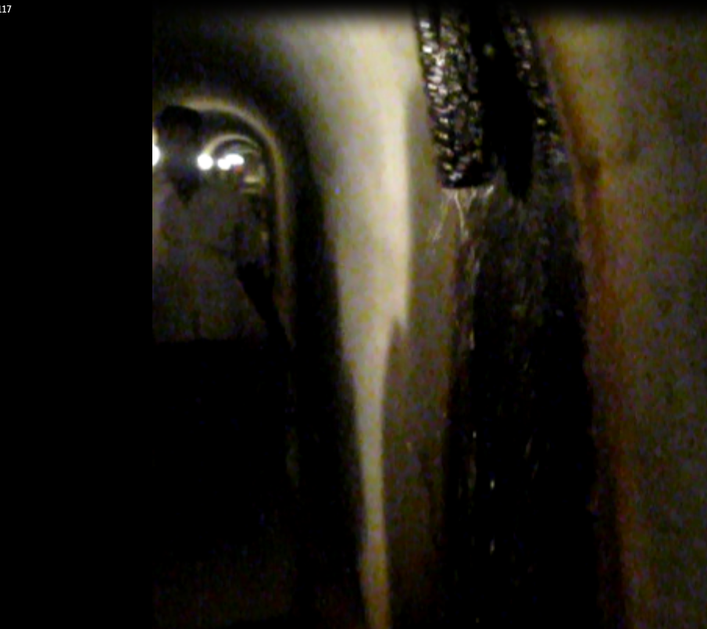
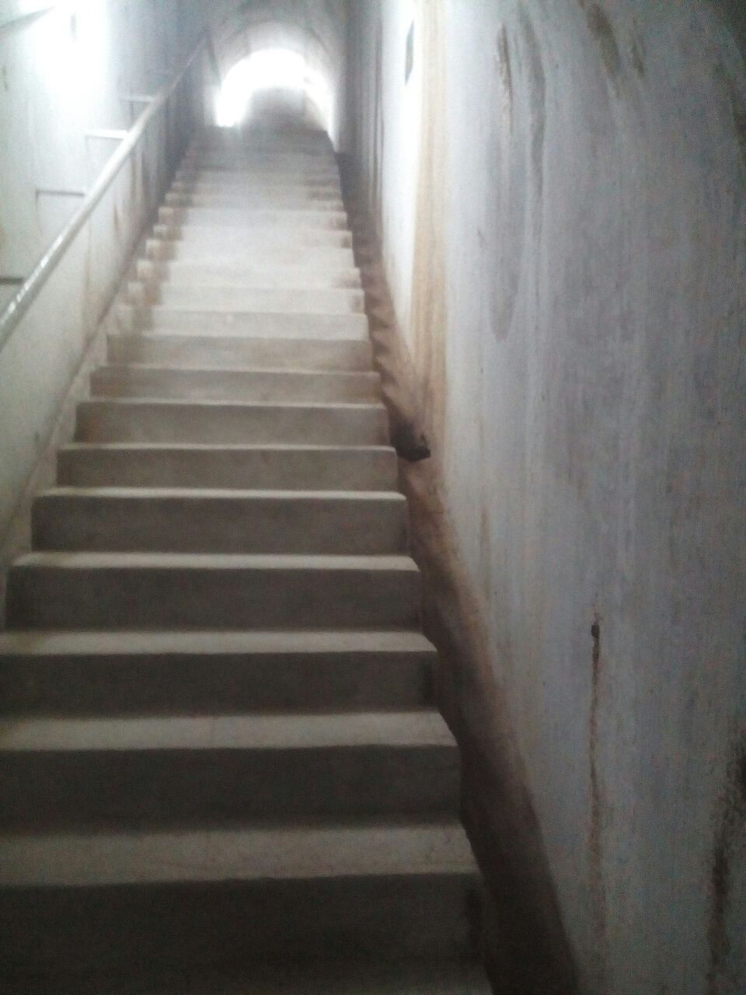
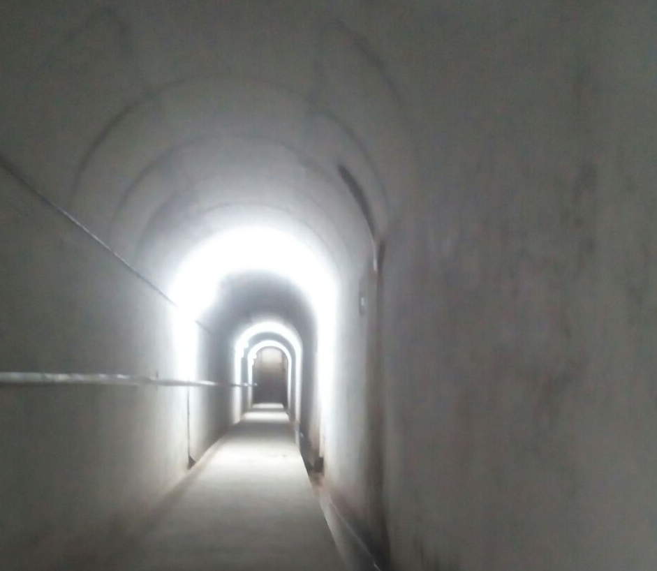
Gallery View

Slide 30
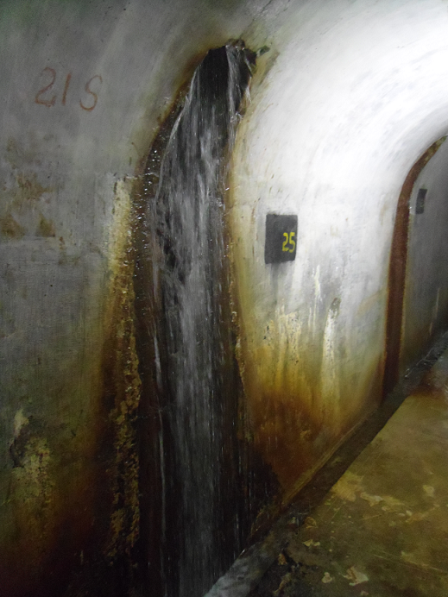
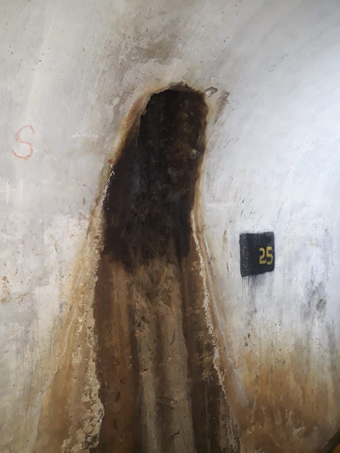
Dry Drain Shaft No. 25
Before Geomembrane 2014
After Geomembrane 2018

Slide 31
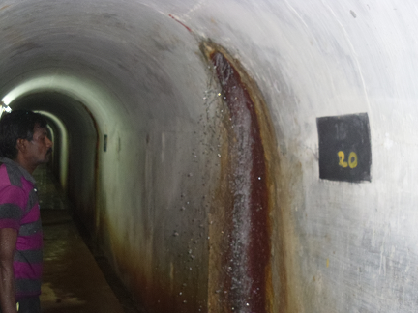
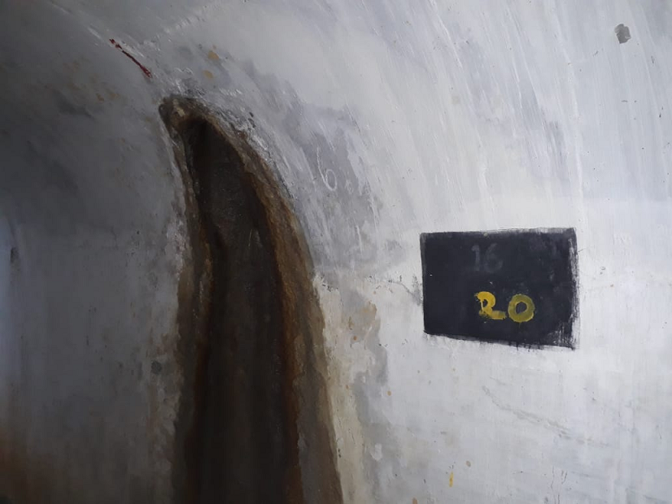
Dry Drain Shaft No. 20
Before Geomembrane 2014
After Geomembrane 2018

Slide 32
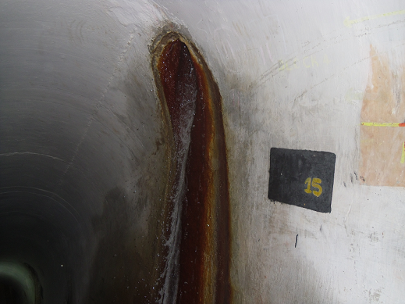
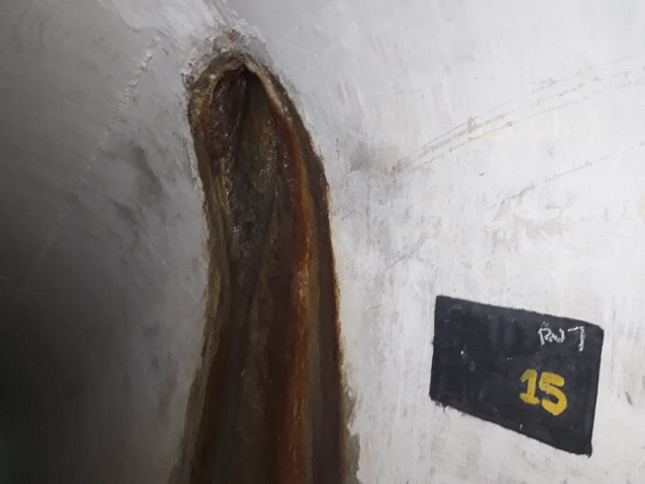
Dry Drain Shaft No. 15
Before Geomembrane 2014
After Geomembrane 2018

Slide 33
Leakage Results

Slide 34

THANK YOU

