Slide 1
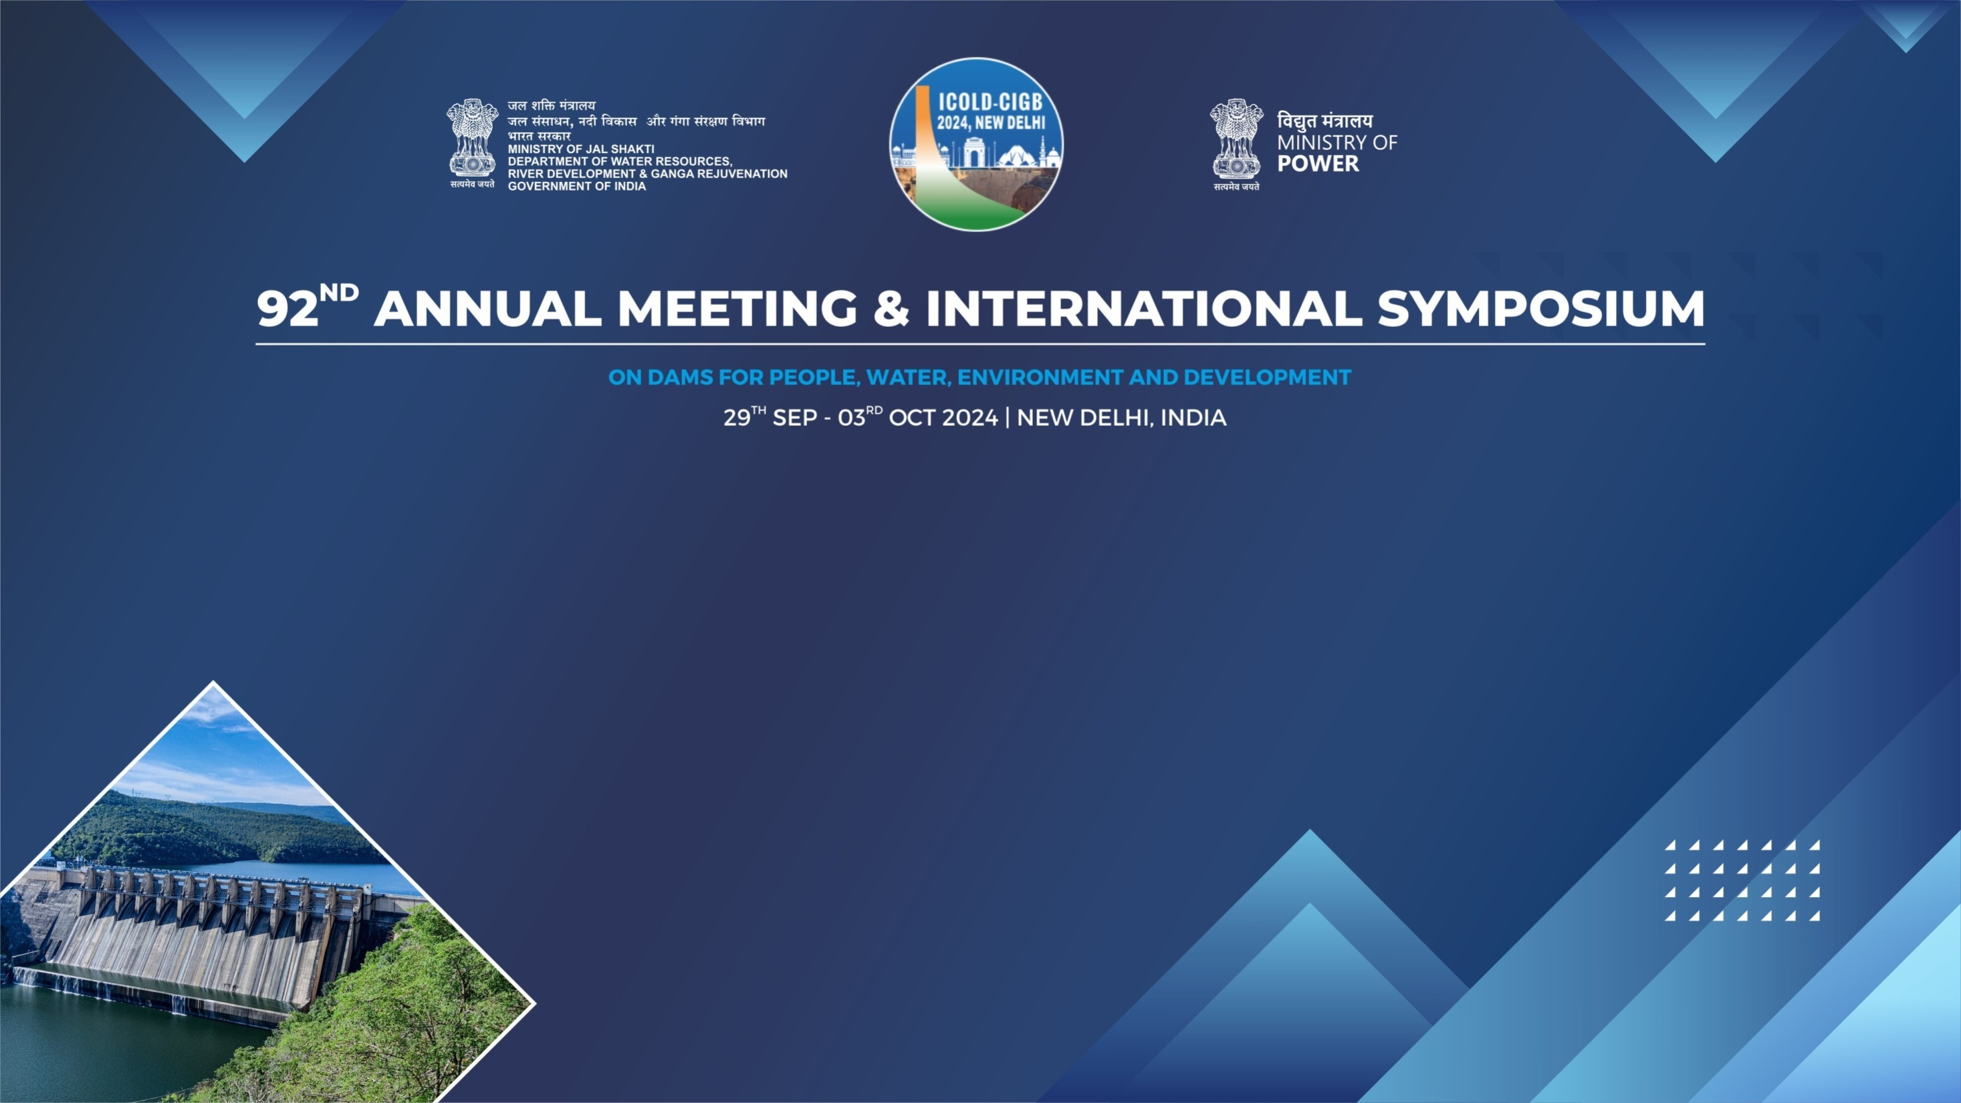
Eco – Friendly panacea for the removal of the Rock outcrop obstruction in the upstream portion of the Sathanur Dam.
Er.E.Arivazhagan, Executive Engineer, TN WRD, India,
Er.N.Santhosh, Assistant Engineer, TNWRD, India,

Slide 2
Gist of the presentation
Brief about the Sathanur Dam.
Necessity for removal of the Outcrop.
Necessity for Diamond Wire Saw Method.
Procedure adopted for the Removal of Outcrop through Diamond Wire Saw Machine.
Photos depicting the Procedure.
Conclusion.

Slide 3
ABOUT SATHANUR DAM
The second-longest river of state Tamil Nadu, River Pennaiyar, originates on the south-eastern slopes of the Chennakesava Hills in Karnataka State.
The Sathanur Dam was constructed at 1954-57 across the river Pennaiyar in Ponnaiyar R.F. of Thiruvannamalai District in Tamil Nadu.
The dam is of masonry-cum-earth dam. The Total length of the reservoir is 780 m of which masonry dam is 419 m the balance 361 m is of earth dam. Its Overall Length is 1668 m which is including Surplus Arrangements.
The Spillway consists of 9 vents of size 12.20 m x 6.10 m, the maximum discharge capacity of the spillway is 1,15,000 Cusecs.
The Saddle Spillway consist of 11 vents of about 12.20 m x 4.57 m each having discharge capacity of 75,000 Cusecs.
However due to the increased inflow, the Additional Spillway was constructed having 11 Vents of size 12.20m x 4.57 m and having discharge capacity 75,000 Cusecs.

Slide 4
Some features of Sathanur Dam
Sathanur Dam is the Third largest dam in capacity in the State of Tamil Nadu and has a gross storage capacity of 8100 Mcft.
Sathanur Dam is a multipurpose dam. It used for irrigation, hydroelectric power generation, drinking water, and fish culture.
Sathanur Dam is a major tourist place in Tiruvannamalai District, which has one of the largest dam parks in the State of Tamil Nadu.
Sathanur Dam has one of the largest crocodile parks in India.

Slide 5
Removal of Outcrop In-front of Additional Spillway for Free Discharge of Flood
The Additional Spillway was constructed during 1998 – 1999. During the construction, the cofferdam was provided. After the execution of work, the cofferdam was only removed, and the outcrop was not removed on both sides. The rock portion on both sides affects the free flow of water.
In the DSRP recommendation, a linear rock ledge is present across the lead channel of the additional spillway which was acting as a coffer to facilitate the construction of additional spillway is left unexcavated obstructions the flow to additional spillway. Part of the rock ledge is found to be above the FRL Level obstructing 30% of the flow through the channel. In order to facilitate the smooth flow it is suggested to remove the rock ledge and the smoothen the channel.

Slide 6
Necessity of Diamond Wire Saw Method
The outcrop was located in front of the Additional Spillway Structure.
However the use of Explosives will lead to severe structural damage of the dam structure and also would affect the Ecosystem of the Reserve Forest.
Hence as recommended by the DSRP Inspection team of DRIP Phase II, Diamond Wire Saw Method was adopted to remove the outcrop without affecting the dam structure and also Ecology of the Forest

Slide 7
Diamond Wire Sawing
Diamond wire sawing is a cutting method that uses a diamond-infused wire, to cut through materials like hard rock ,concrete, etc.,
Cutting : The wire is fed through guide pulleys and passed around or through the material to be cut. The wire is then pulled continuously until the cut is complete.
Cooling : Water cools the wire during the cutting process and carries away grinding debris.
Diamond wire sawing has many advantages, including:
Through continuous cutting motion, the diamond wire saw can cut the material into the desired shape and size along the predetermined cutting path
Fast cutting: Diamond wire saws can cut at speeds of up to 1.5- 4 m2/h.
Smooth cuts: The cutting surface is smooth and requires less subsequent processing.
Low noise and vibration: The process is relatively quiet and produces little vibration.
Low waste: Diamond wire sawing produces less kerf and wasted materials than conventional solid blades.
Versatile: Diamond wire saws can cut in many different orientations and angles, and can be used in complex environments like narrow spaces.

Slide 8
Removal of Outcrop through Diamond Wire Saw Method.
Important Equipments/ Materials Used:
Total Station
LD4 (Light Weight Drilling Machine of diameter 4 Inches)
Diamond Wire Saw Machine
Expansive Mortar

Slide 9
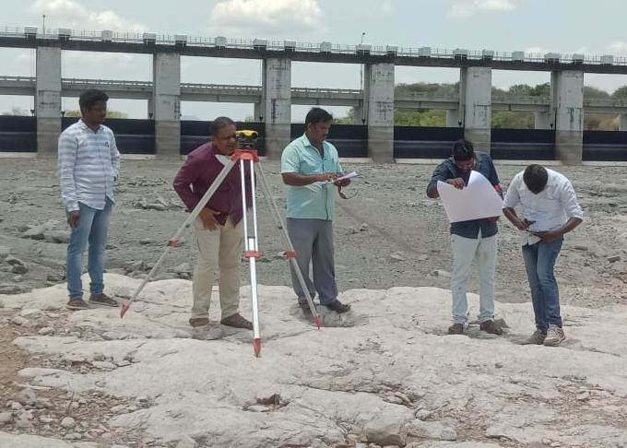
Procedure carried over in removal of outcrop in Additional Spillway of Sathanur Dam:
The outcrop portion was surveyed, and spot levels were taken on both sides.
The outcrop portion was divided into various portions.

Slide 10
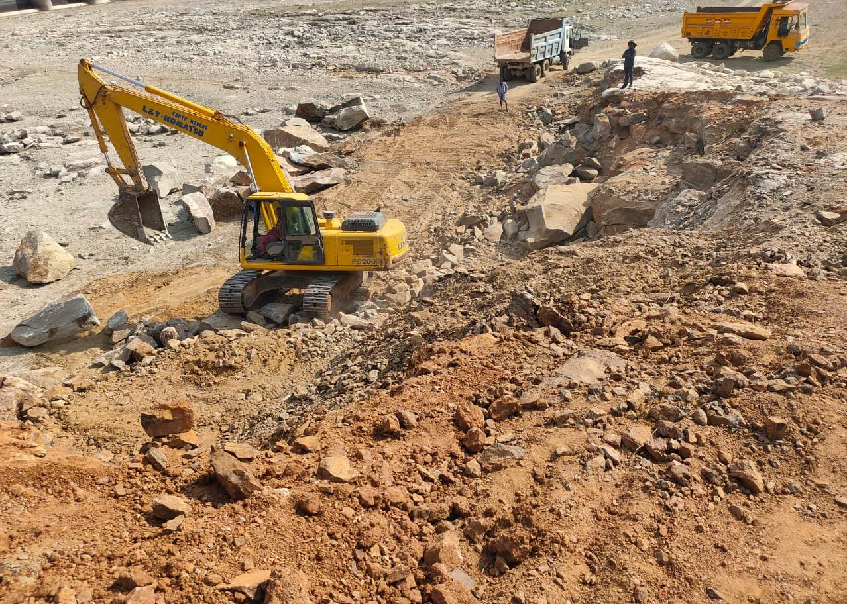
Removal of Loose rocks around the Rock portion

Slide 11
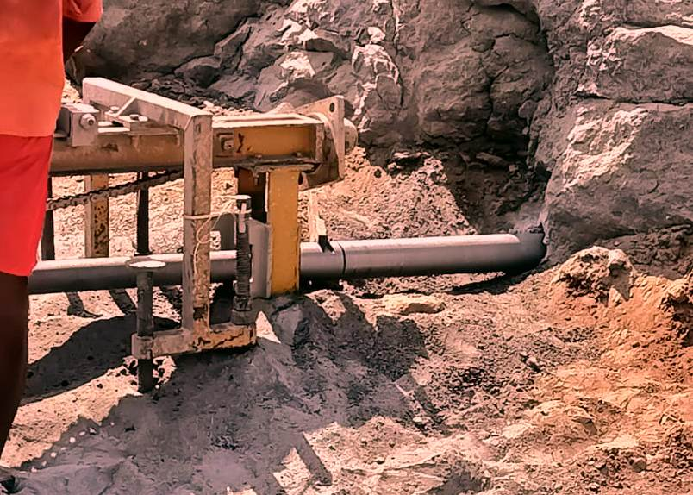
Each portion was drilled with LD4 (Light Weight Drilling Machine of diameter 4 Inches) Drilling machine horizontally and vertically with
L shape to insert the wire saw rope.
The LD4 drilling machine of 100mm Φ hole.

Slide 12
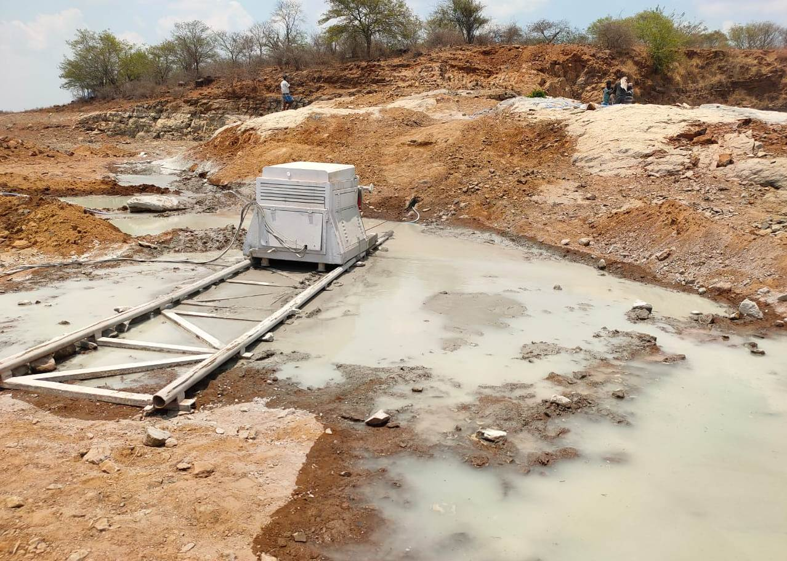
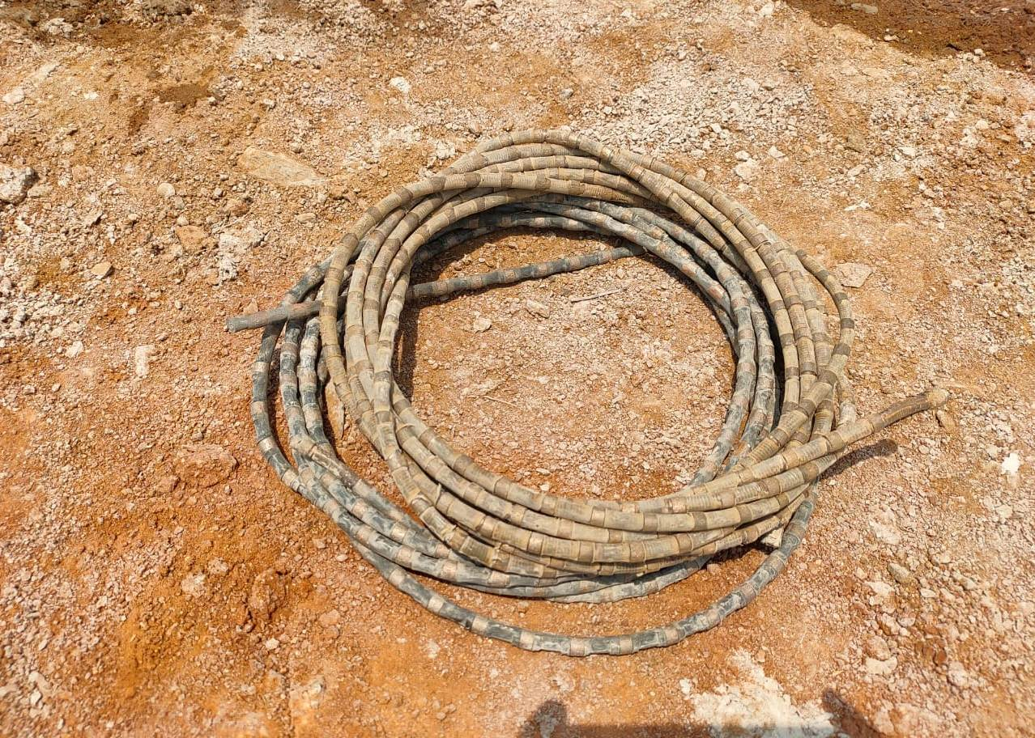
The rock portion was split in to large pieces using wire saw machine.
the Diamond wire have a maximum length of 50 m and 12 mm diameter was used.
The Wire saw machine with trolley of 7m can cut both horizontal and vertical rock portion. The machine having 60 HP motor operating through generator having capacity to cut 4 Sq.m rock portion per hour was utilized.

Slide 13
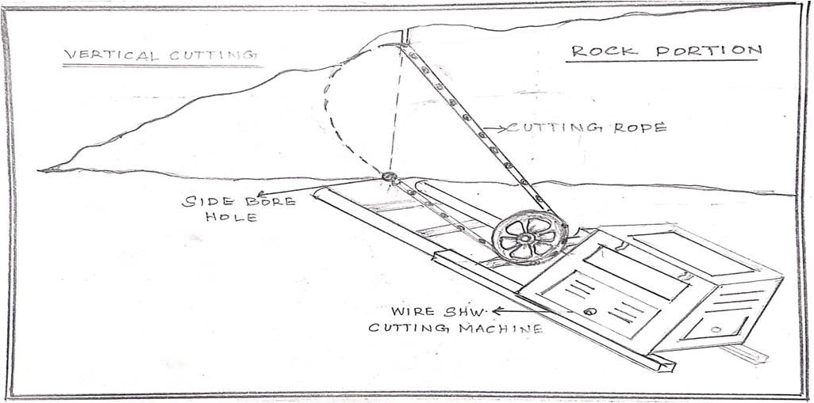
Vertical Diamond wire Cutting

Slide 14
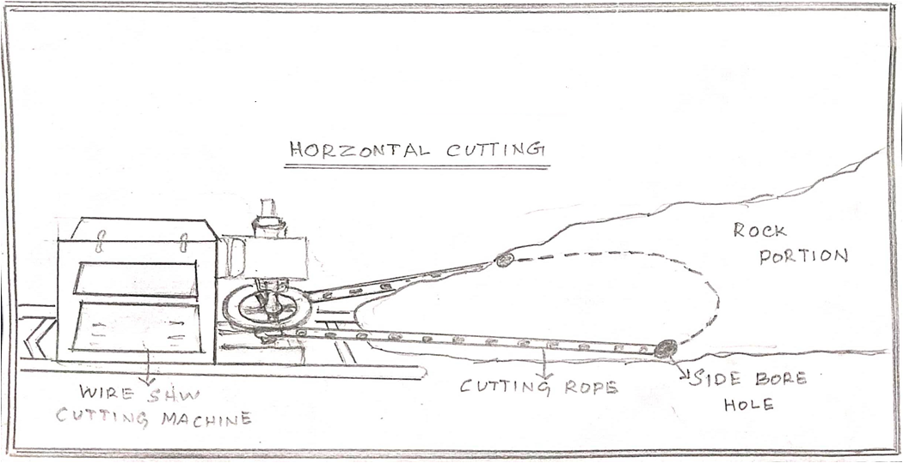
Horizontal Diamond Wire Cutting

Slide 15
Expansive mortar, also known as SCA (Soundless Cracking Agencies), is a non-toxic powder that can be used to crack rock without explosives. Here are some steps for using expansive mortar:
Drill holes
Use an air hammer drill and a drill bit that matches the rock type. Holes should be 38–50 mm in diameter and 70–90% of the way into the rock. Holes should be no more than 20 cm apart.
Mix and pour
Mix the powder with 30% water and pour it into the holes. Fill the holes about 15 mm from the top, and agitate the hole to remove air gaps.
Wait for cracking
The mortar will expand and crack the rock over 4–24 hours.
Remove the cracked material
Use a pick breaker, pneumatic breaker, or excavator to remove the cracked material.
Expansive mortar is a safer and more environmentally friendly alternative to traditional blasting methods. It can be used on a variety of materials, including black granite, marble, limestone, and sandstone.

Slide 16
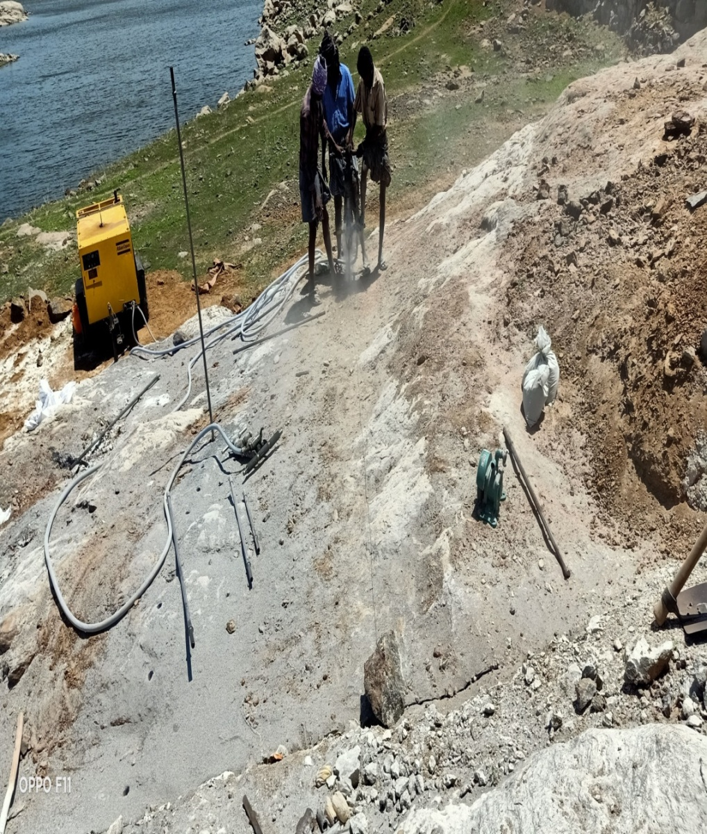
using compressor Drilling machine the drilling holes were provided to split the large pieces to the small one.

Slide 17
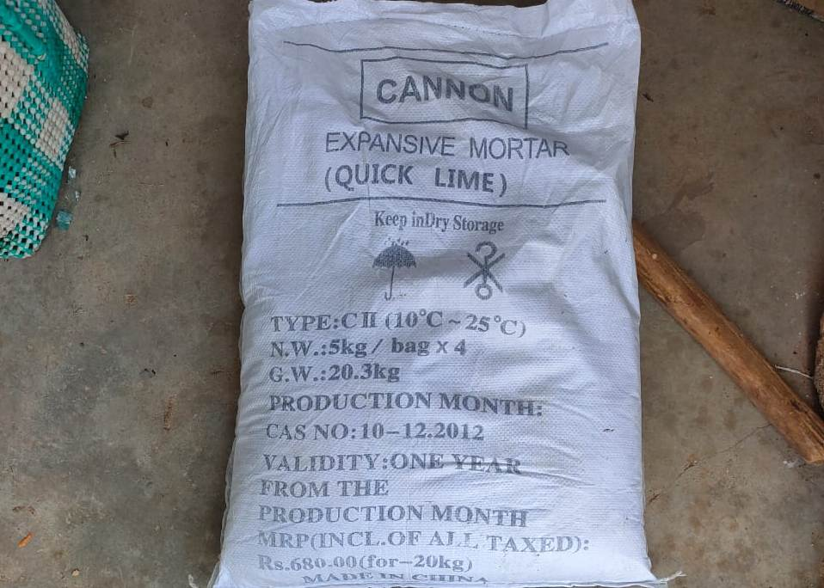
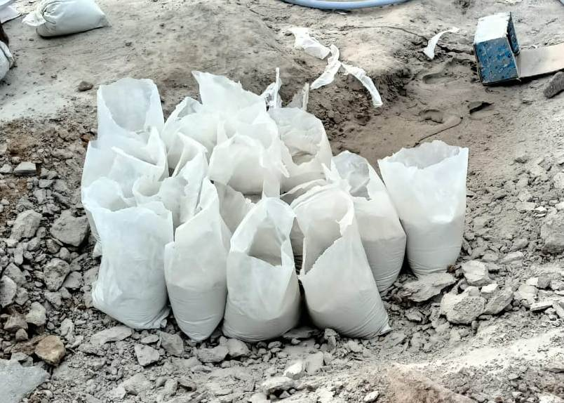
The Expansive mortar (Quick Lime) was available in 20 kg bag which contain 4 Nos of 5 kg packets.

Slide 18
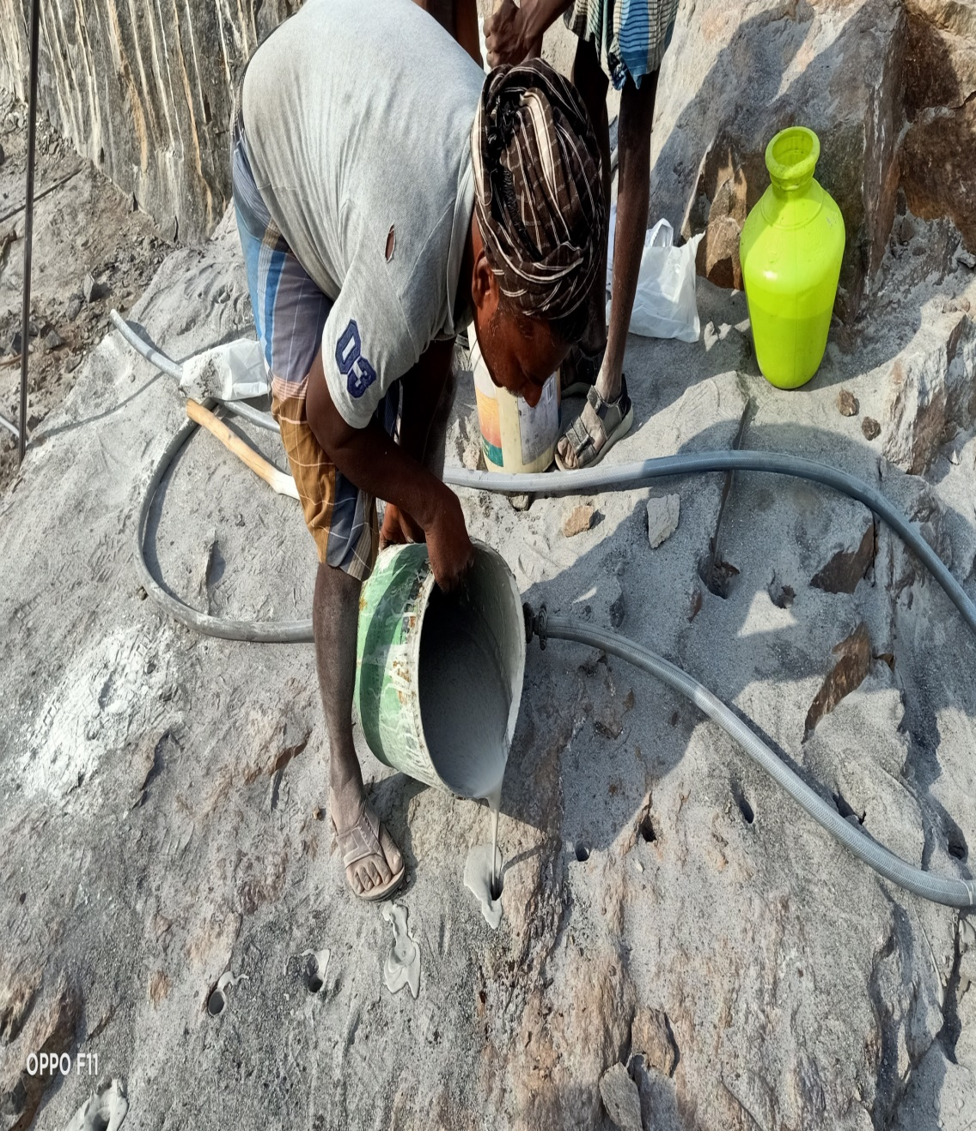
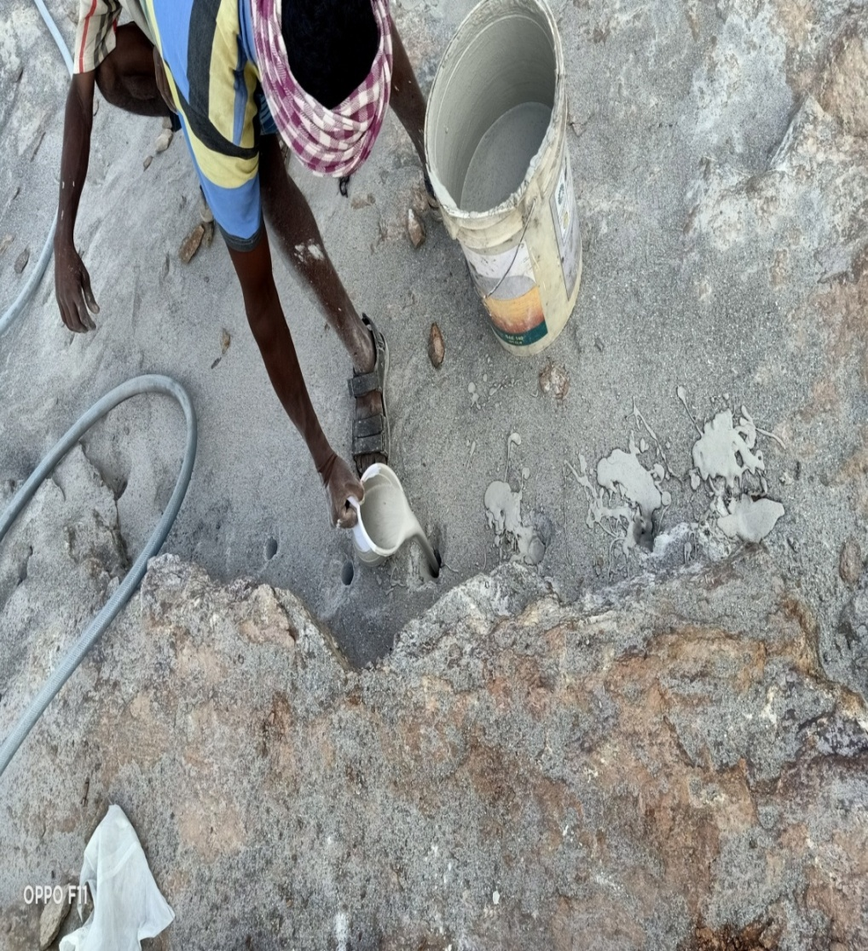
Mix and pour: Mix the powder with 30% water and pour it into the holes. Fill the holes about 15 mm from the top, and agitate the hole to remove air gaps.

Slide 19
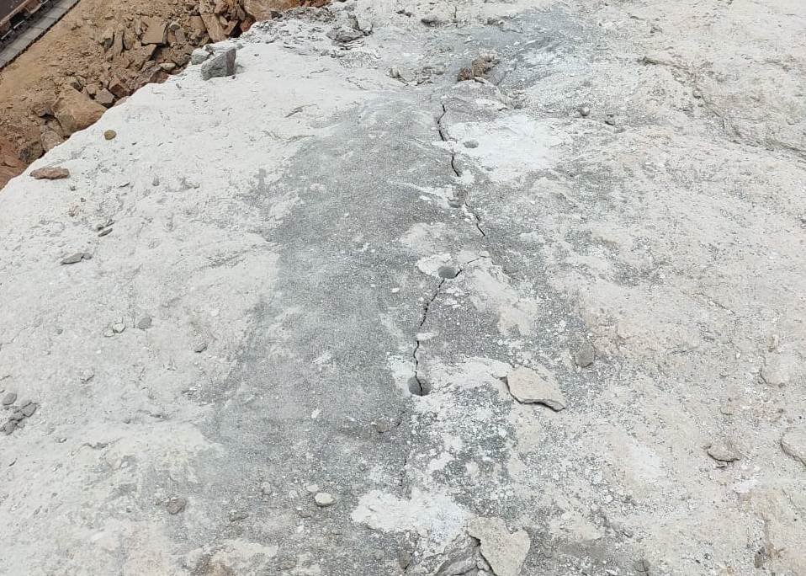
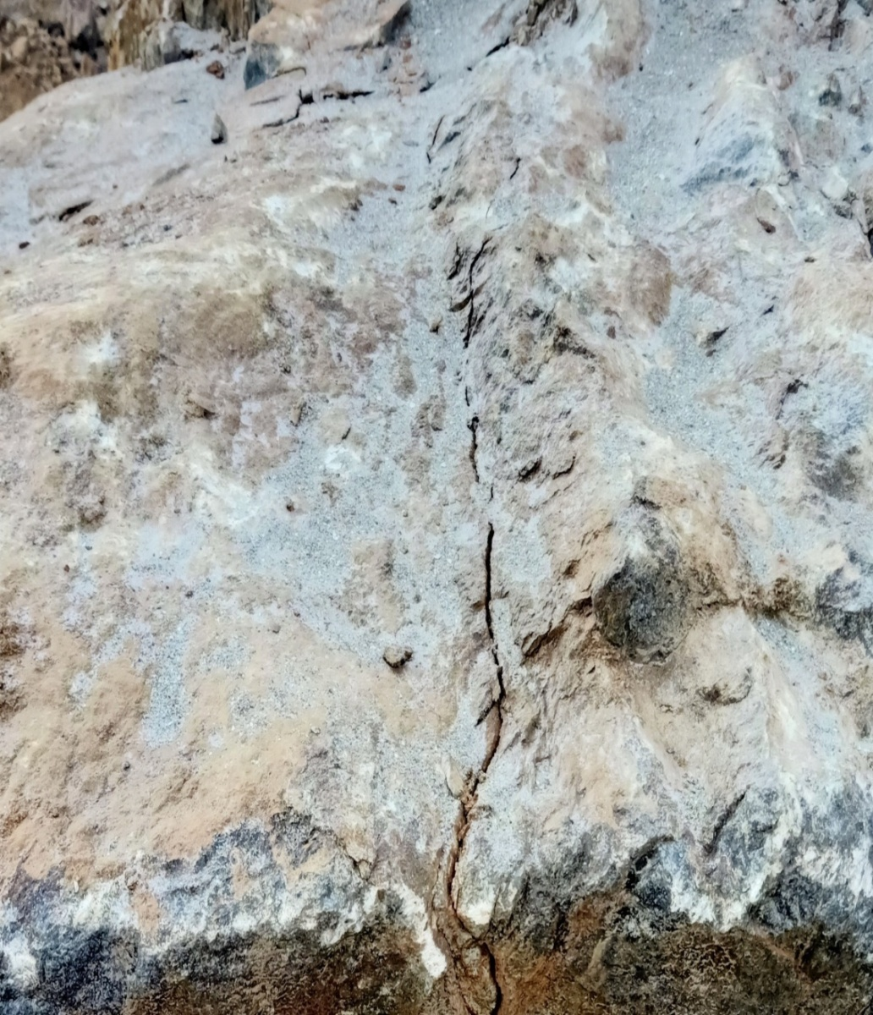
The mortar will expand and crack the rock over 4–24 hours.

Slide 20
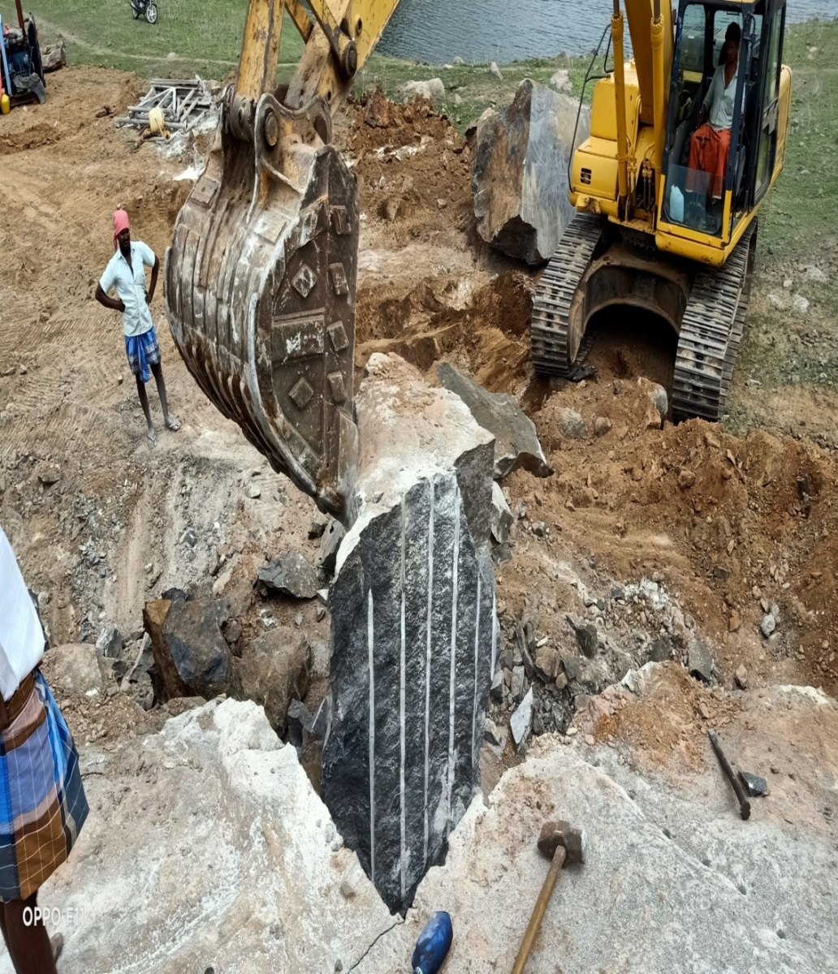
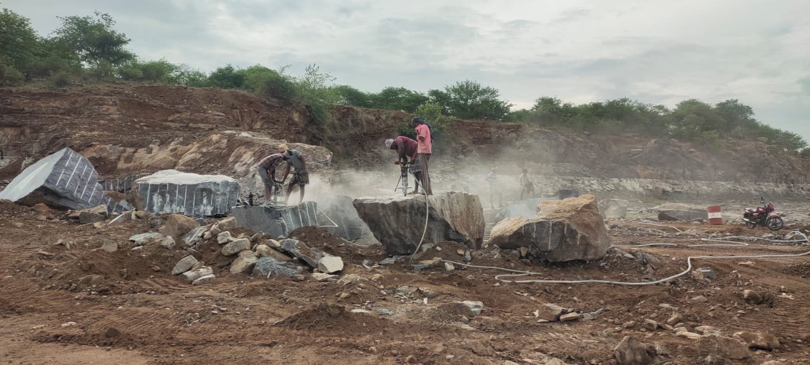
The split rocks were collected through hydraulic excavator and dumped in the stock yard.

Slide 21
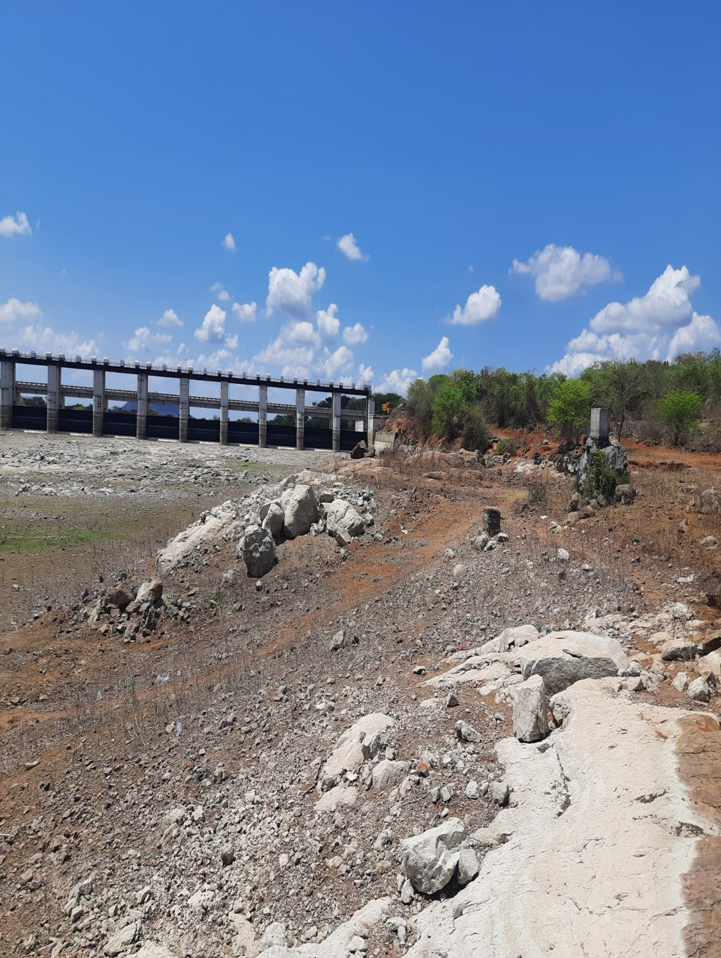
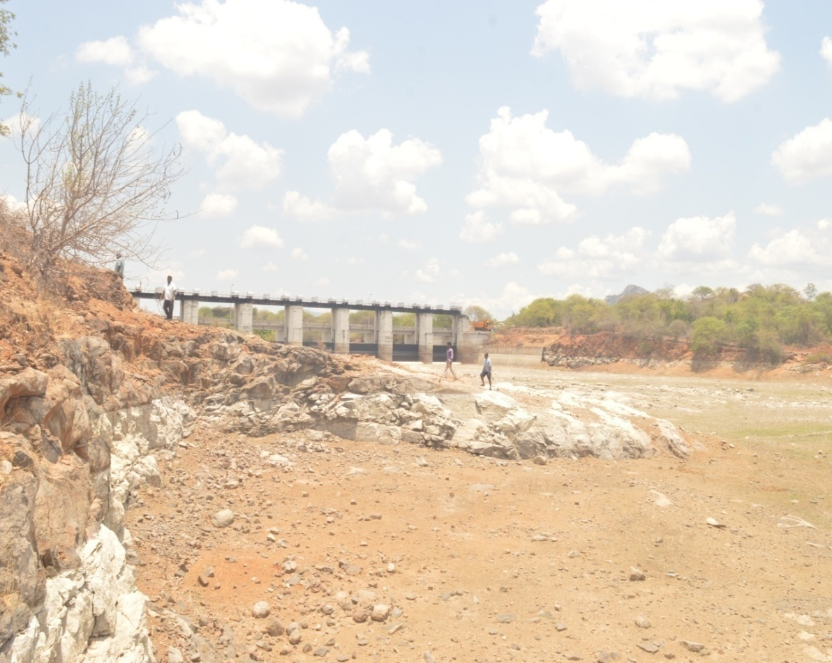
Rock Outcrop Before Execution

Slide 22
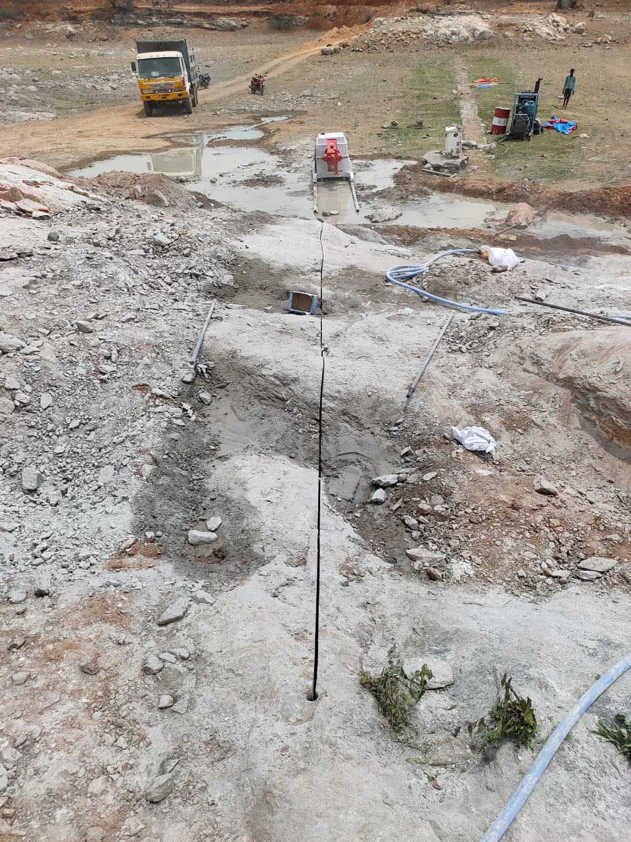
DIAMOND WIRE SAW CUTTING MACHINE- VERTICAL CUTTING

Slide 23
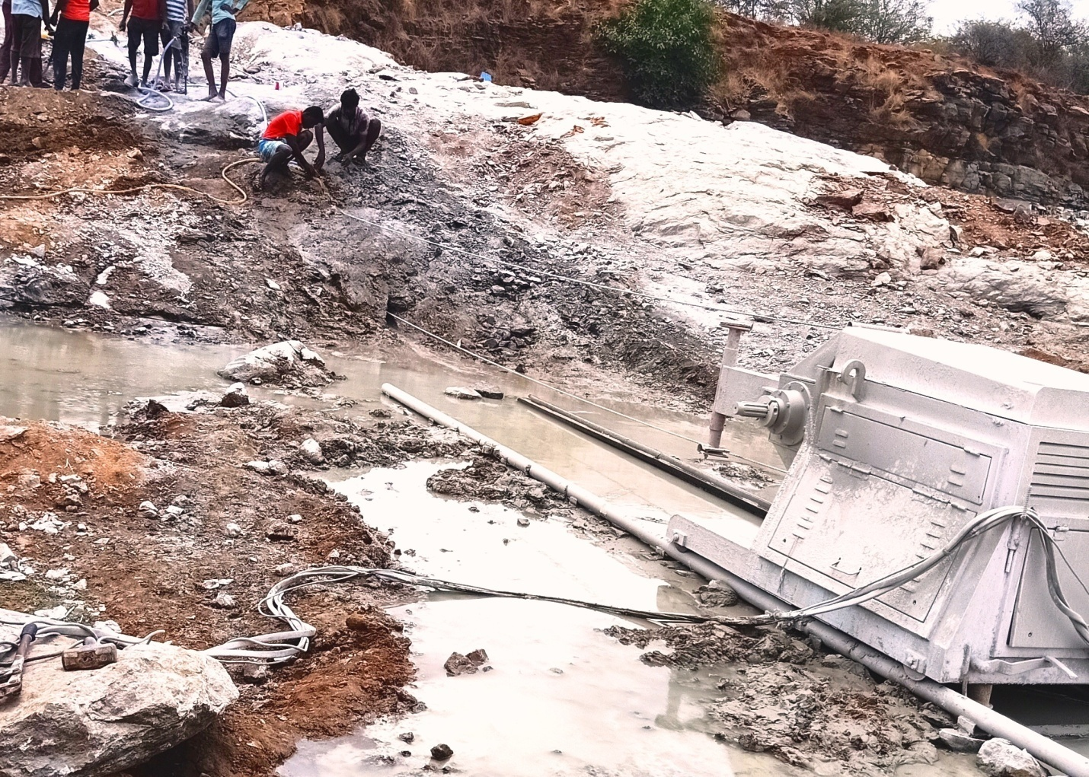
DIAMOND WIRE SAW CUTTING MACHINE- HORIZONTAL CUTTING

Slide 24
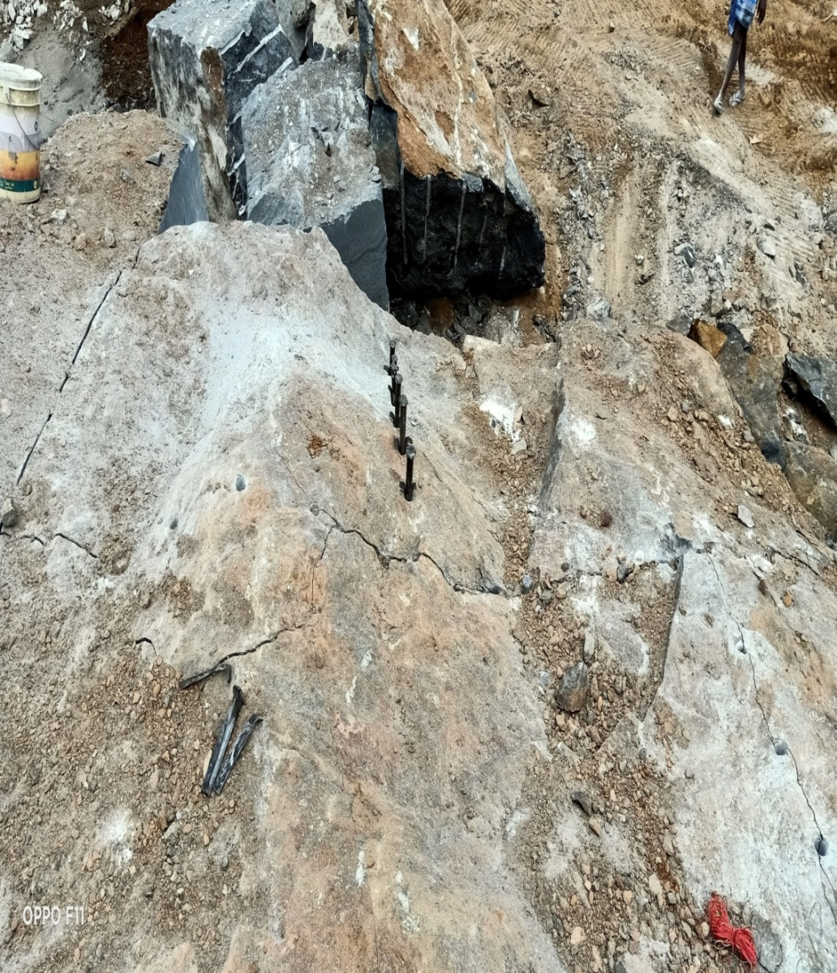
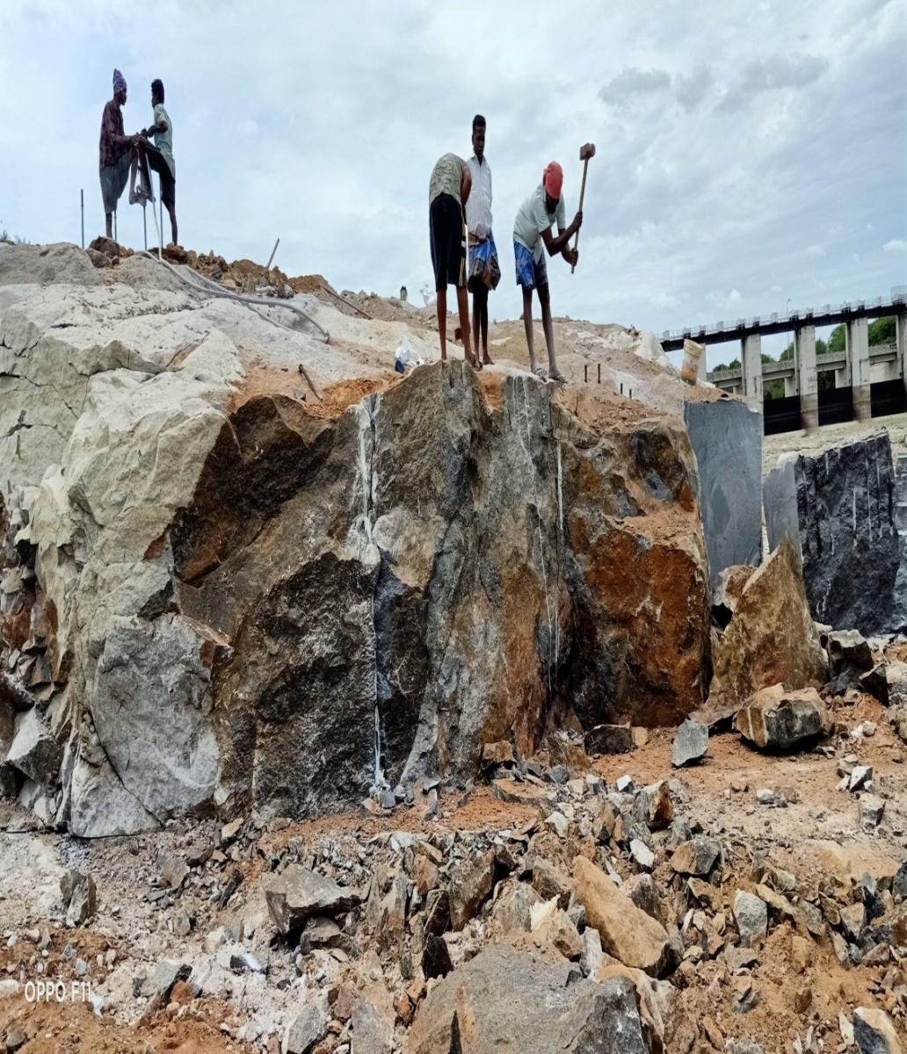
Split into Pieces

Slide 25
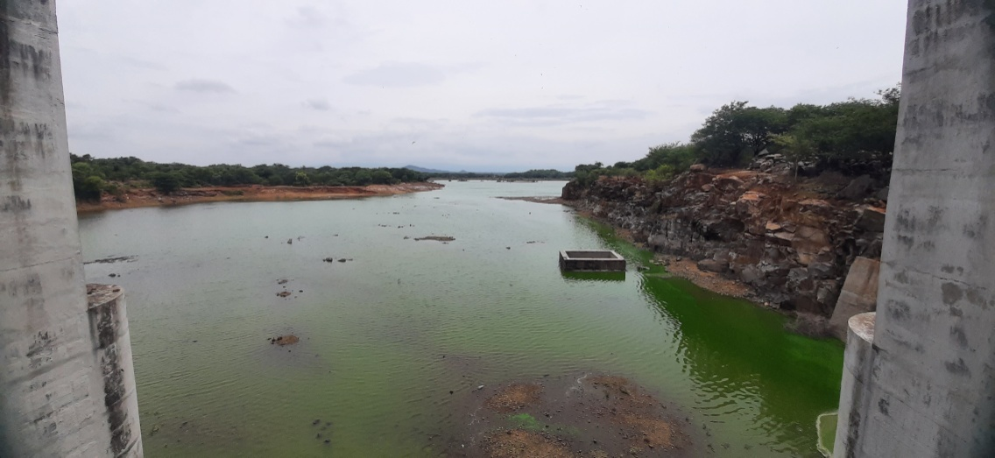
Outcrop Removal – After Execution.

Slide 26
Conclusion
The Hydraulic Split method have been very much pivotal in removing the rock outcrop without causing any Environmental hindrances for the fauna and flora around the reservoir and without any structural damage for the age old life savior structure thereby enhancing the free flow towards the dam.

Slide 27

THANK YOU

