Slide 1

Comparison of the Standard and Emerging Technologies for Managing Dams during Floods
N. Ilich, DRIP Project, SMEC, New Delhi, India
D. Nath Kalita, DRIP Project, SMEC, New Delhi, India

Slide 2
Presentation Layout
Standard Flood Routing - how we do it and why?
Using Linear Programming as an alternative
Various Goals of reservoir management during floods:
  Dam and spillway safety
  Downstream Damage
Benefits: a faster science-based action in emergencies that can be compared to historic outcomes
Future outlook -- a two-pronged approach: A DSS based on combined flood forecast and reservoir management based on optimization

Slide 3
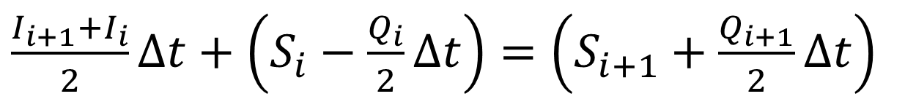
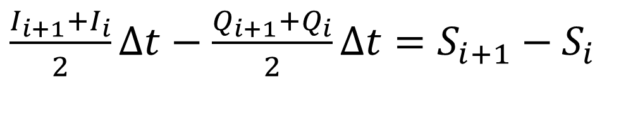
Standard Flood Routing
Requires solving the following differential equation:
$\frac{I_{i+1}+I_{i}}{2}∆t−\frac{Q_{i+1}+Q_{i}}{2}∆t=S_{i+1}−S_{i}$
Various iterative schemes were proposed. The Modified Pulse method puts all known on the left side and all unknowns on the right side of the equation:
$\frac{I_{i+1}+I_{i}}{2}∆t+\left(S_{i}−\frac{Q_{i}}{2}∆t\right)=\left(S_{i+1}+\frac{Q_{i+1}}{2}∆t\right)$

Slide 4
Use of Linear Programming
Optimization can be defined as a process of selecting the best out of many possible solutions. In essence, it involves problems that have more than one possible (feasible) solution, and selection criteria. The main advantage is the ease of providing various criteria:
Maximize outflow
Minimize the use of upper levels of reservoir storage
Minimize downstream damage

Slide 5
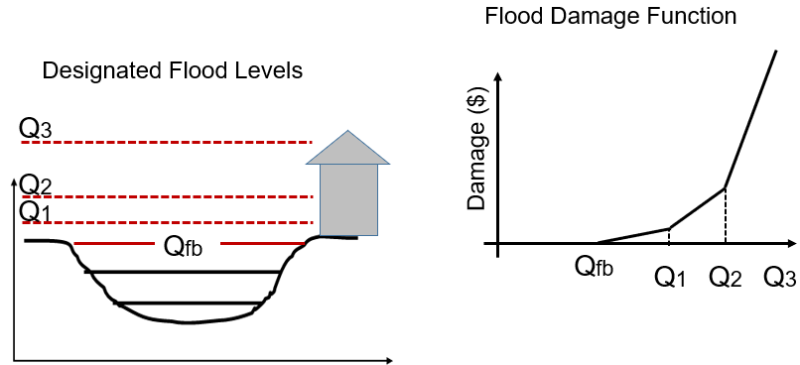
Channel Capacity versus Downstream Damage

Slide 6
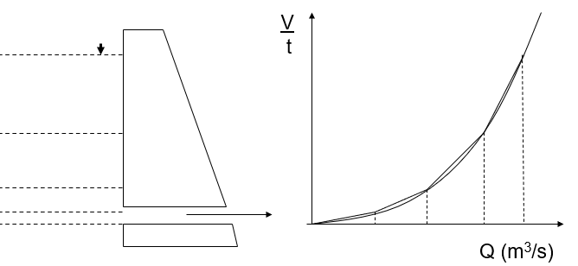
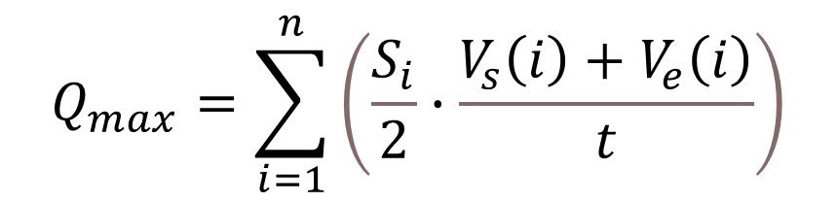
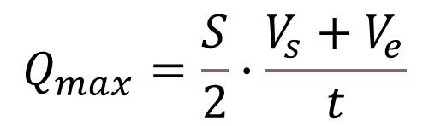
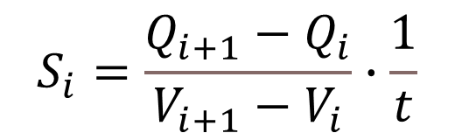
How does LP represent the outflow vs elevation curve?
$$S_{i}=\frac{Q_{i+1}−Q_{i}}{V_{i+1}−V_{i}}∙\frac{1}{t}$$
$$Q_{max}=\sum_{i=1}^{n}{\left(\frac{S_{i}}{2}∙\frac{V_{s}\left(i\right)+V_{e}\left(i\right)}{t}\right)}$$
$$Q_{max}=\frac{S}{2}∙\frac{V_{s}+V_{e}}{t}$$

Slide 7
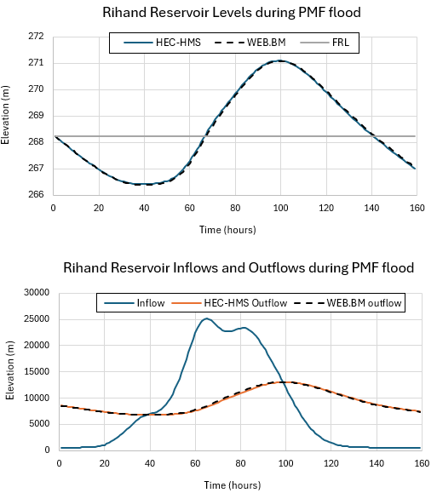
Standard Objective: Maximize Outflow

Slide 8
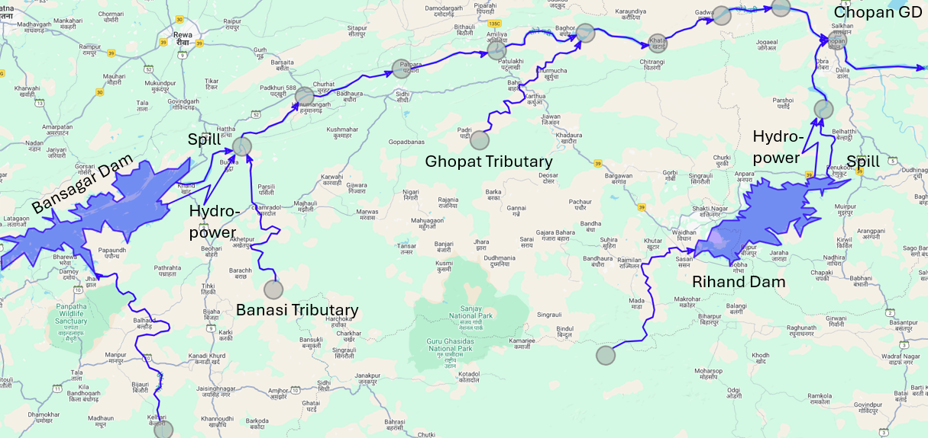
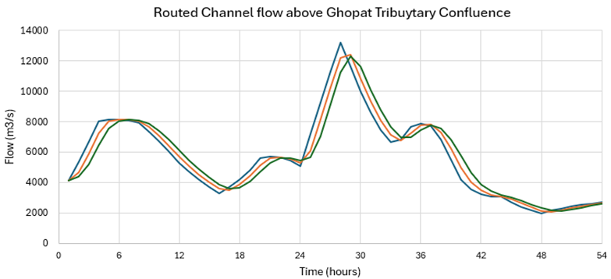
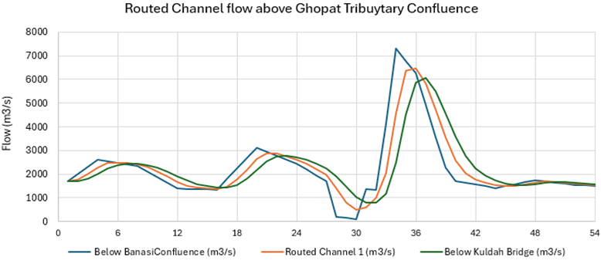
Complex Objective: Minimize d/s Damage below Bansagar and Rihand dams)

Slide 9
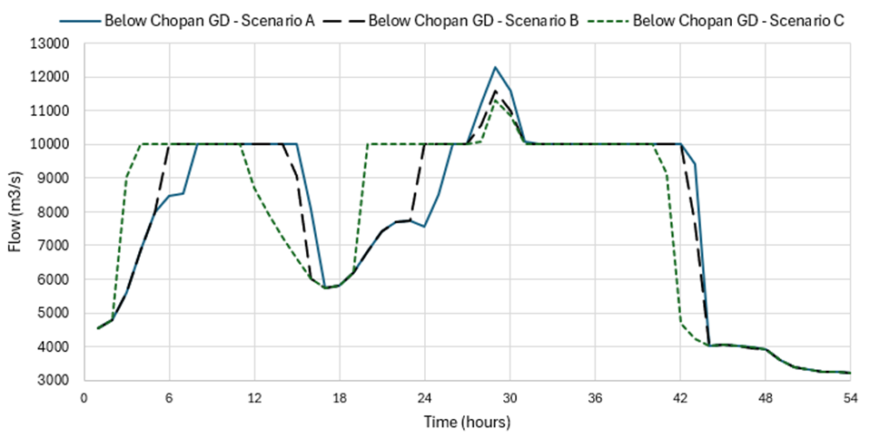
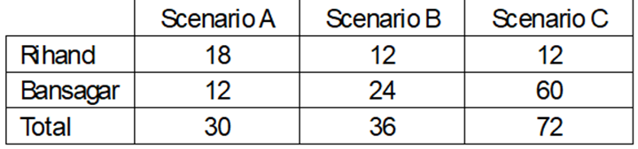
Final Results with the number of hours of hydropower shutdown

Slide 10

Final Results of Scenarios A, B and C (hist. Qp >16,000 m3/s)
Runoff
Forecast
In Scenario:
A – 6 hr
B – 24 hr
C – 72 hr

Slide 11

THANK YOU

