Slide 1
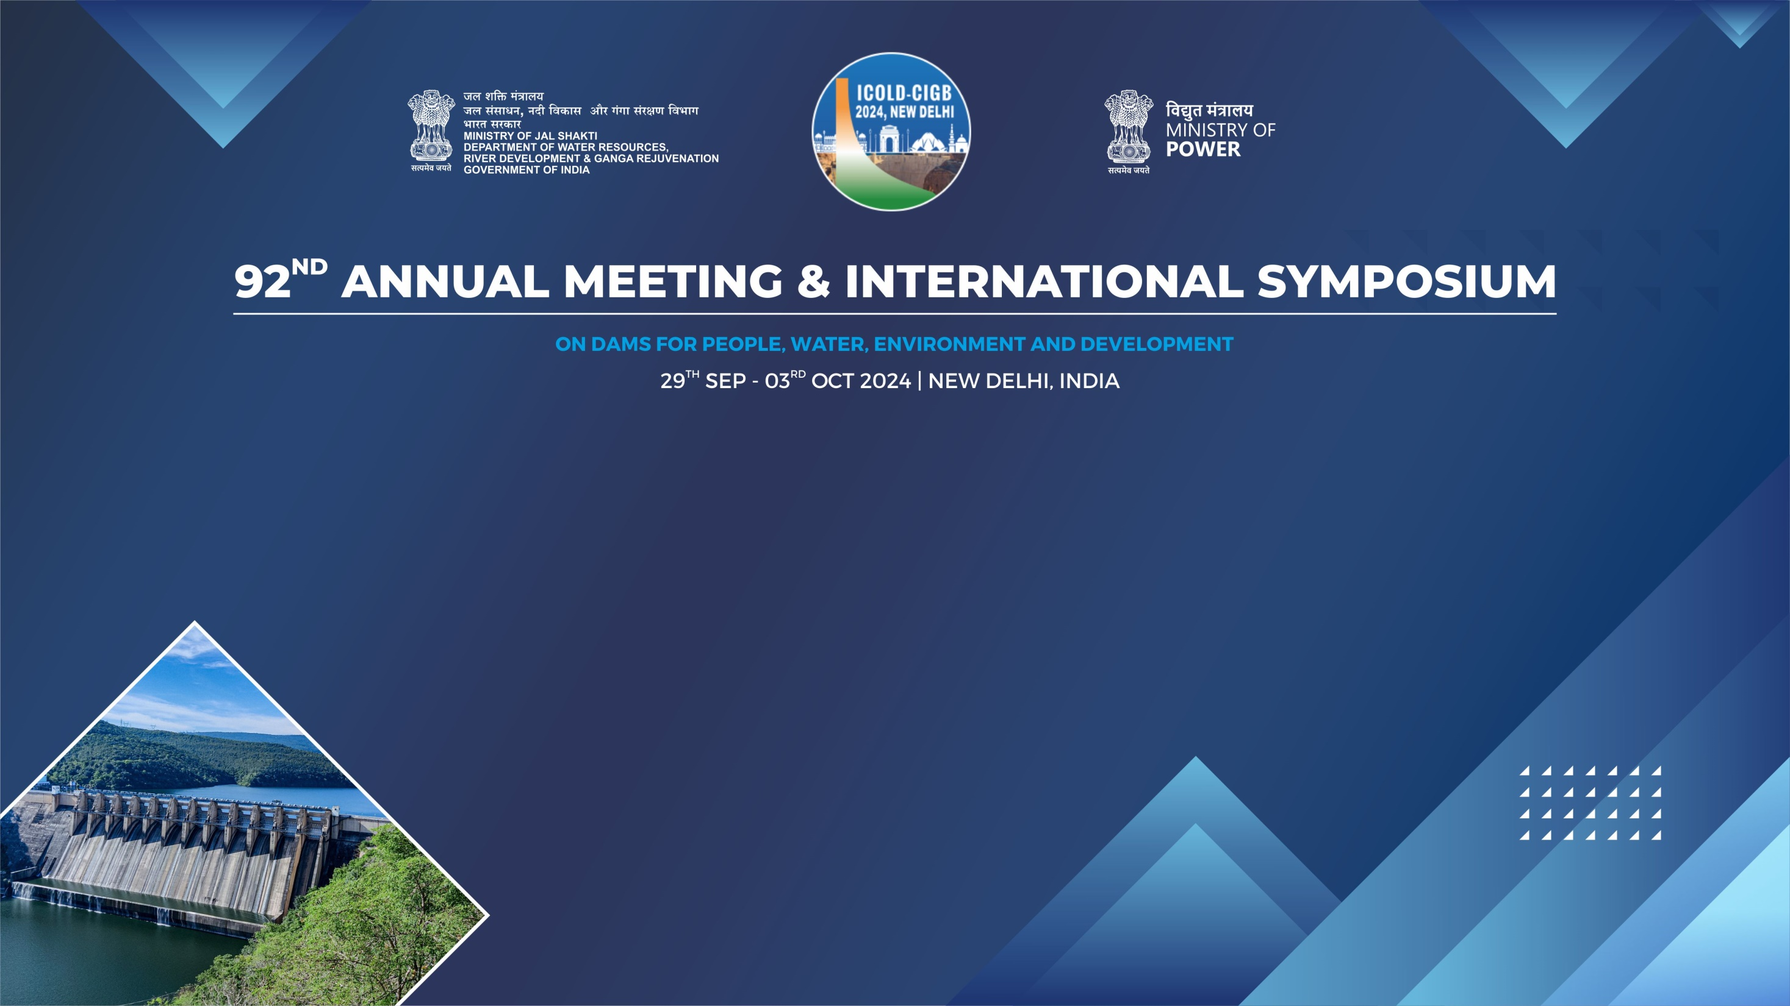
CASE STUDY
Rehabilitation of Energy Dissipation Arrangement of Maneri Dam of Maneri – Bhali Stage – I HEP in District Uttarkashi (Uttarakhand) under DRIP-II
Dr. SANDEEP SINGHAL, Er SURESH CHANDRA BALUNI,
Er PANKAJ KULSHRESHTH, Er ASHUTOSH KUMAR SINGH,
Er MOHIT UNIYAL
UJVN Limited, INDIA

Slide 2
Introduction
UJVN Limited (UJVNL) is a wholly owned corporation of Government of Uttarakhand (India).
UJVNL came into existence on 12 February 2001 to establish, takeover, operate and maintain hydropower plants in the State of Uttarakhand.
At present it operates, hydropower plants ranging in capacity from 1.5 MW to 304 MW, totaling to 1440.60 MW.
UJVNL, besides being committed to develop new power stations, is also carrying out Renovation, Modernization & Upgradation (RMU) of its existing power stations and ensuring safety of dams/barrages under DRIP.
Maneri Dam of MB-I HEP is part of 6 Dams/Barrages of UJVNL included in DRIP-II.

Slide 3
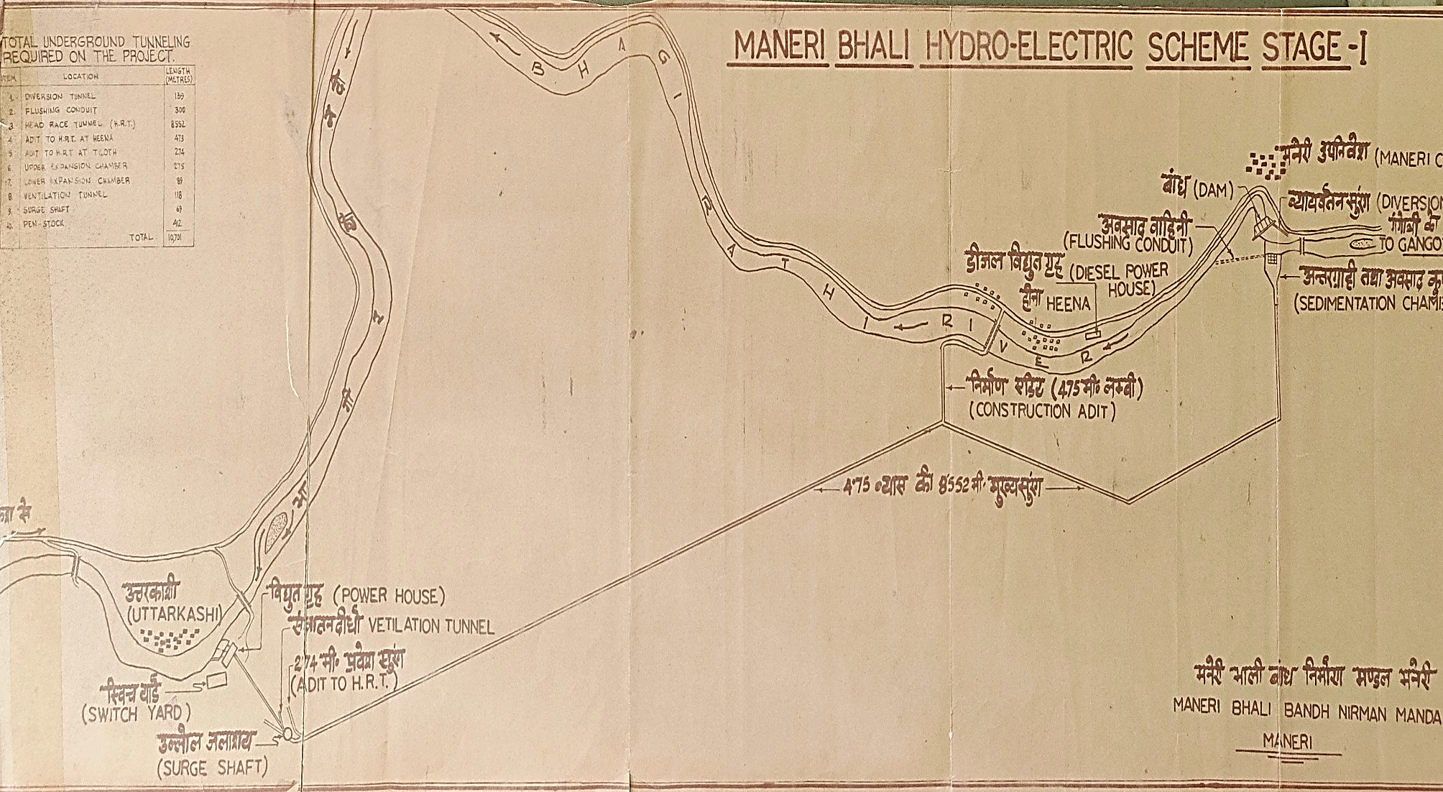
Layout of Maneri Bhali Stage-I Hydro Electric Project (HEP)
MB-I HEP consists of 39 m high concrete gravity dam with 4 nos. ogee spillway across river Bhagirathi.
3X30 MW capacity surface power house has Francis turbines at Tiloth, Uttarkashi.

Slide 4
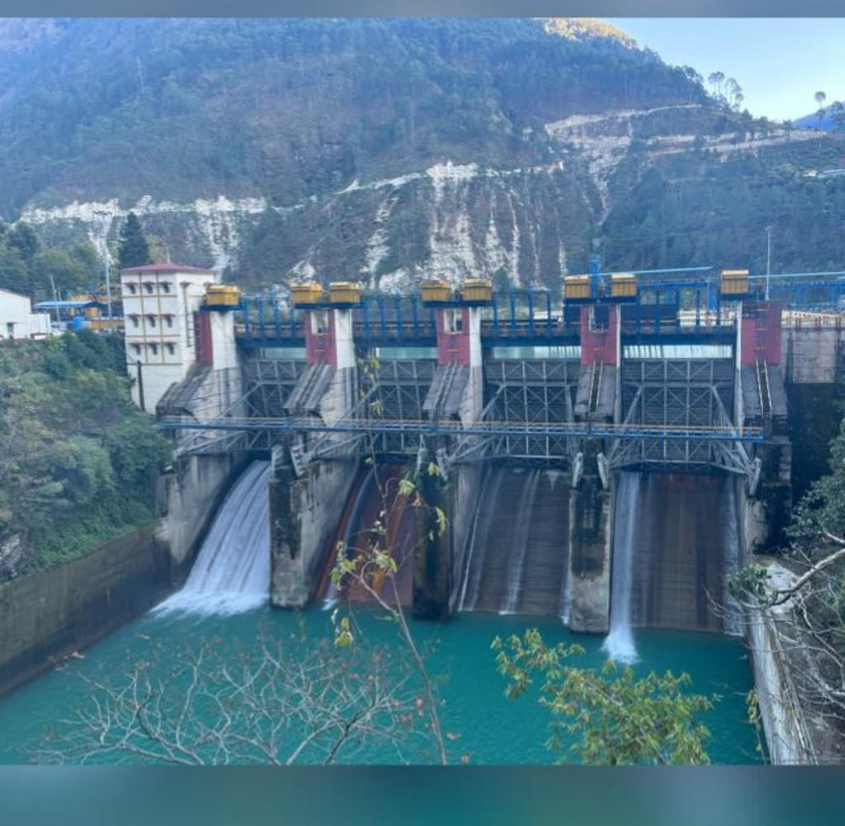
Downstream View of Maneri Dam

Slide 5
Issues with EDA & Appurtenant structures of Maneri Dam
Prolonged operation & catastrophic floods in 2012 & 2013 caused serious structural damage to spillway bays, EDA (Roller bucket) & appurtenant structures of Maneri Dam.
All four spillway bays glacis including steel liner plates were badly damaged.
Spillway glacis 1 & 2 were replaced & repaired by UJVNL in 2013-14.
Damaged spillway glacis 3 & 4 were repaired by HPC M90 Concrete along with various other works under DRIP-I.
Rehabilitation of damaged EDA of Maneri dam was included in DRIP-II and is in progress.

Slide 6
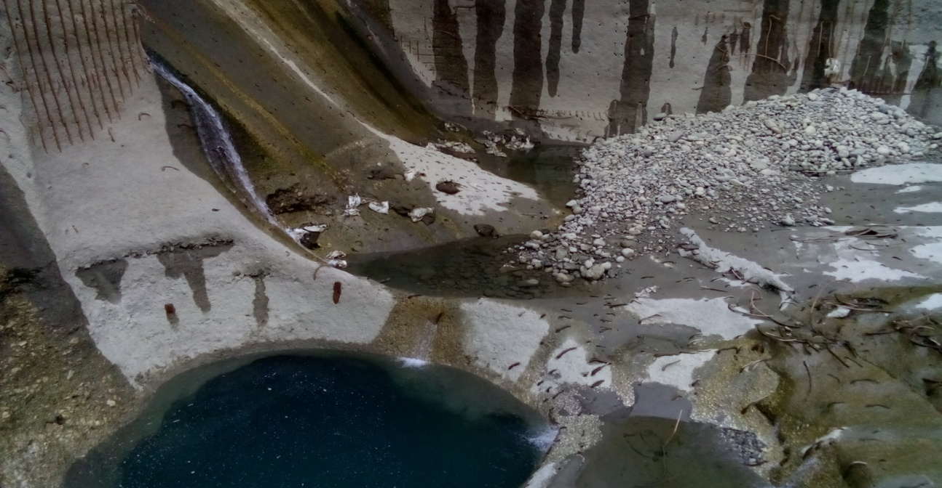
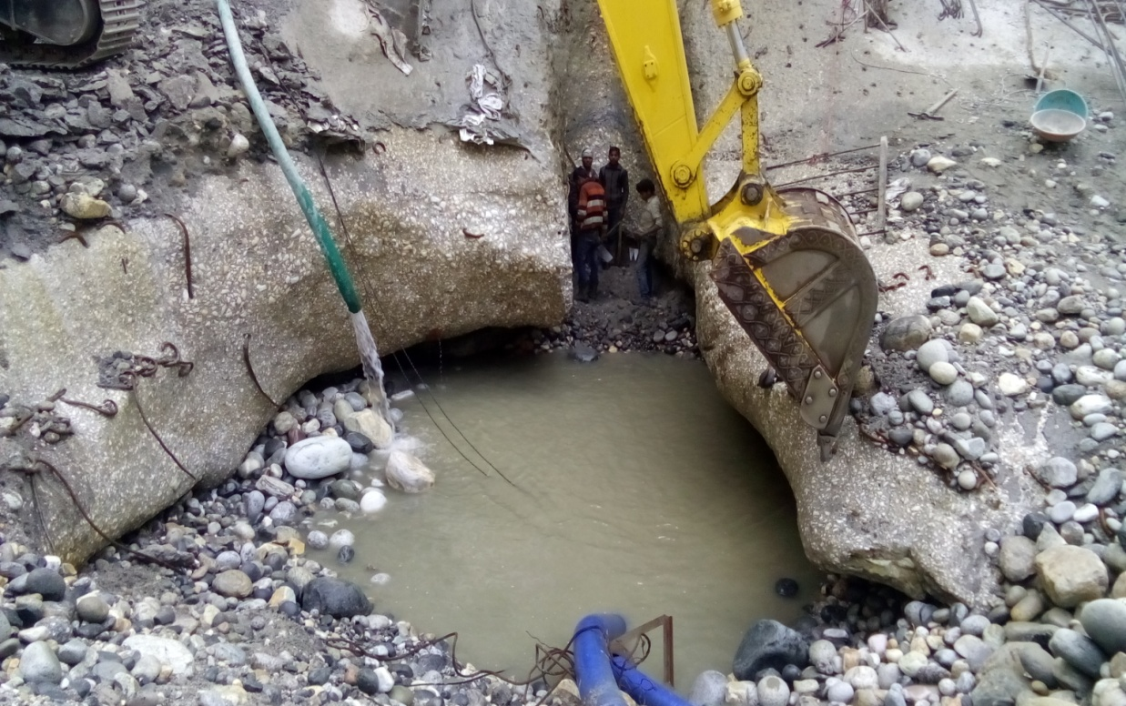
Damages in Roller bucket of Maneri Dam

Slide 7
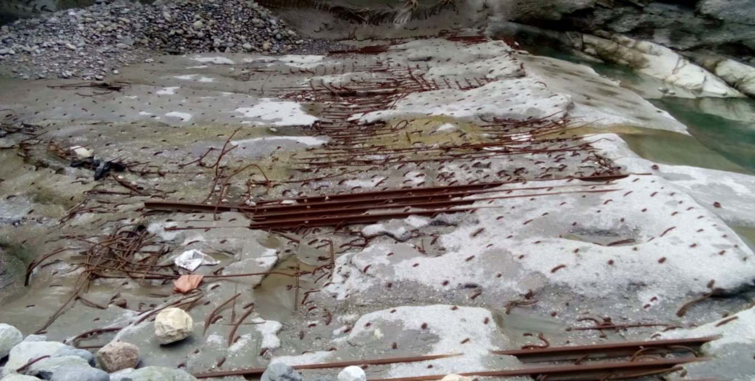
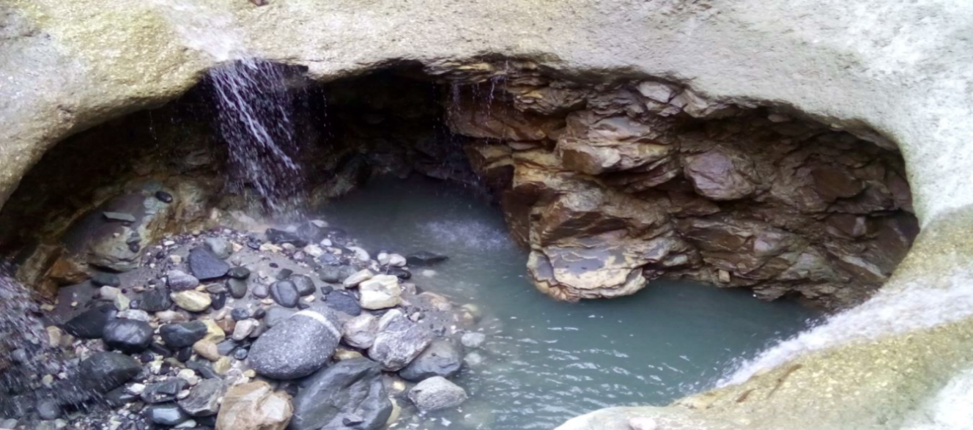
Damages in Foundation & Roller bucket of Maneri Dam

Slide 8
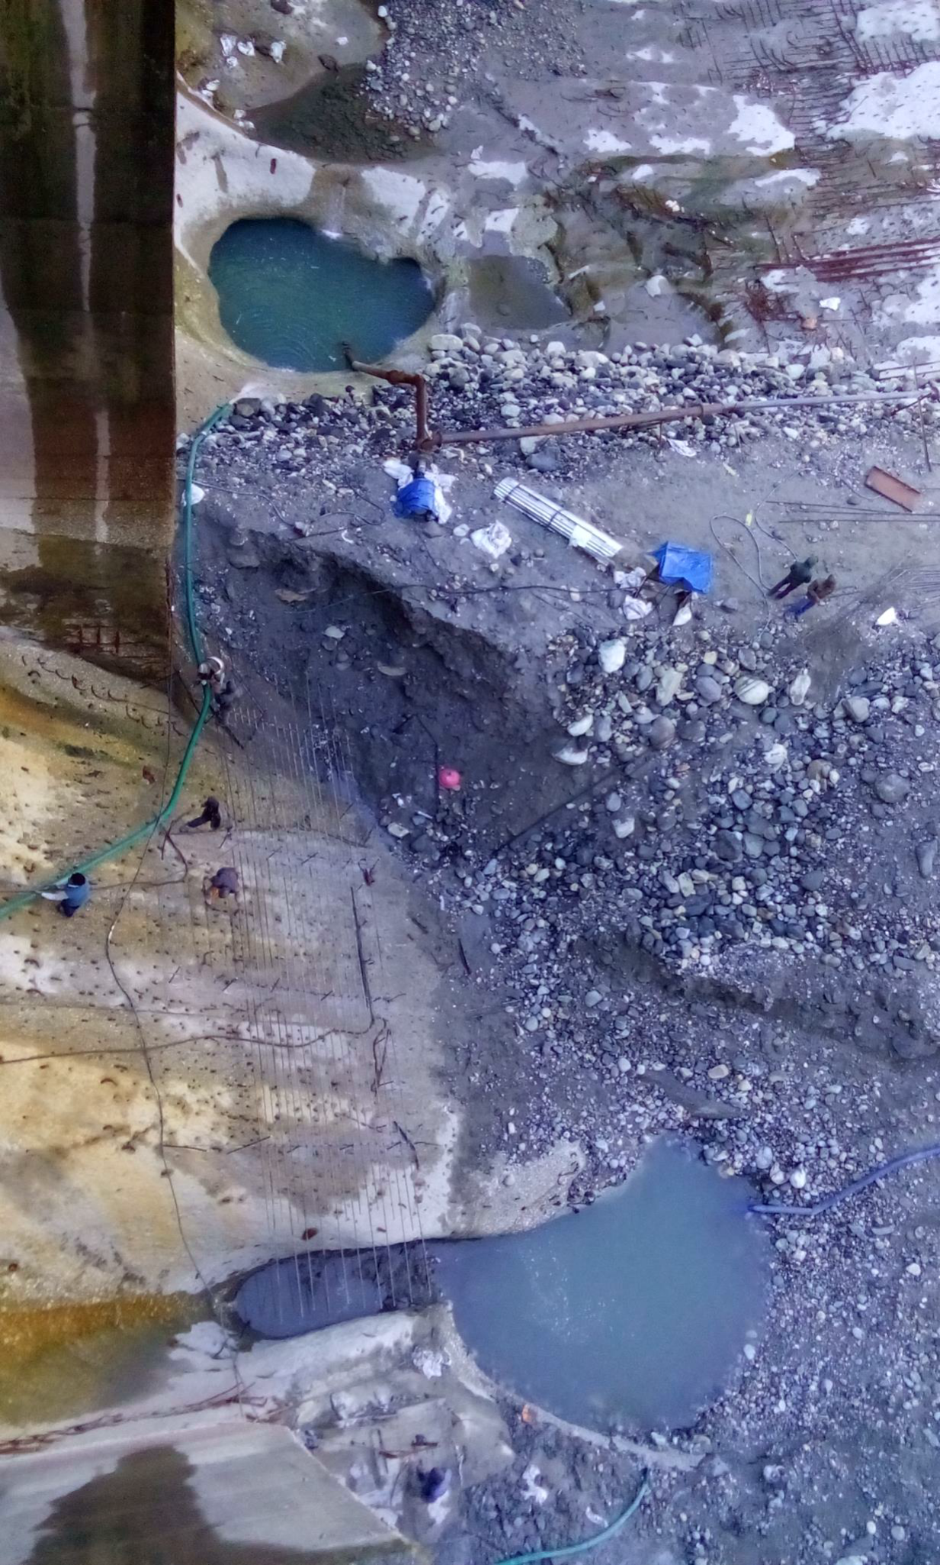
Damage in Foundation & Roller bucket of Maneri Dam

Slide 9
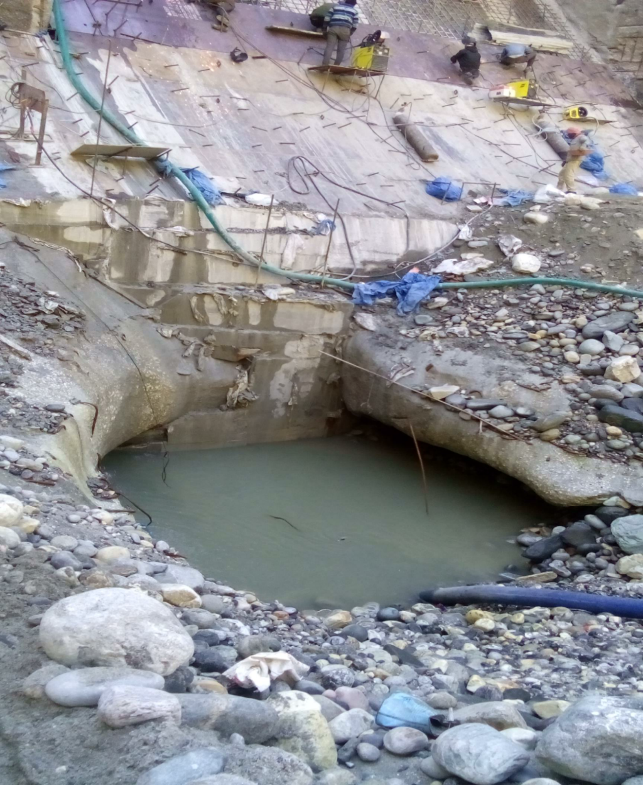
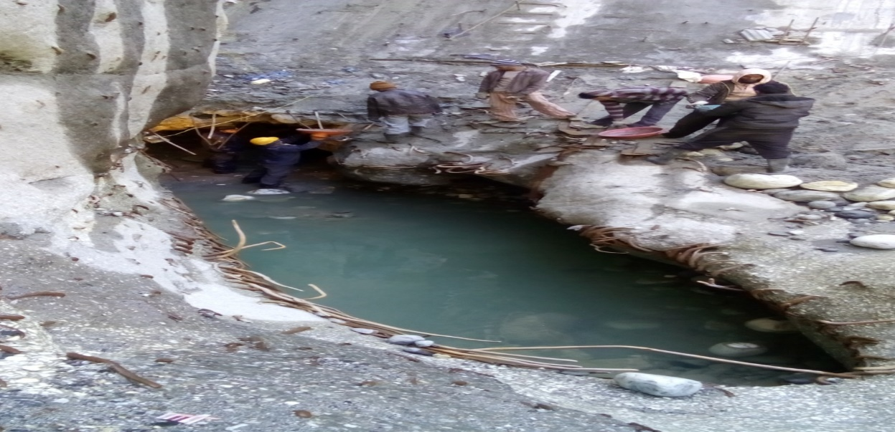
Damage in Foundation & Roller bucket of Maneri Dam

Slide 10
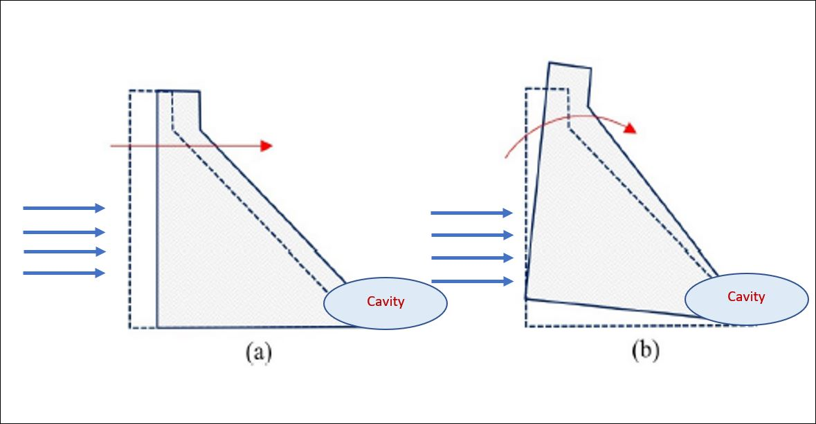
Possible risk due to damages
Cavity created at dam toe may cause slide/over turning of dam by water thrust. This is a potential risk to dam safety & may induce huge flow of water & cause disaster in downstream area of Uttarkashi town.

Slide 11
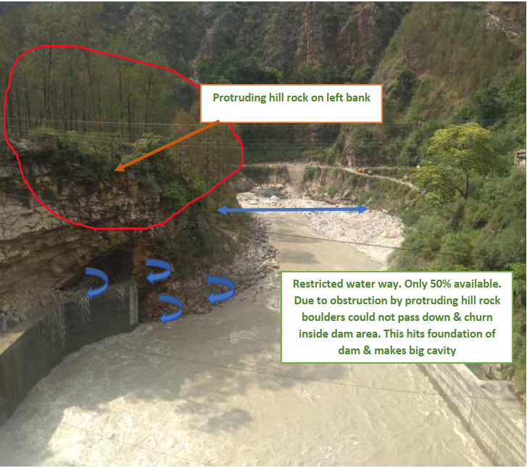
Cause of Damage in Foundation and Roller Bucket
Rolling boulders during floods are obstructed due to restricted waterway width in downstream due to hill block creating adverse flow conditions & return currents produce churning effect & causing severe damages to Roller bucket as proven from model study.

Slide 12
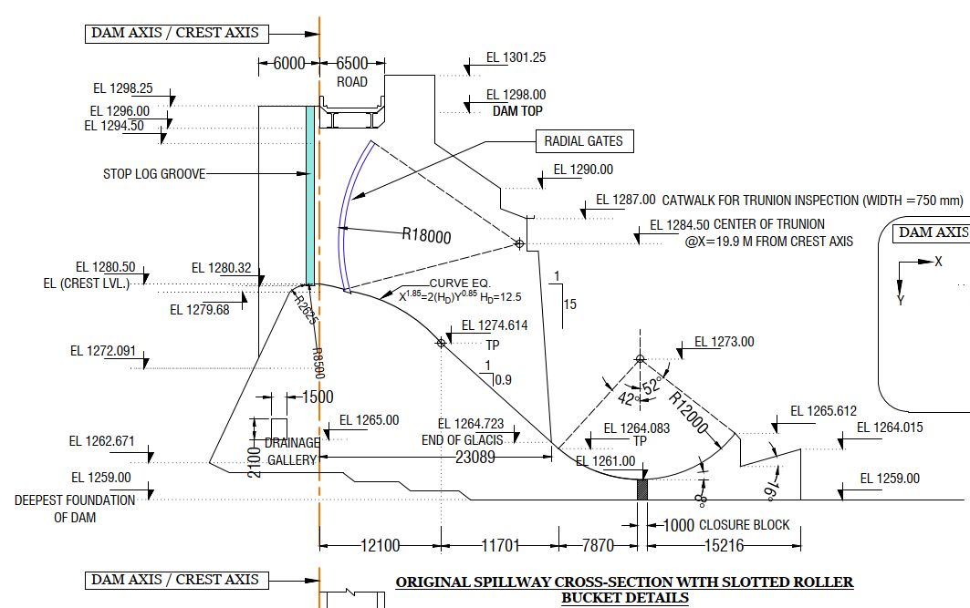
Investigation of problem & Model studies
Hydraulic model studies recommended by CPMU to check & evaluate adequacy of the existing EDA under present flow conditions.
First phase of hydraulic model study was performed at IRI, Roorkee in 2018-19 under DRIP-I with roller bucket arrangement & existing site conditions.
It was observed that existing design of EDA i.e. roller bucket was not efficient in dissipating the energy of higher flood due to narrow waterway width in downstream.

Slide 13
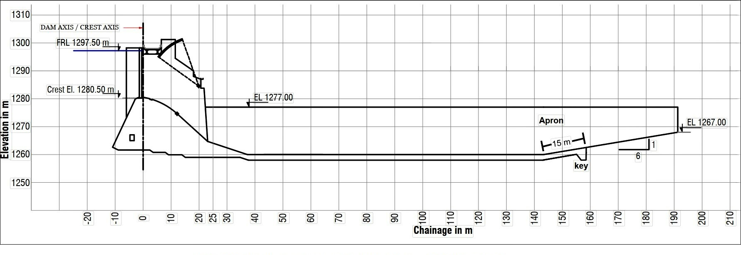
Model studies:- Recommendations
Second phase of hydraulic model study was performed at IRI, Roorkee in 2020-21 & 2021-22 under DRIP-II with stilling basin & unrestricted waterway.
Adoption of stilling basin as new type of EDA for Maneri dam was validated through the results.

Slide 14
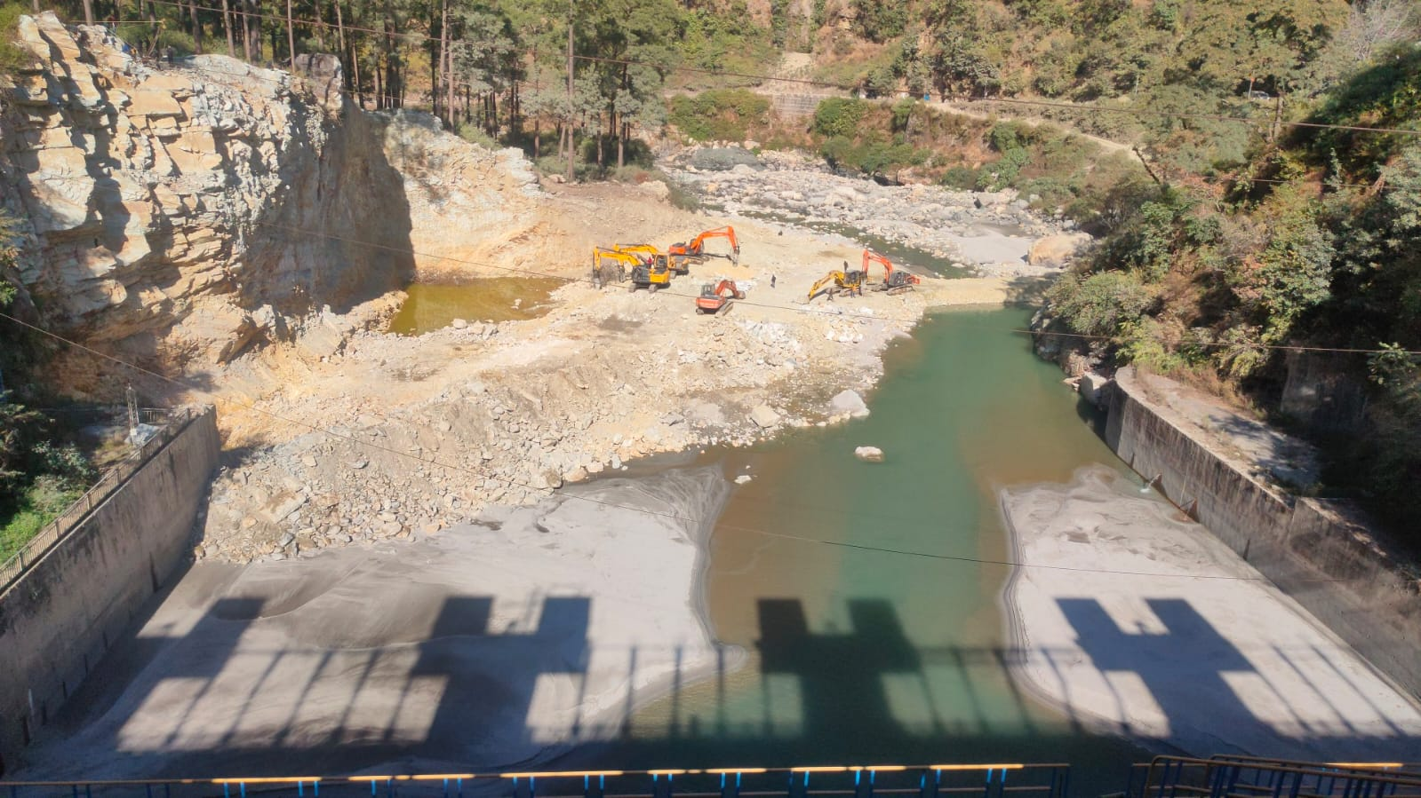
Remedial measures on the basis of model study
Cutting & dressing of protruding hill rock to increase available effective waterway width in downstream.
Work included in DRIP-II & being executed.
Work started in Oct-2021 & was scheduled to be completed in Oct-2024.
Cutting & dressing of protruding hill rock completed in March-23

Slide 15
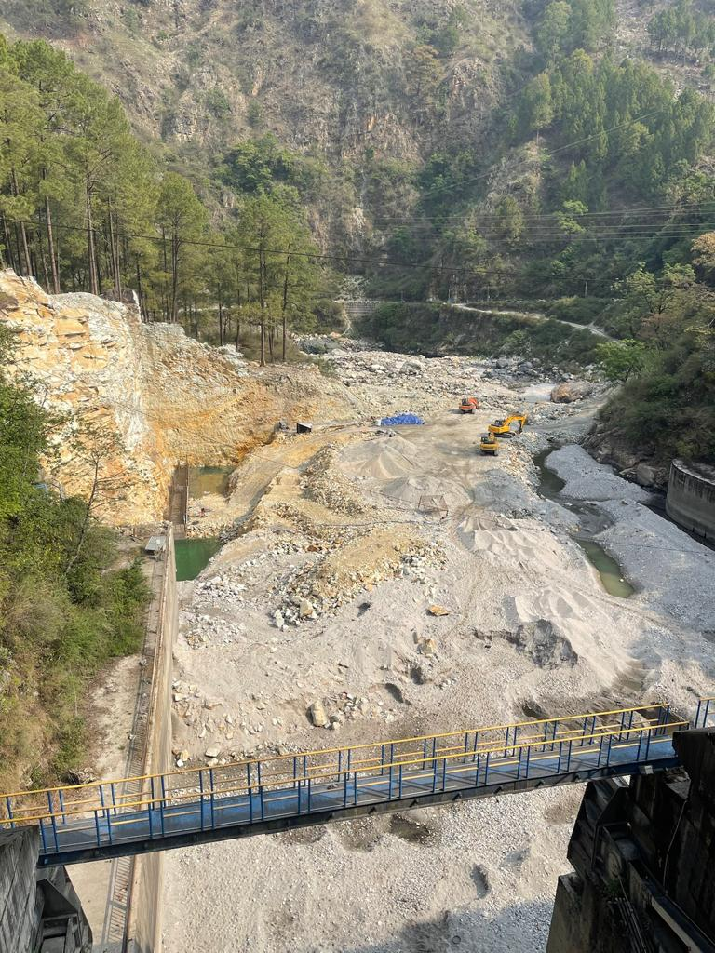
Present Status of work
Concreting in left training wall started in April-2023.
Excavation of river bed to accommodate proposed 100 m long stilling basin shall be executed in upcoming lean season from October 2024.

Slide 16
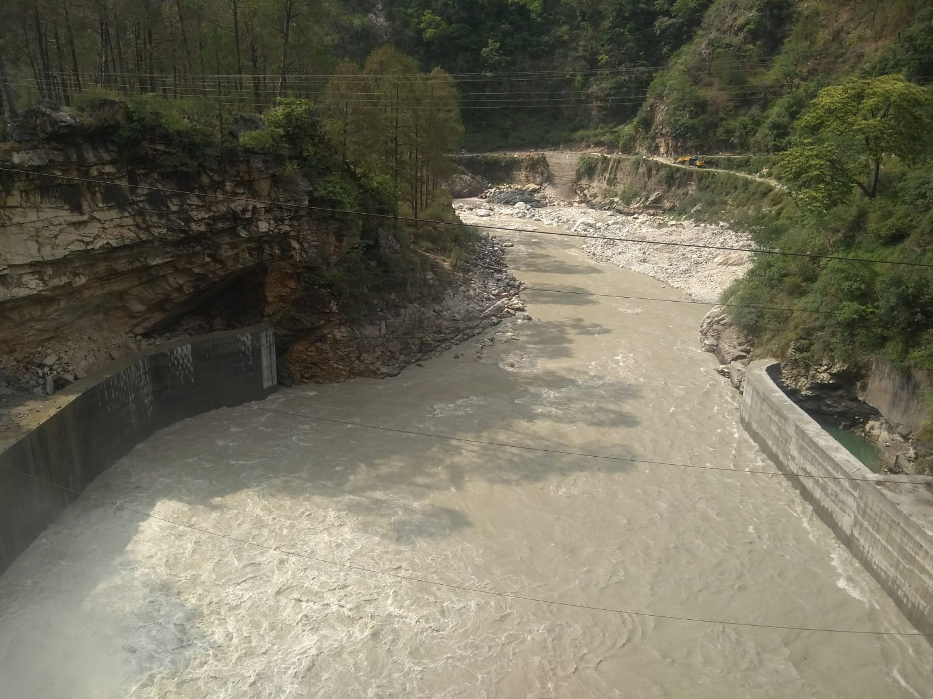
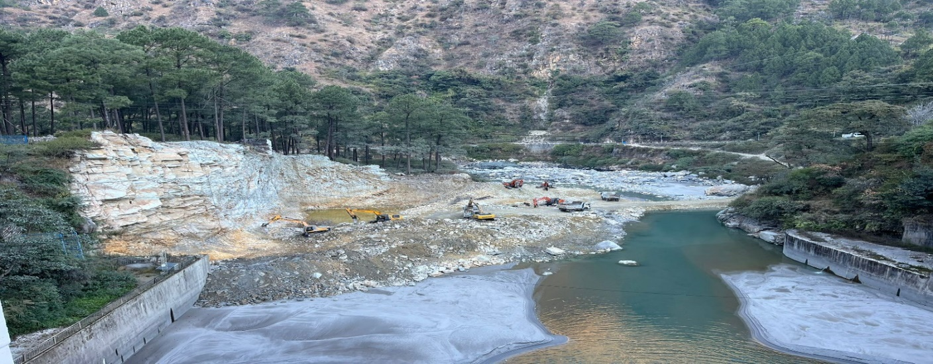
Downstream view at left bank of Maneri Dam
Before hill excavation
After hill excavation

Slide 17
Challenges in execution of works at Maneri Dam Site
Due to high discharge in summer & monsoon seasons i.e. May to September, limited time slot is available for execution of works at Maneri dam site i.e. Oct-April of the year.
Due to very low temperature at site during working season working conditions at Maneri Dam site are harsh & difficult.
Limited working methodologies & strict adherence to rules & regulations of the Bhagirathi Eco-sensitive zone.
Blockage of roads due to landslides in rainy days interrupts supply of material & machinery in the area.

Slide 18
Conclusion
Stilling basin type EDA along with the unrestricted waterway in the downstream of Maneri Dam shall greatly help in the smooth passage of boulders during floods. The damages to EDA shall also reduce to a great extent.
Moreover the repair of stilling basin if required, would be quite easier as compared to roller bucket.

Slide 19
References
TM 93-RR(H2-01) Hydraulic Model Studies for optimization of stilling basin for 90 MW Maneri Bhali Stage-I H.E. Project (Uttarakhand)
CDSO_GUD_DS_07_v1.0 “Guidelines for Safety Inspection of Dams”
IS 7365-2010 “Criteria for hydraulic design of bucket type energy dissipators”
IS 4997-1968 “Criteria for hydraulic jump type stilling basin with horizontal and sloping apron”

Slide 20

THANK YOU

