Slide 1

The Hydraulic consideration and assessment of the Srisailam Dam Spillway
Dr Hany Salem, SMEC International, Australia

Slide 2
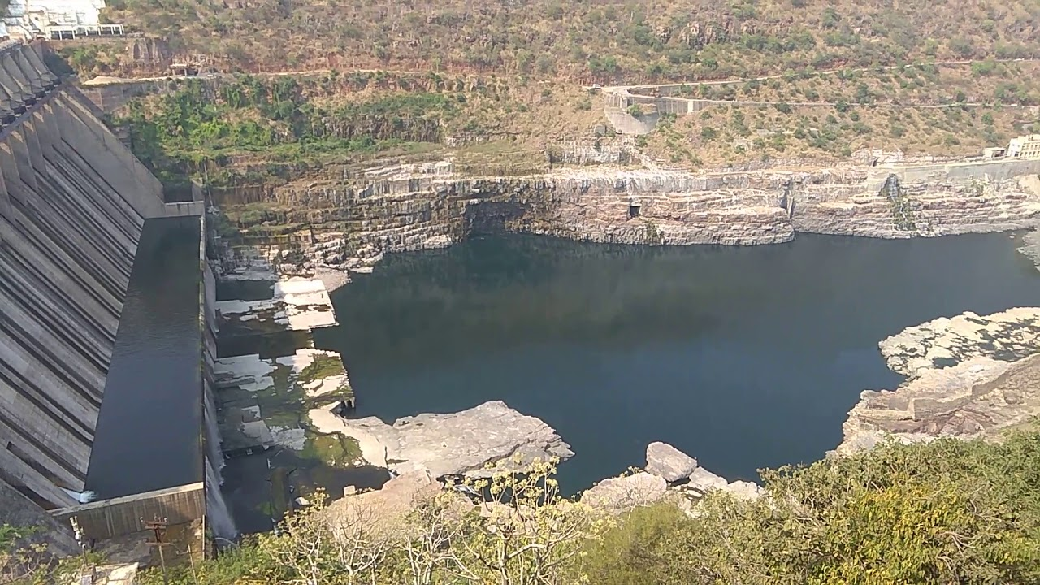
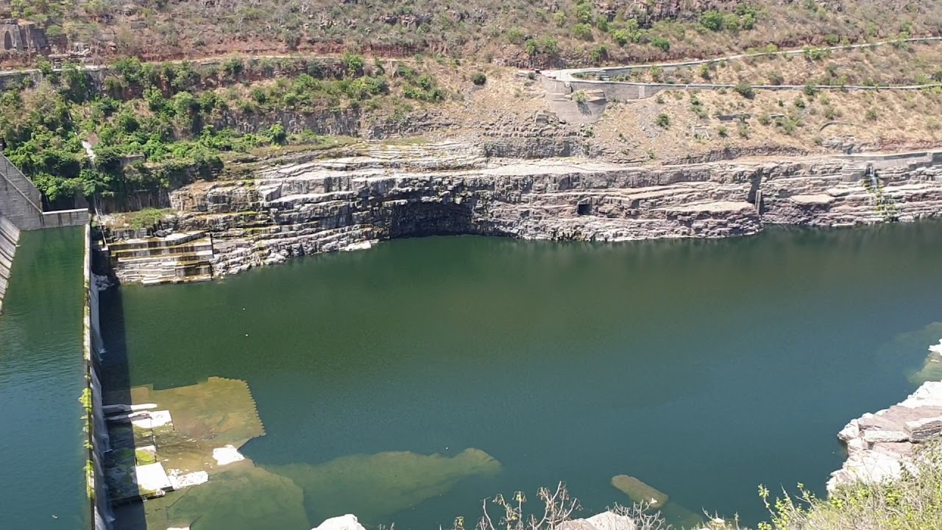
Contents:
1. | Project Background
2. | Issues related to dissipating energy
3. | Ski jet and plunge pool scour
4. | Further studies
5. | Q&A

Slide 3
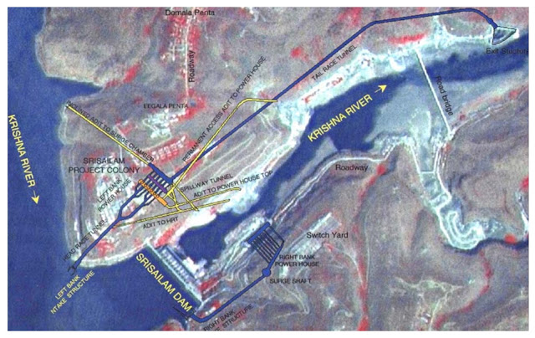
Background:
Location and layout

Slide 4
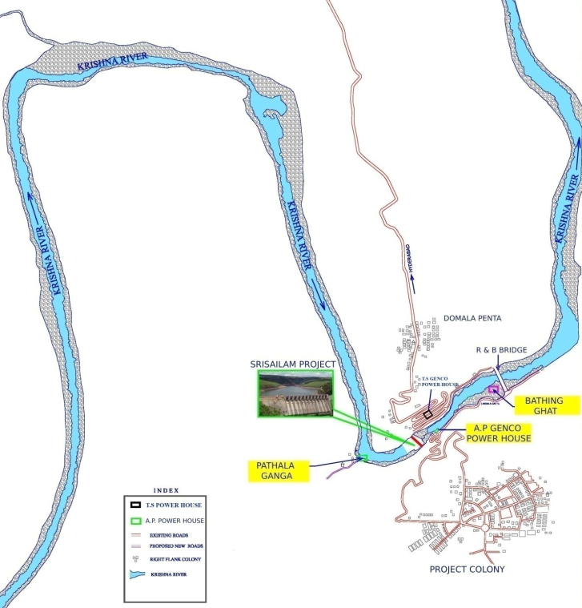
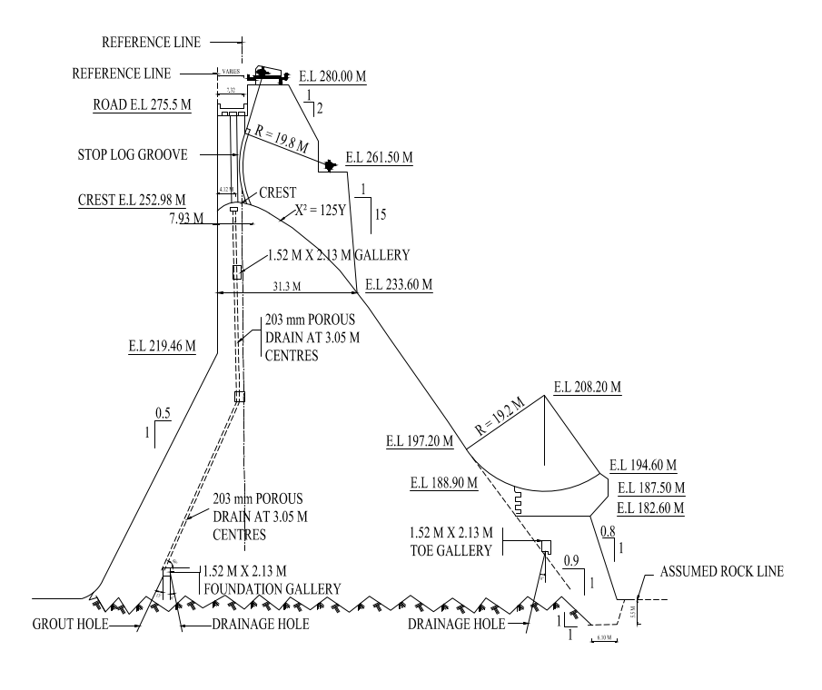
Background:
River Morphology and Typical cross section

Slide 5
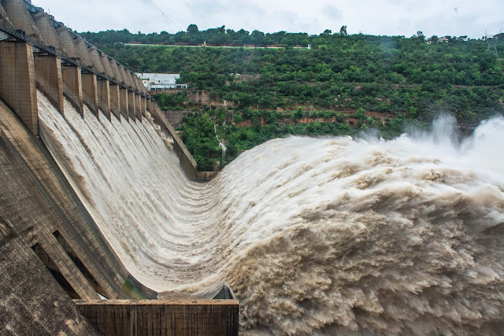
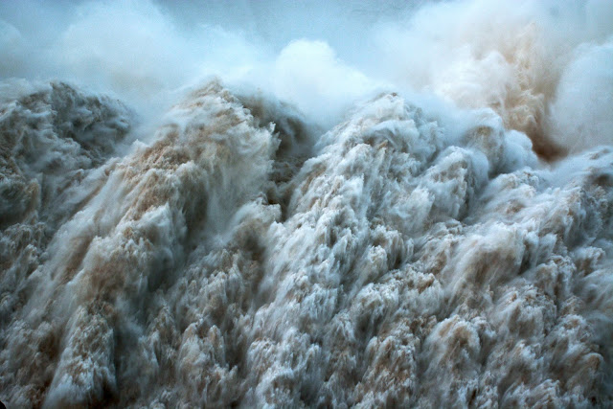
Gates opening sequence :
Sequence of gates to be opened | Sequence of gates to be opened
1 | 6
2 | 6,7
3 | 6,7,8
4 | 5,6,7,8
5 | 5,6,7,8,9
6 | 4,5,6,7,8,9
7 | 4,5,6,7,8,9,10
8 | 4,5,6,7,8,9,10,11
9 | 2,3,4,5,6,7,8,9,10
10 | 2,3,4,5,6,7,8,9,10,11
11 | 2,3,4,5,6,7,8,9,10,11,12
12 | 1, 2,3,4,5,6,7,8,9,10,11,12

Slide 6
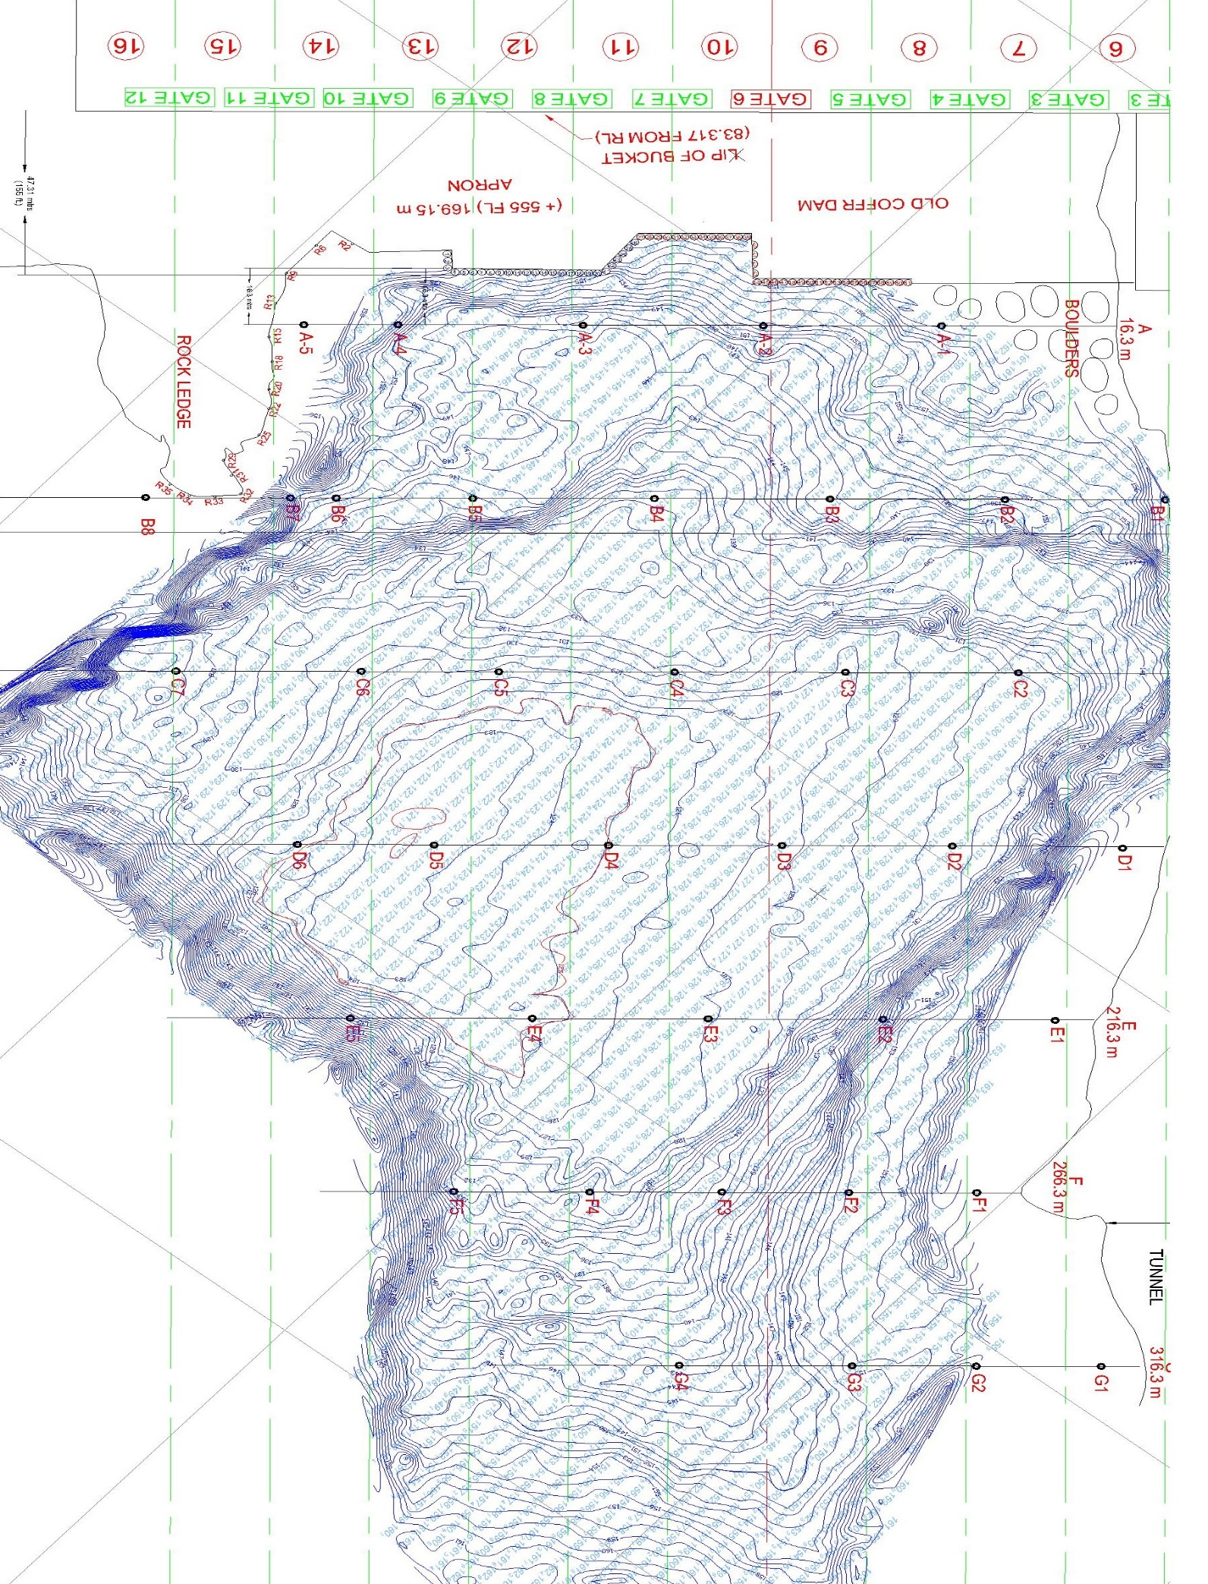
Issues in Srisaillam Dam
Apron
Plunge pool
Energy dissipation
DEEP SCOURING IN
PLUNGE POOL
APRON

Slide 7
Issues: Apron
In the detailed Bathymetric survey, it was detected that the retrogression near the cylinders was deepened by 2m to 5m.
The scours are identified at a distance of 15m from the face of the cylinder
The old coffer dam is caved and deepened nearly 3m to 5m inside.
Avoid impinging of jet on cylinders during low flows

Slide 8
Issues: Apron
cylinders have not been anchored into the deep foundation.
The base of the cylinders and the tremie concrete placed at their base have been eroded.
Scour in Cylinder 10 to 16
Protection works to ensure the safety of the existing apron.
Almost all the cylinders of old coffer dam are damaged and are to be repaired.
Cylinders at junctions due to change in alignment ie., Cylinder 26, Cylinder 16, etc., are badly damaged and rubble in the Cylinders has come out and cavities formed

Slide 9
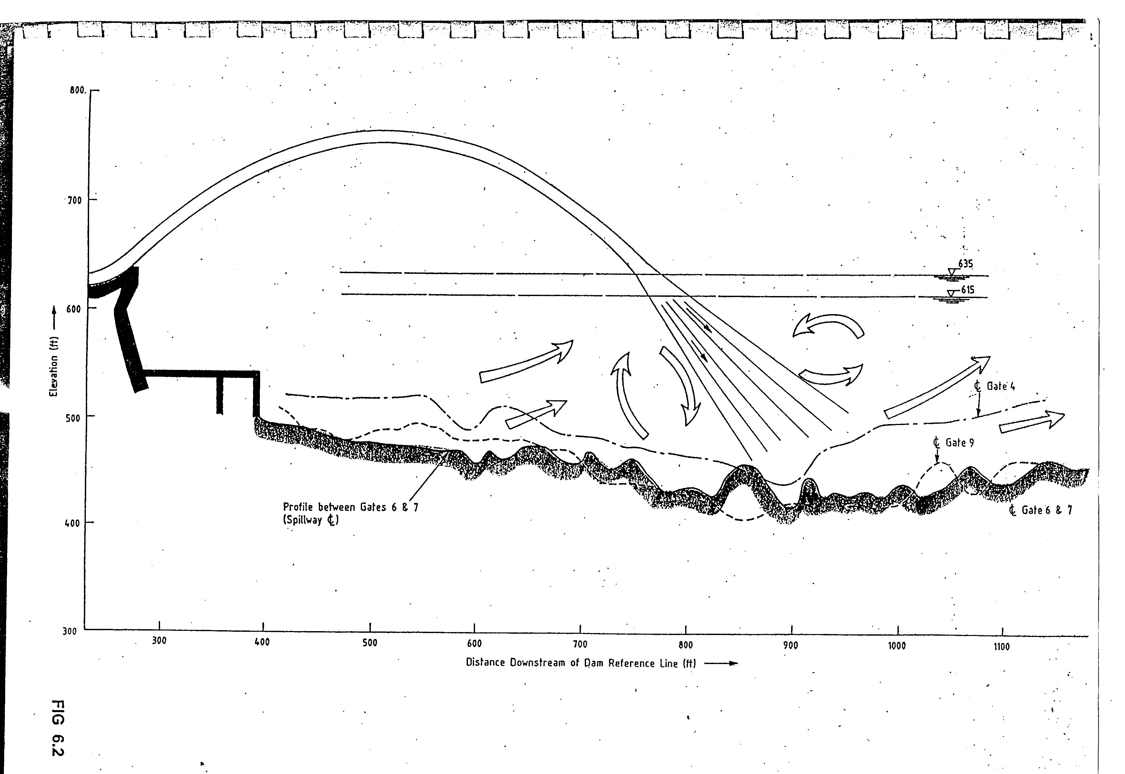
Issues: Plunge Pool
The formation of a deep plunge pool has serious safety implications for the sliding stability of the dam, stress patterns in the foundation area, and the stability of banks on either side of the river channel.
The jet moving with a high Froude number tries to lift heavier masses into turbulence to attain stability
About 300 m DS of the dam axis, on the valley floor, a 30 m diameter, 65 m deep depression
At 152.4 m downstream of the dam line, the river bed level dropped by 20 to 21.5m, forming another pool.
12 a large cavity is observed at this old coffer dam.
some portion of Tremie Concrete laid during 2002 was scoured over a period of 17 years

Slide 10
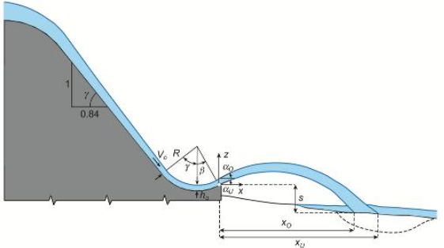
Ski jump energy dissipation:
Generic design criteria for the jet trajectories
Pressures on the flip bucket
Conditions of flow chocking (hydraulic jump) on the flip bucket
Energy dissipation as a function of the approach flow conditions (water depth ho, Froude number Fr)
The flip bucket geometry e.g., angle β (beta) and radius R
Plunge pool pre-excavation depth
Securing the plunge pool scouring

Slide 11
Ogee and chute hydraulic calculation
The routed PMF peak discharge is 43,333 m3/s based on the flood routing studies.
The rating curve of the spillway was determined based on the existing configuration e.g., the sharp-crested weir, ogee crest elevation (El), the approach channel water depth, etc.

Slide 12
Ogee and chute hydraulic calculation
The spillway rating curve was determined based on:
    The existing geometry profile of ogee
    Hydraulic contraction of the pier
    P/He ratio of the ogee
    Other head correction factor
    Using USBR Standard curves
The water surface (WS) profile of the ogee and chute was calculated based on step method using a water surface profile model.

Slide 13
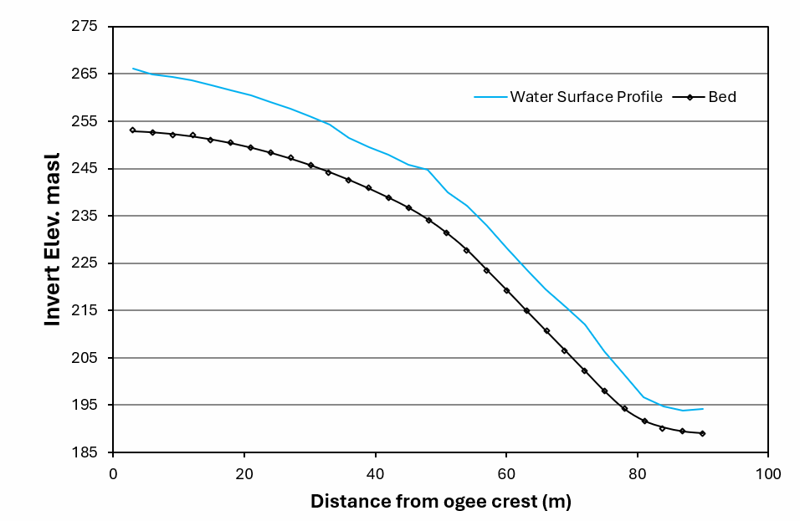
Spillway parameters and Chute profile :
Routed PMF peak discharge =43,333 m3/s
Parameter | Unit | Value | Description
Q (PMF) | m^3/s | 43,333 | The routed peak discharge of the PMF as per flood routing report
The river bed El | masl | 154.0
Ogee Sill El | masl | 253.0
P - Depth of Ogee | m | 98.98
Nos of gates |  | 12.00
Width of Gate - W | m | 18.30
P/H0 |  | 4.77
C0 | m^0.5/S | 2.18 | Sharp crested ogee discharge coefficient based on P/H0
Max. Head (H0) | m | 20.74
Max El of the reservoir | masl | 273.7
Ha- velocity head at approach | m | 0.1
Water surface profile from ogee to bucket

Slide 14
Cavitation index:
Cavitation is defined as the formation of a gas and water vapor phase within a liquid resulting from excessively low localized pressures.
The existence and extent of cavitation damage are dependent upon:
    the boundary shape
    the damage resistance characteristics of the boundary
    the flow velocity
    the flow depth
    the elevation of the structure above sea level
    length of time the cavitation occurs.

Slide 15
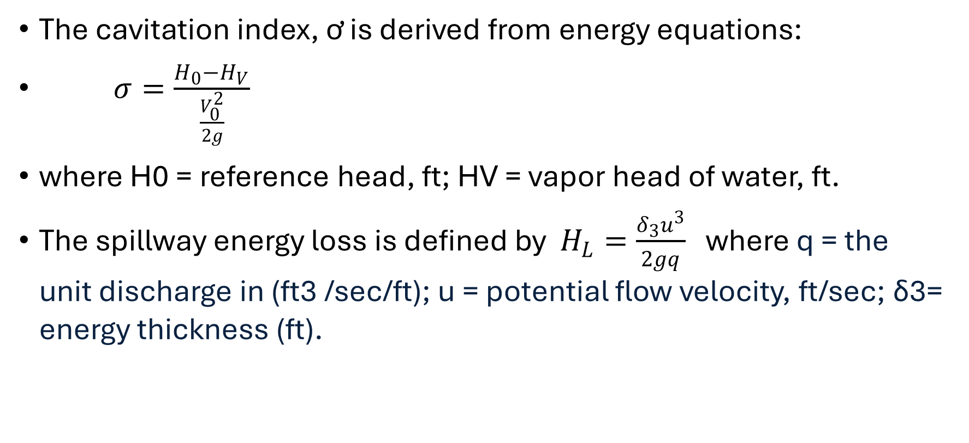
Cavitation index:
The cavitation index, ơ is derived from energy equations:
$σ=\frac{H_{0}−H_{V}}{\frac{V_{0}^{2}}{2g}}$
where H0 = reference head, ft; HV = vapor head of water, ft.
The spillway energy loss is defined by $H_{L}=\frac{δ_{3}u^{3}}{2gq}$ where q = the unit discharge in (ft3 /sec/ft); u = potential flow velocity, ft/sec; ẟ3= energy thickness (ft).

Slide 16
Cavitation index on the Chute and Bucket
The cavitation index (Flow Sigma, σ) is below 0.2 and above 0.1 at stations Nos 39, 81, and 84 for PMF discharge.
The index is more than the threshold limit of 0.1 in all stations.
Aerators are not needed for cavitation as per USBR recommendations.

Slide 17
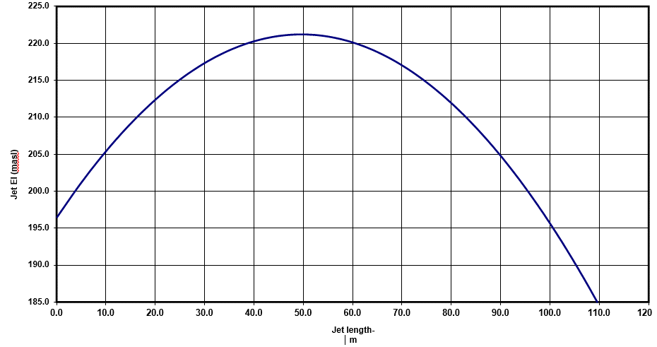
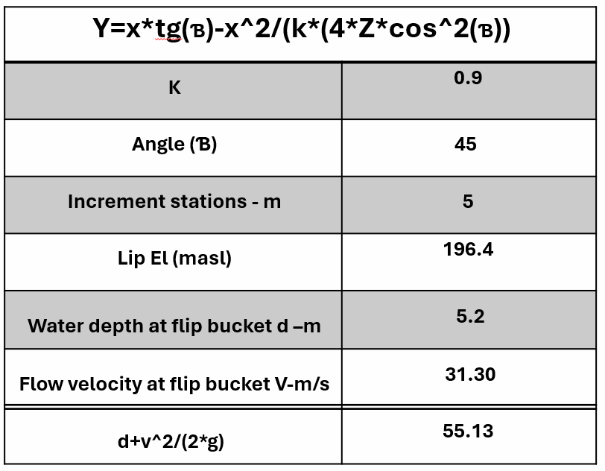
Y=x*tg(Ɓ)-x^2/(k*(4*Z*cos^2(Ɓ))
K | 0.9
Angle (Ɓ) | 45
Increment stations - m | 5
Lip El (masl) | 196.4
Water depth at flip bucket d –m | 5.2
Flow velocity at flip bucket V-m/s | 31.30
d+v^2/(2*g) | 55.13
Free-falling jet calculation
The spillway chute leads to a flip bucket, which has been used as an energy dissipater of the released flow
The flip bucket angle had been designed previously at 45 degrees at the beginning, and its radius is 19.2 m for all bays.
Jet length and height
Jet profile parameters
Discharge: PMF=43,333 m3/s
Jet length: 110 m
Jet height ~25 m from the flip bucket outlet

Slide 18
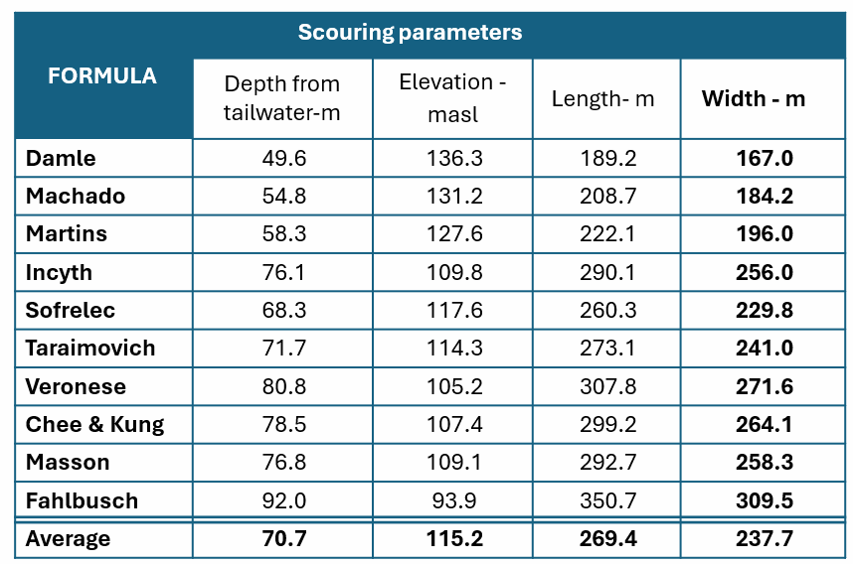
Plunge Pool Scour Depth calculation
Plunge pool scour depth based on empirical formulas
Parameter | Value
Design discharge | PMF
Total Flow (m3/s) | 43333.0
Unit Discharge (m2/s) | 162.60
Bucket Flow Depth (m) | 5.200
Width of jet at plunge pool (m) | 266.5
M.W.L. (masl) | 271.27
T.W.L. (masl) | 185.93
Apron Elevation (masl) | 154.50
D90 (m) | 1.00
D50 (m) | 0.50
Head drop from reservoir level to tailwater level (H) –m | 85.34
Tailwater depth above apron (h) –m | 31.43
Average scour depth is ~ 71 m from the Tailwater
The scour depth is 39.3 m from the dam toe
The current plunge pool's minimum level is 10 m above the PMF's scouring level
The potential scouring could be critical for the dam safety

Slide 19
Recommendations for further studies
Bathymetric survey of plunge pool area
Geotechnical assessment of the plunge pool
Reservoir routing studies
Geo Physical survey for the cylinders and apron area
Underwater Videography and Photography of the upstream face of the dam.
Geological studies of existing left and right flanks
Computational Fluid Dynamics 3D modeling for the spillway

Slide 20

THANK YOU

Slide 21
Y=x*tg(Ɓ)-x^2/(k*(4*Z*cos^2(Ɓ))
K | 0.9
Angle (Ɓ) | 45
Increment stations - m | 5
Lip El (masl) | 196.4
Water depth at flip bucket d –m | 5.2
Flow velocity at flip bucket V-m/s | 31.30
d+v^2/(2*g) | 55.13

Slide 22
Parameter | Value
Design discharge | PMF
Total Flow (m3/s) | 43333.0
Unit Discharge (m2/s) | 162.60
Bucket Flow Depth (m) | 5.200
Width of jet at plunge pool (m) | 266.5
M.W.L. (masl) | 271.27
T.W.L. (masl) | 185.93
Apron Elevation (masl) | 154.50
D90 (m) | 1.00
D50 (m) | 0.50
Head drop from reservoir level to tailwater level (H) –m | 85.34
Tailwater depth above apron (h) –m | 31.43
FORMULA | Scouring parameters
 | Depth from tailwater-m | Elevation - masl | Length- m | Width - m
Damle | 49.6 | 136.3 | 189.2 | 167.0
Machado | 54.8 | 131.2 | 208.7 | 184.2
Martins | 58.3 | 127.6 | 222.1 | 196.0
Incyth | 76.1 | 109.8 | 290.1 | 256.0
Sofrelec | 68.3 | 117.6 | 260.3 | 229.8
Taraimovich | 71.7 | 114.3 | 273.1 | 241.0
Veronese | 80.8 | 105.2 | 307.8 | 271.6
Chee & Kung | 78.5 | 107.4 | 299.2 | 264.1
Masson | 76.8 | 109.1 | 292.7 | 258.3
Fahlbusch | 92.0 | 93.9 | 350.7 | 309.5
Average | 70.7 | 115.2 | 269.4 | 237.7

Slide 23
Instructions:
All presenters at ICOLD 2024 are prompted to use this template for presentations. Please do not alter font or background.
Use slide #2 (First page) as start page and insert a heading for your presentation and name of presenter/author(s).
  Do not delete or alter the top left corner text box. It will be used by the organizing committee for session number.
Use slide #3 for further.
Use slide #4 (Last page) as the last slide in the presentation.
Delete this slide with instructions.

