Slide 1

Guideline for Safe Placement of Hydraulic Power Packs & Control Rooms at Dam
AKHILESH KUMAR HM EXPERT DRIP II & III, INDIA

Slide 2
Contents:
1. Introduction
2. Purpose
3. Technical Considerations
4. Hydraulic Power Pack
5. Control Room Design
6. Automatic Reservoir Monitoring & Control
7. Architectural Requirements
8. Conclusion

Slide 3
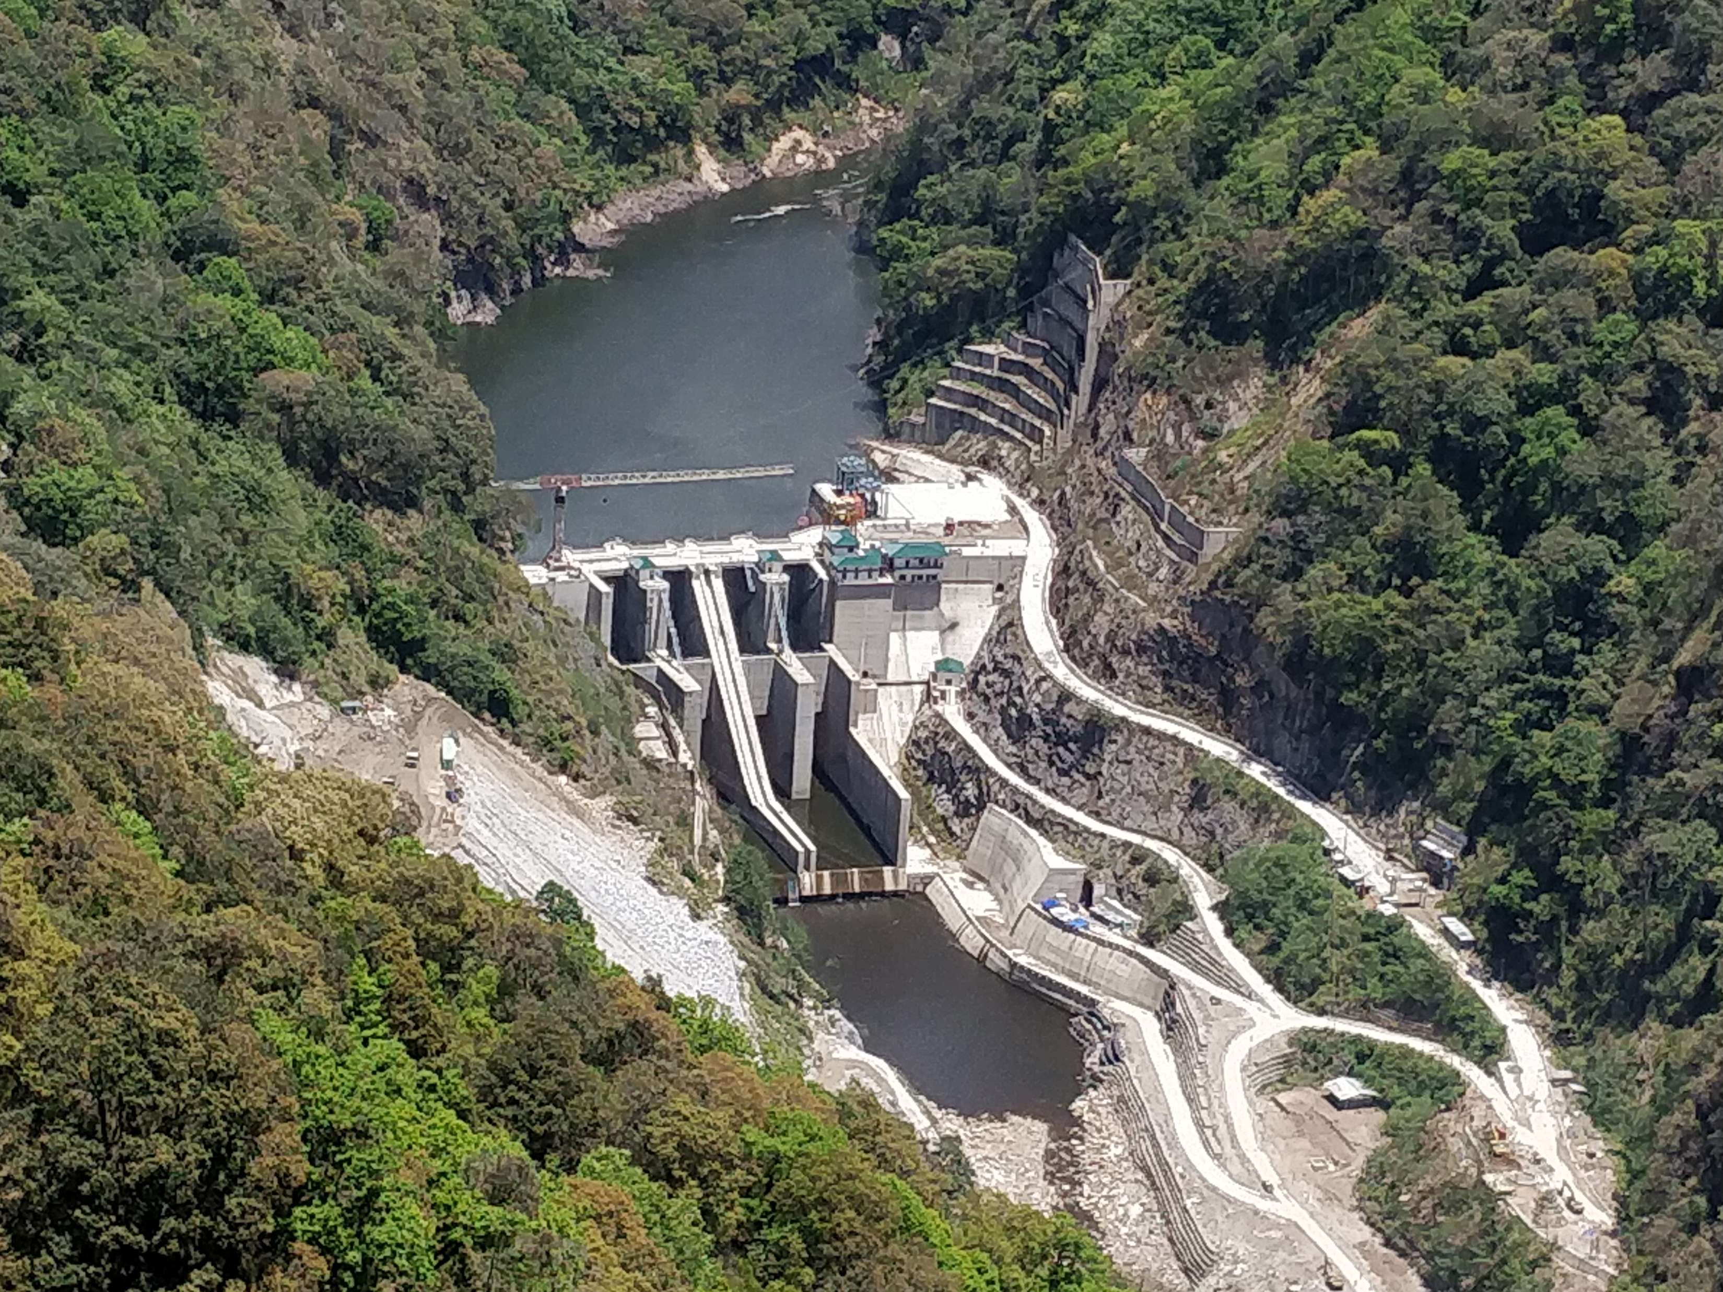
INTRODUCTION
Dams are essential for irrigation, flood control, hydropower generation, and drinking water supply. India has seen significant growth in dam infrastructure post-independence.
This presentation outlines guidelines for safe placing of hydraulic power packs and control rooms in dam environments under the DRIP II initiative.

Slide 4
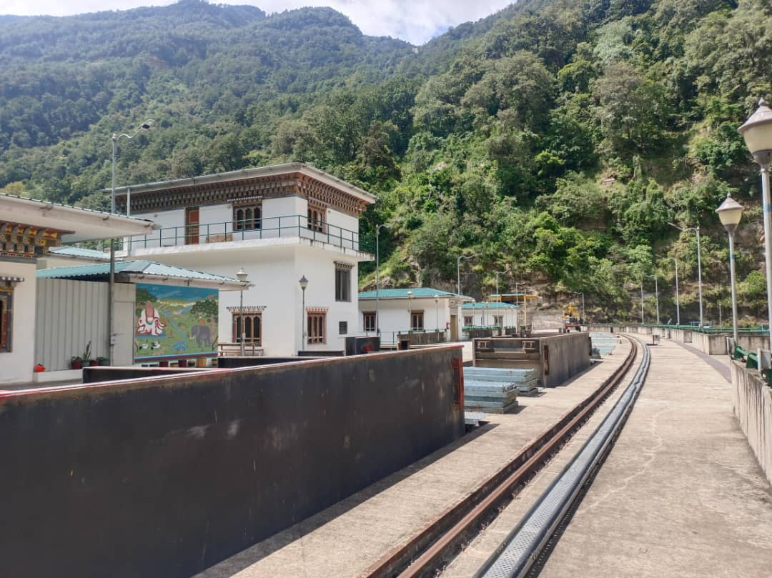
PURPOSE
Aims to maximize redundancy to handle flood hazards and adverse conditions.
Acclimating dam owner for ensuring safety and operability of Dam.
Relook for dam facility in Hilly reason with diurnal storage for Hydro Electric Power Scheme

Slide 5
TECHNICAL CONSIDERATIONS
Spillway Radial gates regulate incoming flow and ensuring reservoir capacity and Level.
Operable locally or remotely via local control panels or computer systems.
Since 1980s, hydraulic hoists have been preferred for reliability ,maintenance free & ease of use.
Hydraulic systems offer greater precision , operational efficiency and suited to partial opening.

Slide 6
CONT…
SAFETY MEASURES
Redundant pumps and motors ensure the components working in variable temperature conditions.
Selection of suitable Hydraulic fluid as per location.
SYSTEM SPECIFICATIONS
Components must be durable and reliable.
Systems should corrosion-resistant, conforming to DIN/BIS standards.
Placing of Piping on noise-proofing pads.

Slide 7
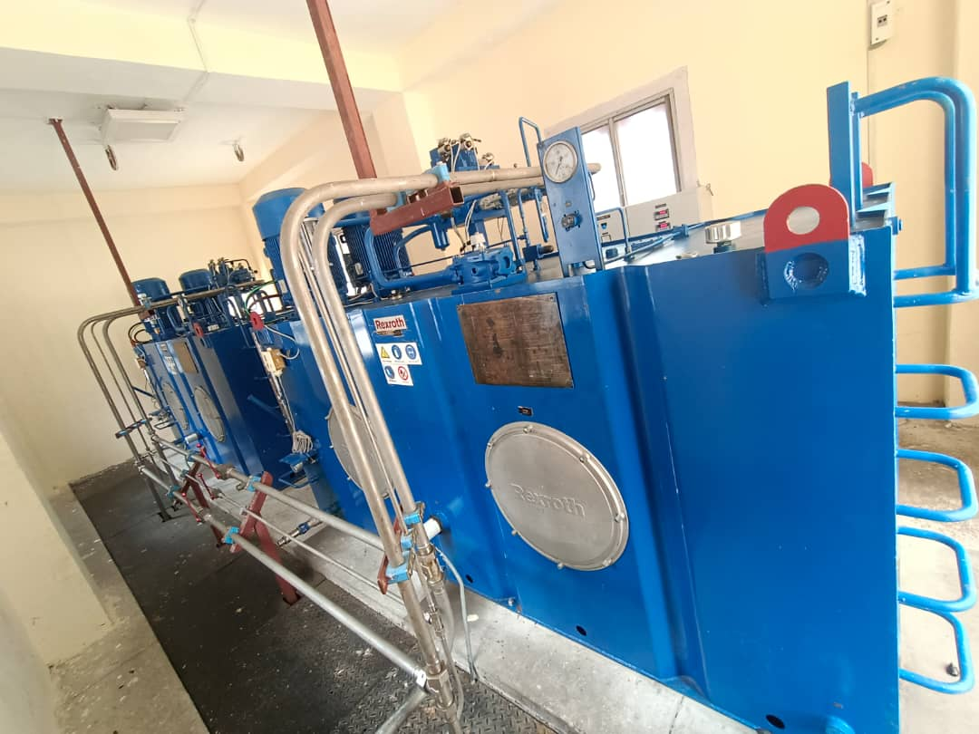
COMPONENTS OF HYDRAULIC HOIST
Hydraulic Cylinders
Hydraulic Power Pack
Local Control Panel
Piping and HosesSafety Features
Mounting Frame
Hydraulic oil (Energy carrier)

Slide 8
HYDRAULIC POWER PACK DESIGN AND OPERATION
Components
Includes a reservoir, PD pumps, motors, control valves, gauges, and filters. They are designed for operational fluid systems.
Flexible Connections & Fluid Tank
Ryan Braided Rubber Hoses rated for 20MPA.
Stainless steel hydraulic fluid tank.
Piping and Fittings
Stainless steel piping with noise-proofing clamps. Socket-welding type fittings and welded-neck flanges are used.
Cleanliness and Maintenance
Systems must be clean and free of foreign matter. Flushing and chemical cleaning are required before use.

Slide 9
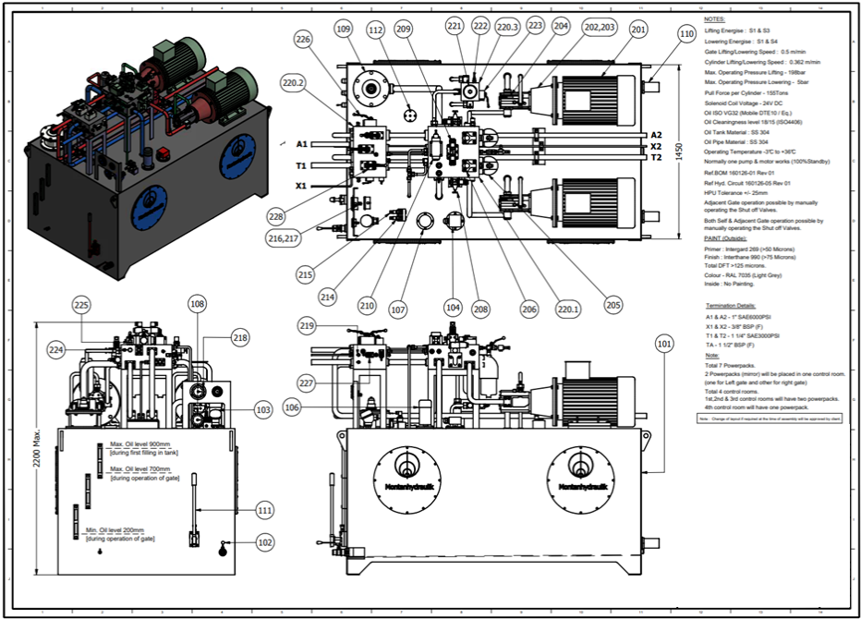
SCHEMATIC DIAGRAM OF POWER PACK

Slide 10
Design & Engineering of Control-Room
Operator Safety and Layout
Control rooms must prioritize safety, visibility, and accessibility. Comprehensive layout for ease of operation and provision for future expansion.
Environmental Controls
Temperature regulation and adequate illumination.
include auxiliary facilities like kitchens and toilets.
Remote Operation
OPC media and SCADA systems for remote operation. Internet and OFC for remote monitoring

Slide 11
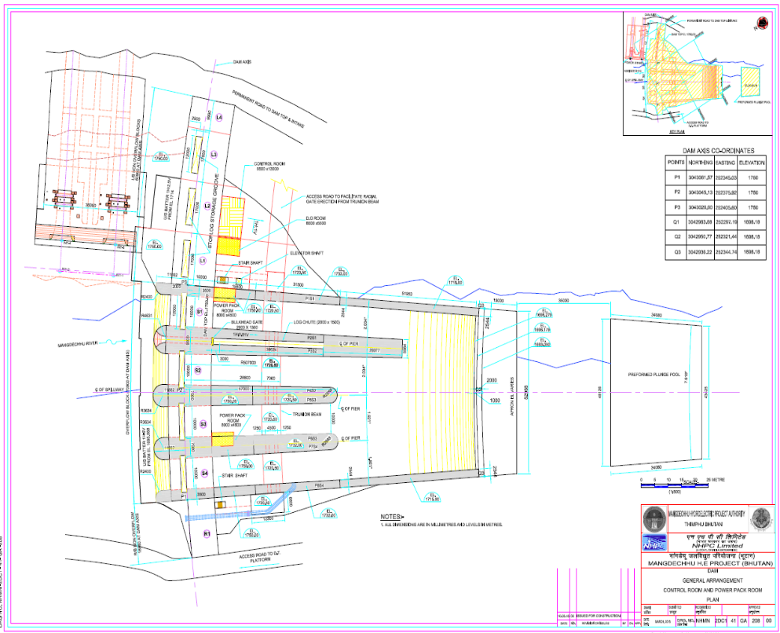
Schematic diagram of Control Room & Powerpack
Control Room
Power pack Room

Slide 12
Automatic Reservoir Monitoring & Control
ARMAC Equipment
Remote Control Systems
Computerized systems for spillway radial gate operation. Includes radar type level measuring devices, monitors, CPU and alarms.
Data Monitoring
Monitoring of reservoir level, flow rate, gate position, and discharge trends. Alarms and events tracking.
Modes of Operation
Local, remote semi-auto, and remote auto modes for gate operation.
Emergency Features
Redundancy for signal transmission and remote operation in emergencies.
Dedicated communication by walkie talkie.

Slide 13
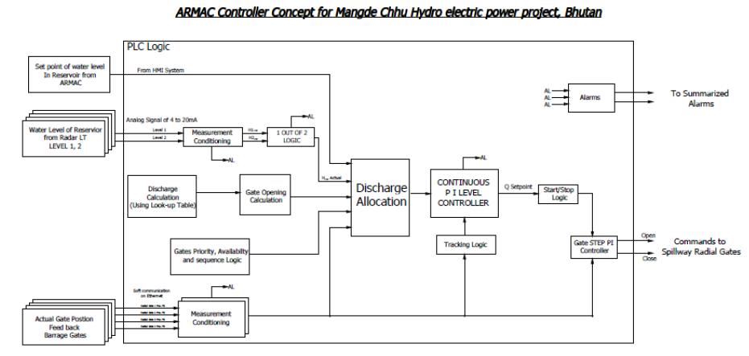
ARMAC CONTROLLER CONCEPT

Slide 14
Architectural Requirements
Dam Control Room Placement
Location and Accessibility
The control room should be adjacent to the dam structure on non-overflow blocks, Accessible via all-weather roads, Concrete steps in slope and ropeway systems for access.
Human Factor Considerations
Design should minimize human error with perfect Man Machine Control
Adequate access, emergency exit, and operational links.

Slide 15
Architectural Requirements Dam Control Room Placement
Temperature and Lighting
Comfortable temperatures (18.3-20.0 °C) and proper lighting (500-800 lux). No perceptible lighting flicker.
Extended Control Room at Dam Colony
The operability access from main control room to Dam colony . Accessibility shall be provided by OFC cable and similar equipment as of placed main control room.

Slide 16
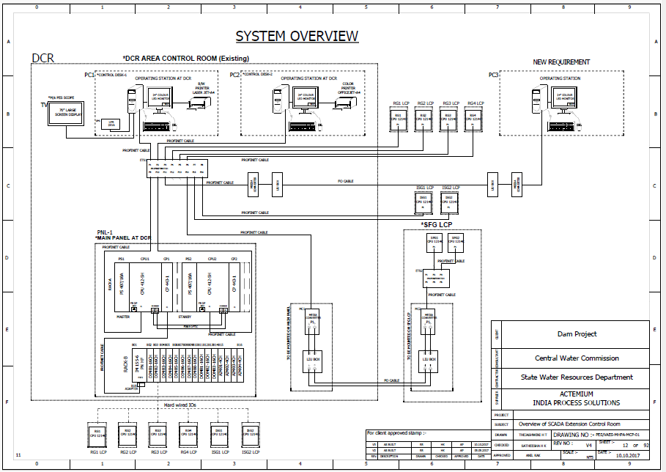
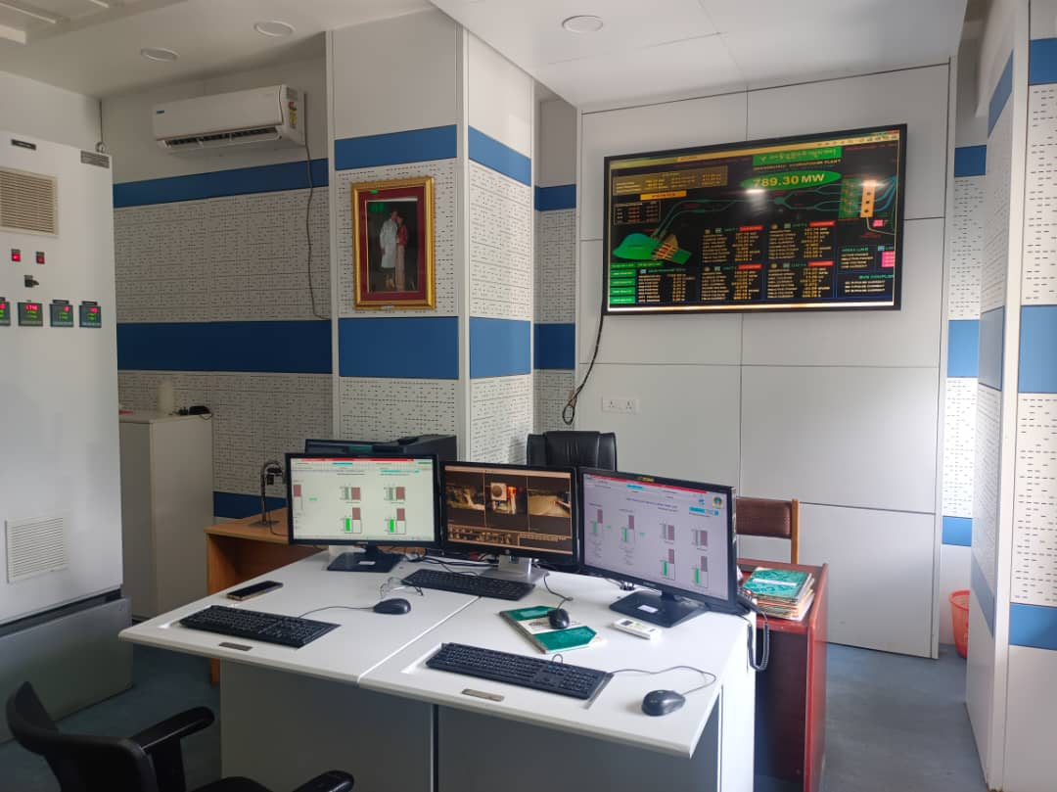
Typical Overview of Extended Control Room

Slide 17
Spillway Radial Gates - Key Points
Control: Can be operated manually, electrically, or hydraulically, either locally or remotely.
Advantages: Efficient water regulation, reduced hoisting force due to radial design, and suitable for large discharges.
Maintenance: Requires regular inspection of seals, bearings, and hoisting systems to ensure functionality.

Slide 18
Operation Modes of Spillway Radial Gates
Local Mode
Gate operation is managed directly at the site using local control panels located near adjacent power pack.
Remote - Semi Auto Mode
Gates are controlled remotely from a control room with manual inputs, allowing partial automation for specific operations.
Remote - Auto Mode
Fully automated control from a control room, with the gate operation managed by a computer system based on predefined parameters.

Slide 19
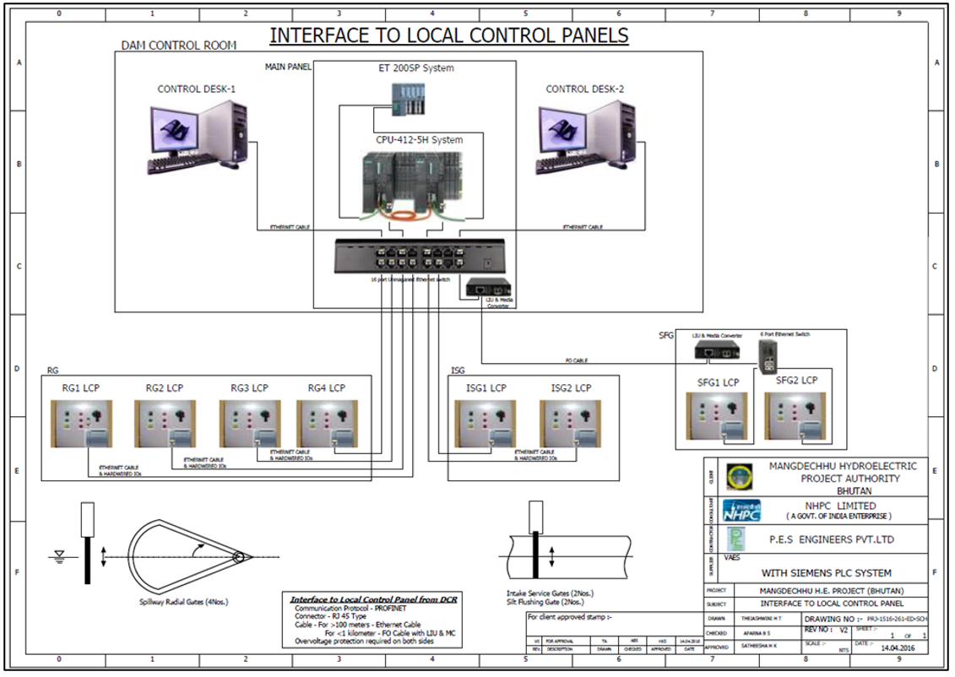
Manual mode operation
Manual mode of operation, continuously monitor the Reservoir level and flow of the water on the screen the select the gates manually from the operator screen.
make a decision to operate the gates. i.e., to open further or to close. based on reservoir level

Slide 20
Conclusion for Adoption of Guidelines
Control Room & Power Pack Location: Ensure placement at the dam top for safety from hazards such as PMF, unprecedented floods, landslides.
Emergency Operations: Provide an extended control room at the dam colony for access of engineer in-charge for emergency management.
Guidance Display: Display operation and maintenance instructions inside the control room for operator guidance, including gate opening sequences, discharge, and water levels

Slide 21
Conclusion for Adoption of Guidelines
Operator Roster: Maintain an 8-hour shift roster for reliable working hours of operators/supervisors.
Communication Access: Ensure easy access to operators and remote machine control via optical fiber/internet.
System Monitoring: Allow operators to freely update the hourly system status.
Inspection Visits: Restore monthly inspection visits to the dam site for rectifying management issue, technical issue and repair.

Slide 22
Conclusion for Adoption of Guidelines
Spare Parts Availability: Keep spare parts, fuses, tools, and repair equipment readily available in the control room mini-store.
Documentation: Maintain a library with all drawings, manuals, and vendor contact details in the control room.
Vendor Contact: Contact vendors for power pack malfunctions.
Cylinders : Design new cylinders in line with the relocated power pack at the dam top if replacement is needed.

Slide 23
Conclusion for Adoption of Guidelines
SCADA System:
  For dams with a SCADA system, extension counters at residence place from main dam control room using electronic equipment and OFC cable.
  For dams without a remote operation control room, institute a SCADA system or the starter on/off switch at a control room for gate operation during emergencies.
Power Pack Relocation: Consider shifting of power packs from below the deck level to the dam top, with an estimated cost of ₹15 lakhs per gate (excluding civil work) for piping and attachments.

Slide 24

THANK YOU

