Slide 1

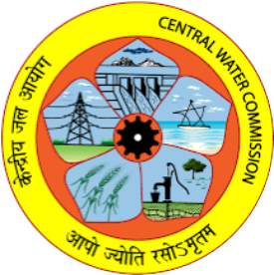
Single Catchment Delineation using ArcGIS
Vijay Singh Meena,
Deputy Director
Central Water Commission

Slide 2
Catchment Parameter Estimation using Arc GIS
To calculate:
1 Catchment Area
2 Longest flow Path
3 Centroidal Length
4 Slope

Slide 3
Selection of SRTM File
LONGITUDE
60 - 65 E | 49
65 - 70 E | 50
70 - 75 E | 51
75 - 80 E | 52
80 - 85 E | 53
85 - 90 E | 54
90 - 95 E | 55
95 - 100 E | 56
LATITUDE
5 - 10 N | _11
10 - 15 N | _10
15 - 20 N | _09
20 - 25 N | _08
25 - 30 N | _07
30 - 35 N | _06
Project Location:
Longitude 76° 42’ 23.10” E
Latitude 10° 13’ 18.85” N

Slide 4
Selection of SRTM File
E.g. Idamalayar Dam
Project location is 76° 42’ 23.10” E and 10° 13’ 18.85” N
Longitude is between 75 E to 80 E
Latitude is between 10 N to 15 N
So SRTM File to be used is 52_10

Slide 5
Make a Project folder
Let’s Start !!!
Make the project folder and paste relevant SRTM file in it.
Connect this SRTM File and assign it proper coordinate system as described in next steps.

Slide 6
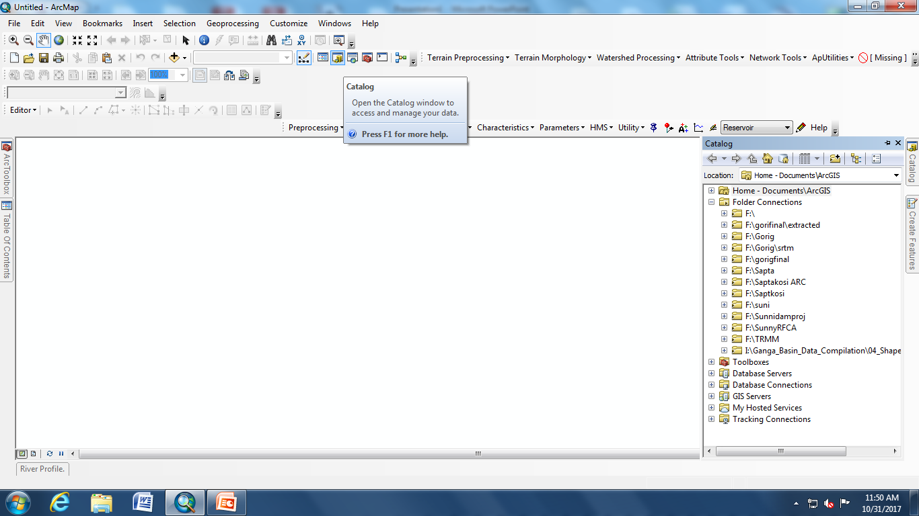
Catalog to Connect to Folder
Arc GIS interface

Slide 7
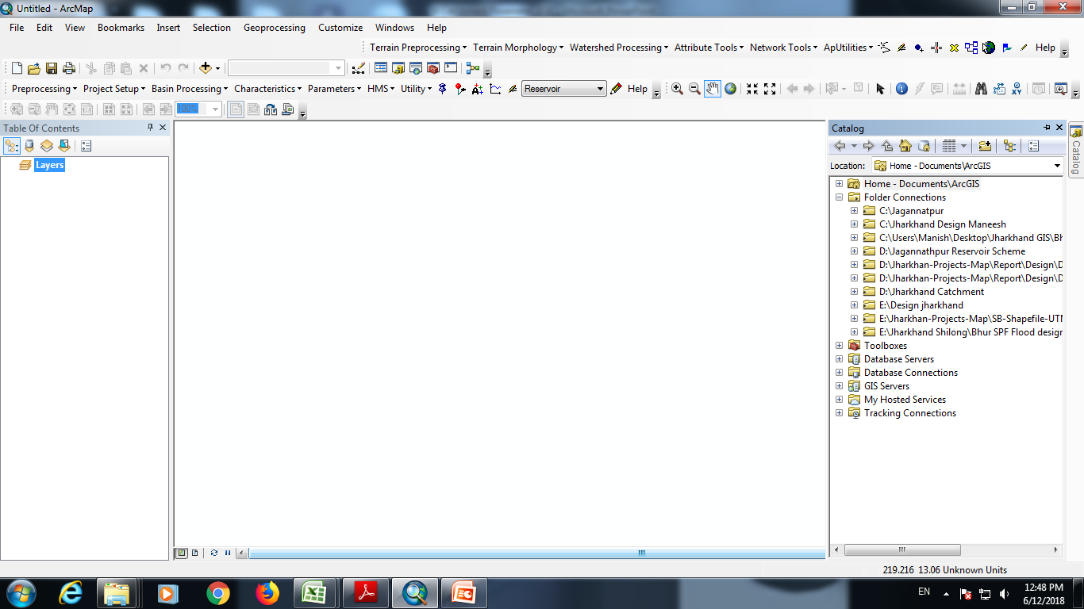
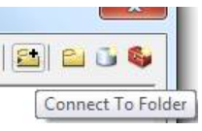
Adding the Project Folder
Using

Slide 8
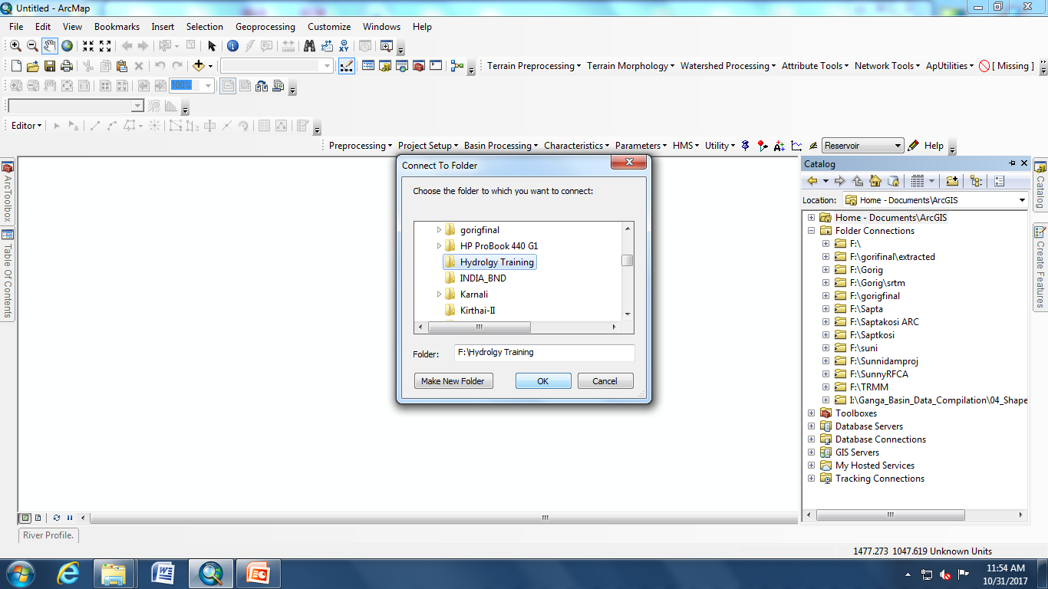
Folder Connection Step
Select the folder created for the project

Slide 9
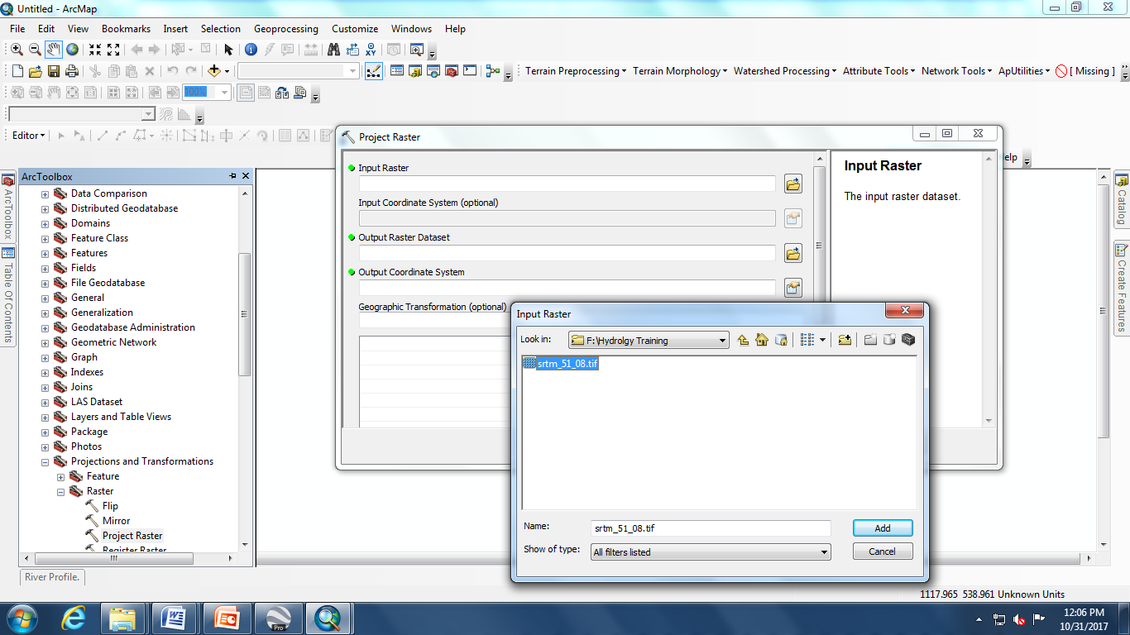
Connect to Projects SRTM File
(Data Management Tools->Projection & Transformations->Raster->Project Raster
Provide projection to the SRTM file

Slide 10
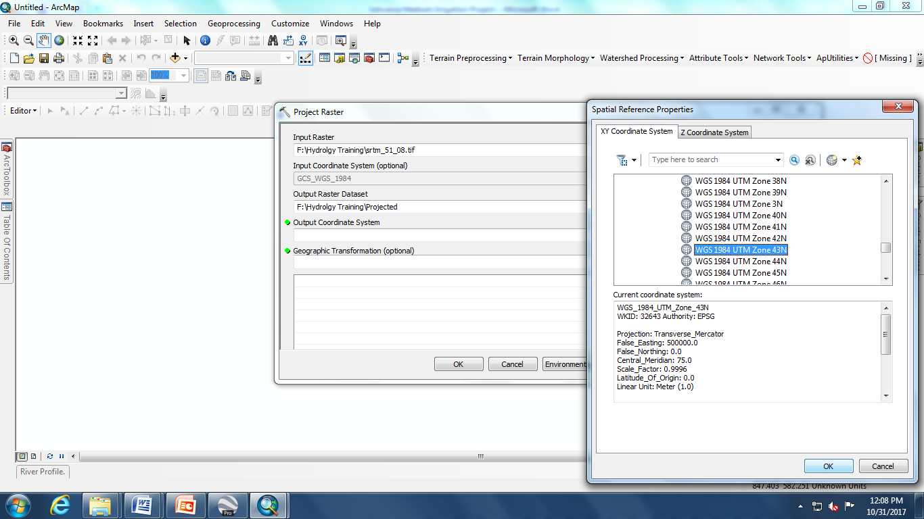
Add OUTPUT COORDINATE SYSTEM
Select UTM zone Using the Table below
Longitude/ Easting | UTM Zones
60 - 66 E | 41 N
66 - 72 E | 42 N
72 - 78 E | 43 N
78 - 84 E | 44 N
84 - 90 E | 45 N
90 - 96 E | 46 N

Slide 11
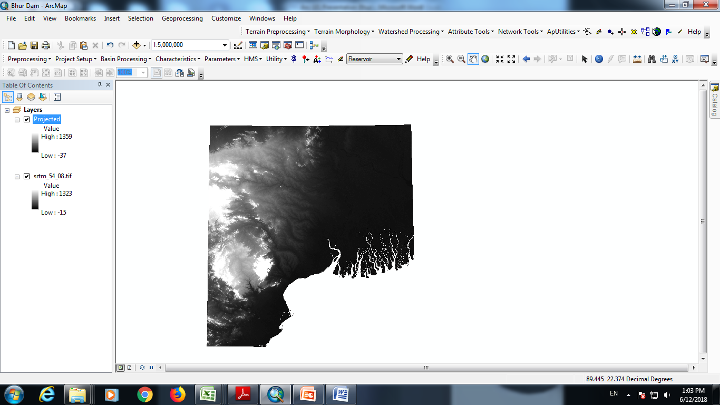
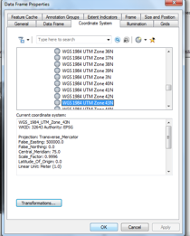
Check Coordinate System(Right Click->Data Frame Properties)
Check whether SRTM projected or not.
Rt. Click Data Frame Property Coordinate System

Slide 12
Check whether coordinate system assigned successfully, if not reassign the same
Save the work with relevant project name

Slide 13
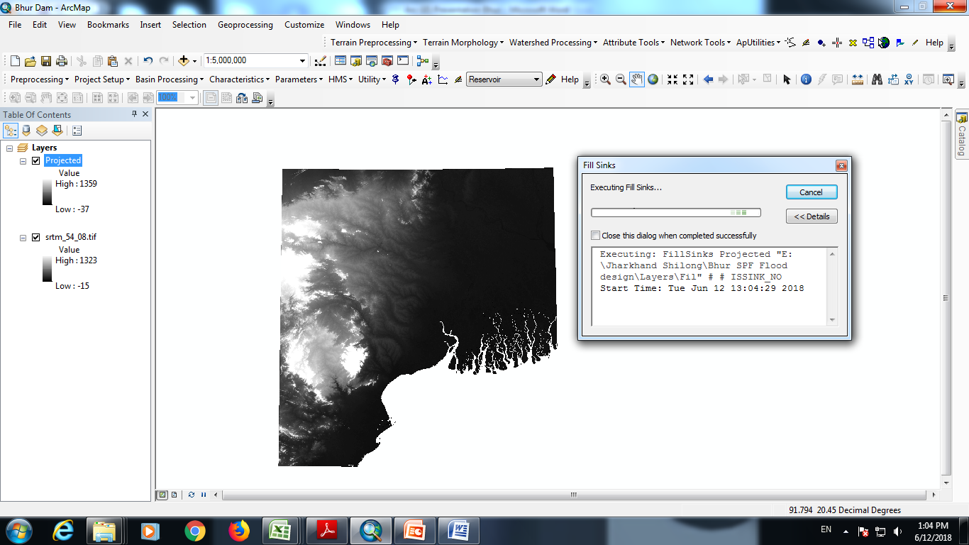
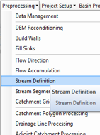
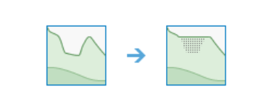
Perform the PREPROCESSING STEPS ( Fill Sinks to Adjoint Catchment Processing)-Fill sink
A sink is a cell with an undefined drainage direction; no cells surrounding it are lower.

Slide 14
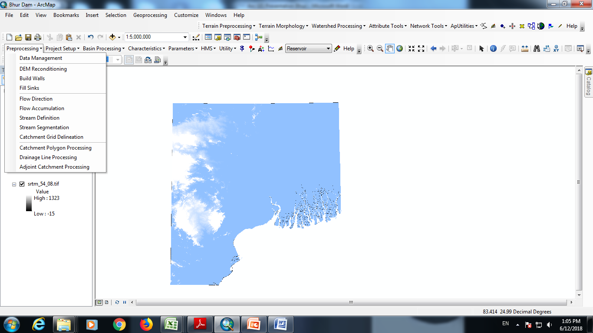
Fill Sink completed
After Completion of Fill sink step, DEM color changes as shown

Slide 15
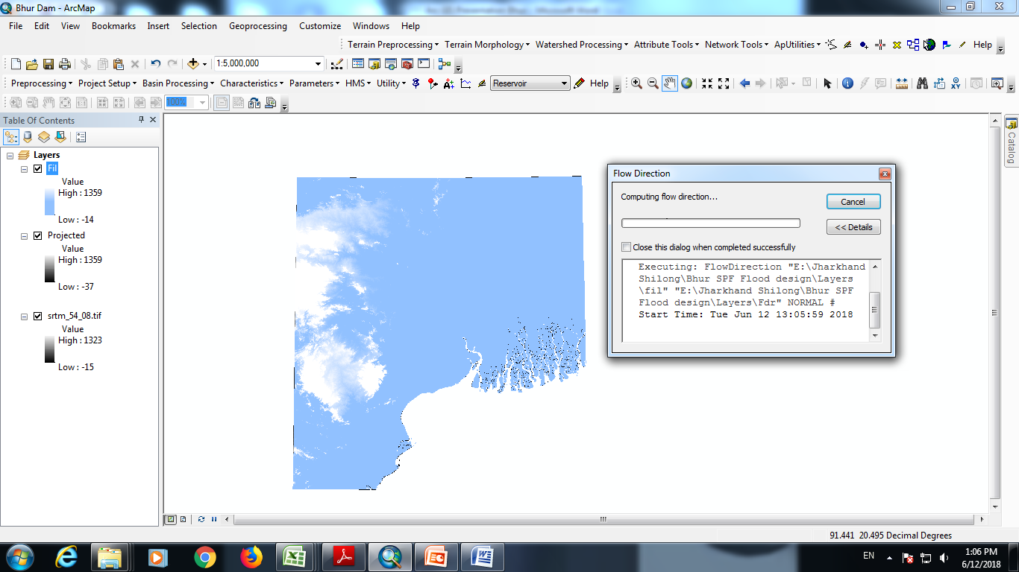
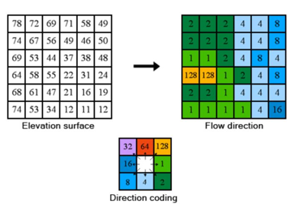
Flow Direction computations
The D8 flow method models flow direction from each cell to its steepest downslope neighbor.

Slide 16
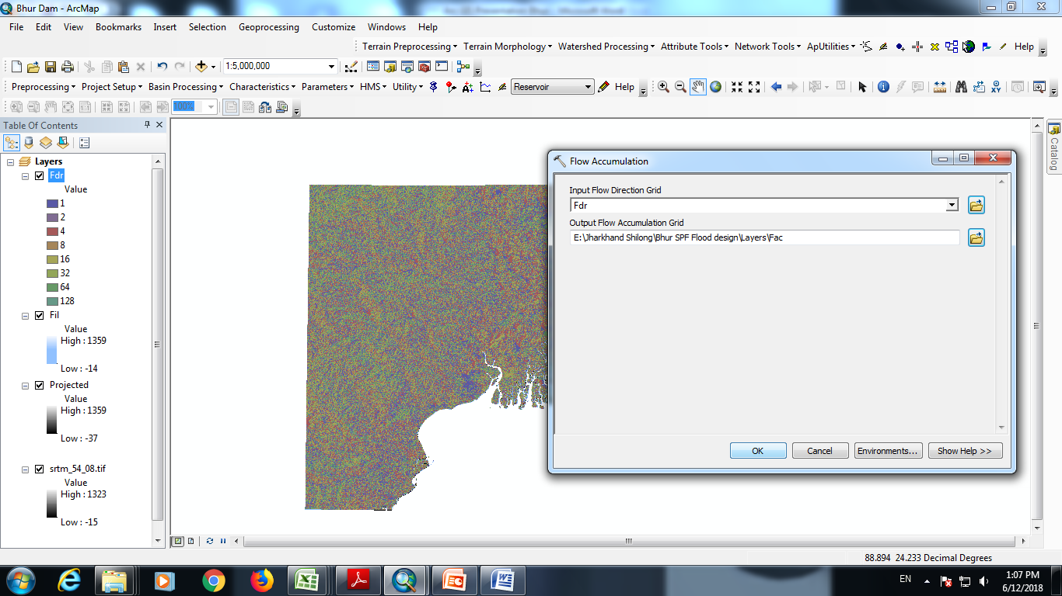
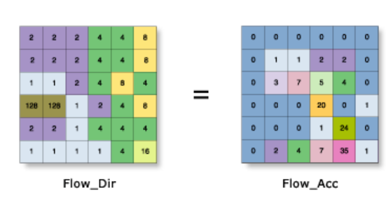
Flow Accumulation computations
The result of Flow Accumulation is a raster of accumulated flow to each cell, as determined by accumulating the weight for all cells that flow into each downslope cell.

Slide 17
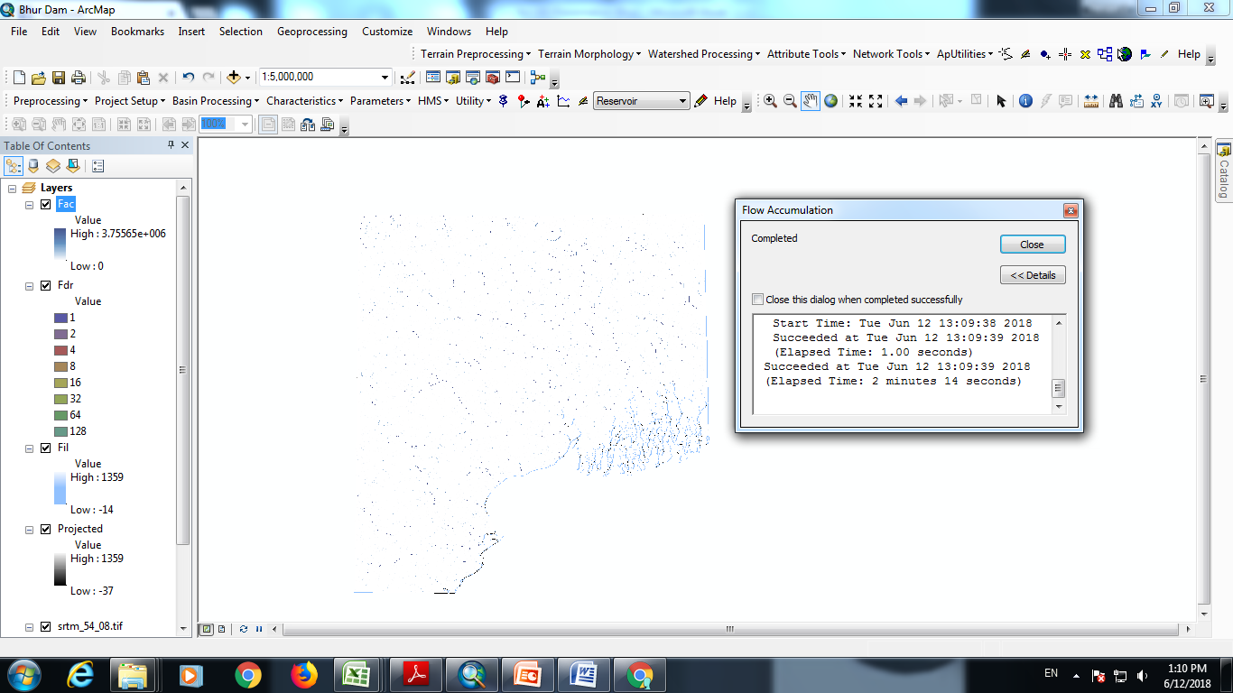
Flow Accumulation computations

Slide 18
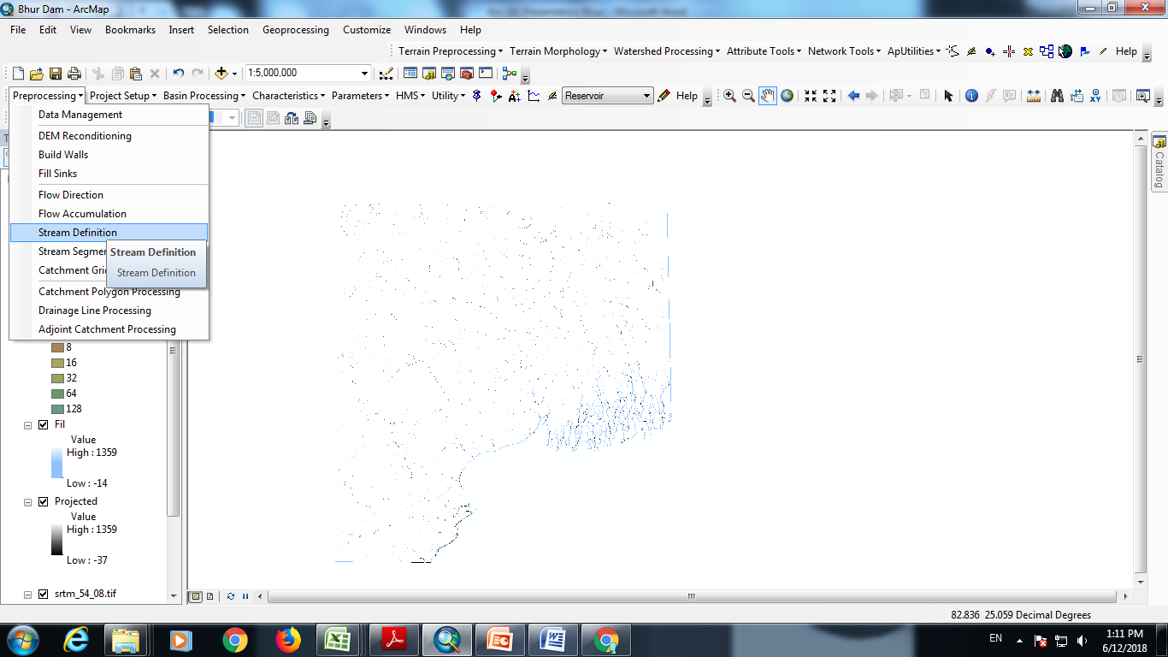
Stream definition
In this step we provide condition (Area or No. of cells contributing) to define a stream.

Slide 19
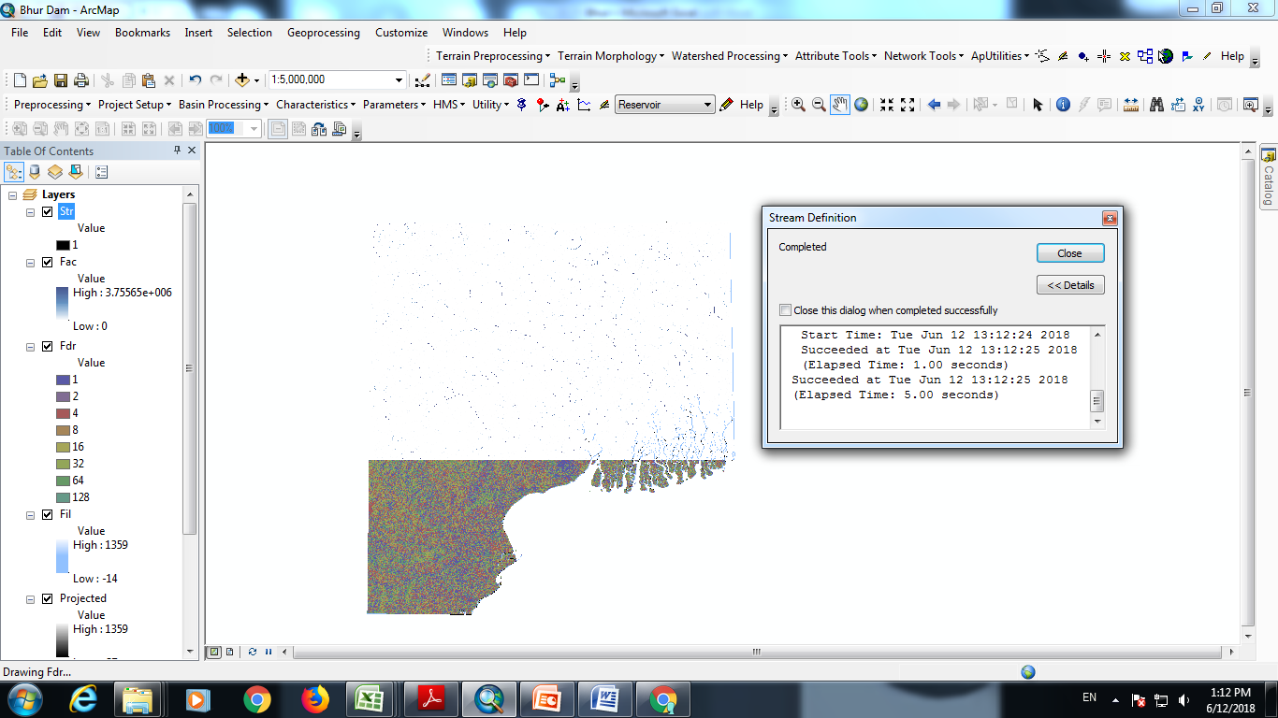
Stream definition completed

Slide 20
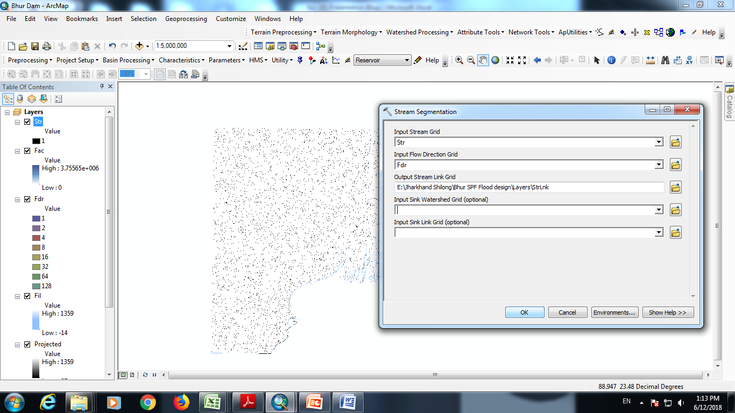
Stream segmentaion
Assigns unique values to sections of a raster linear network between intersections.

Slide 21
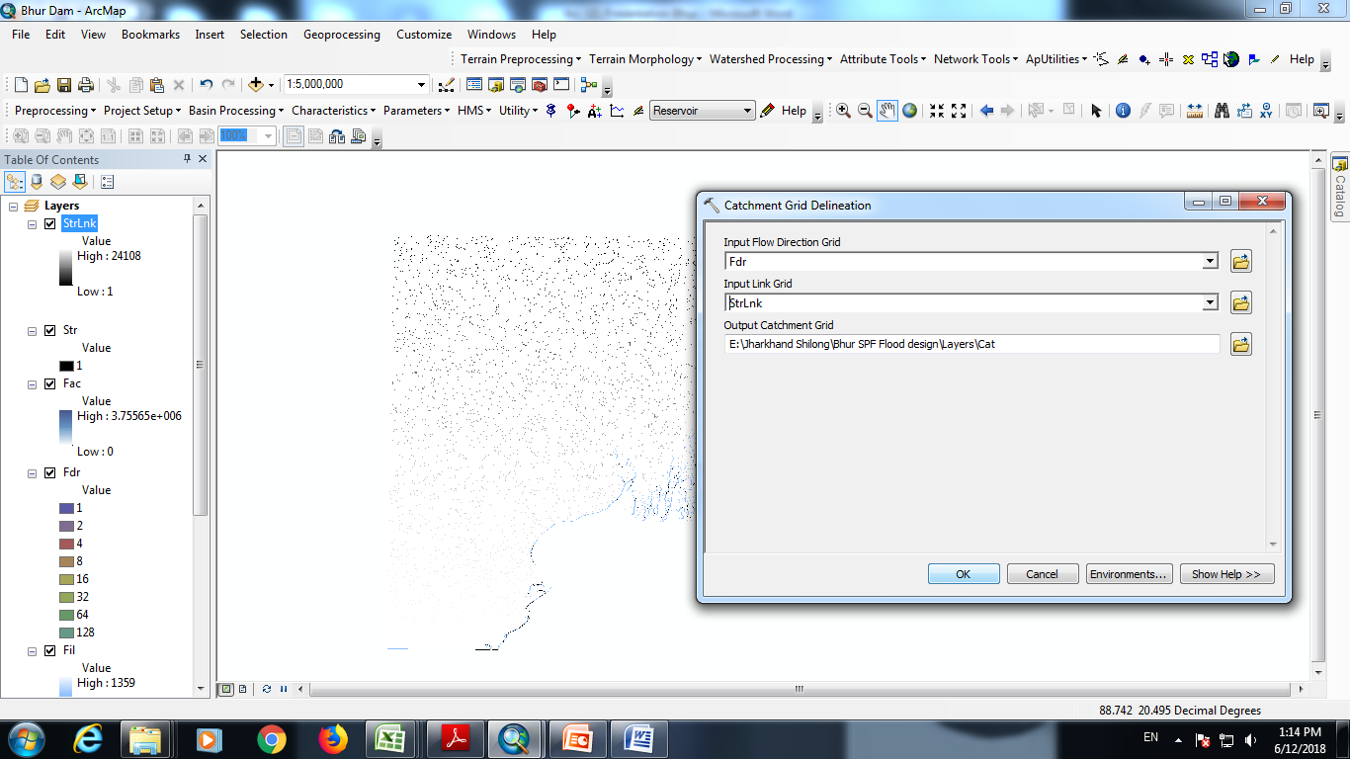
Catchment Grid Delineation
In this step area contributing each Stream Segment is estimated

Slide 22
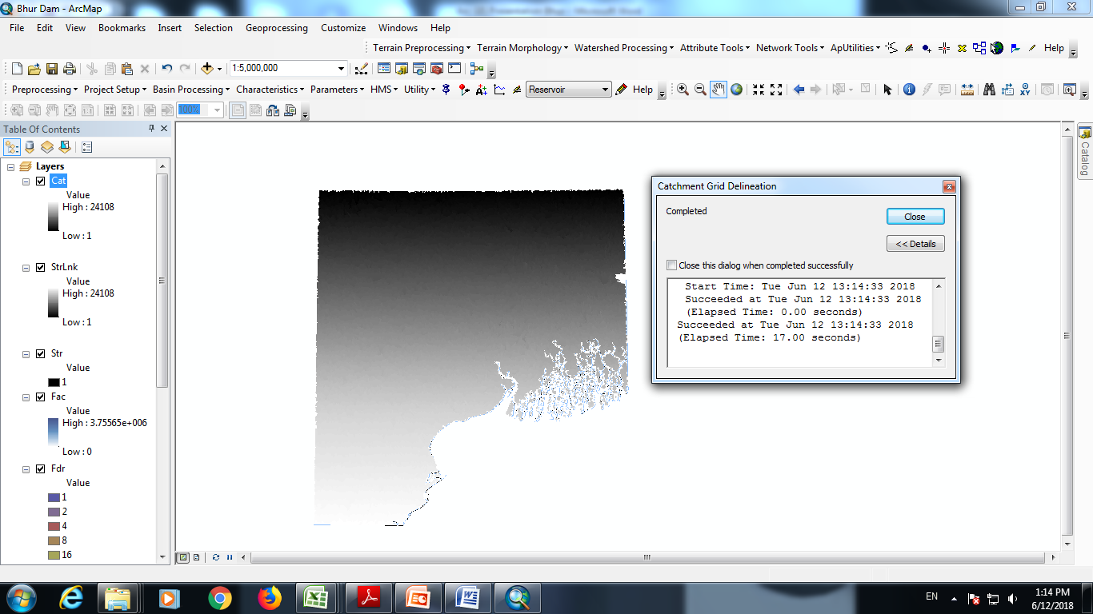
Catchment Grid Delineation contd....

Slide 23
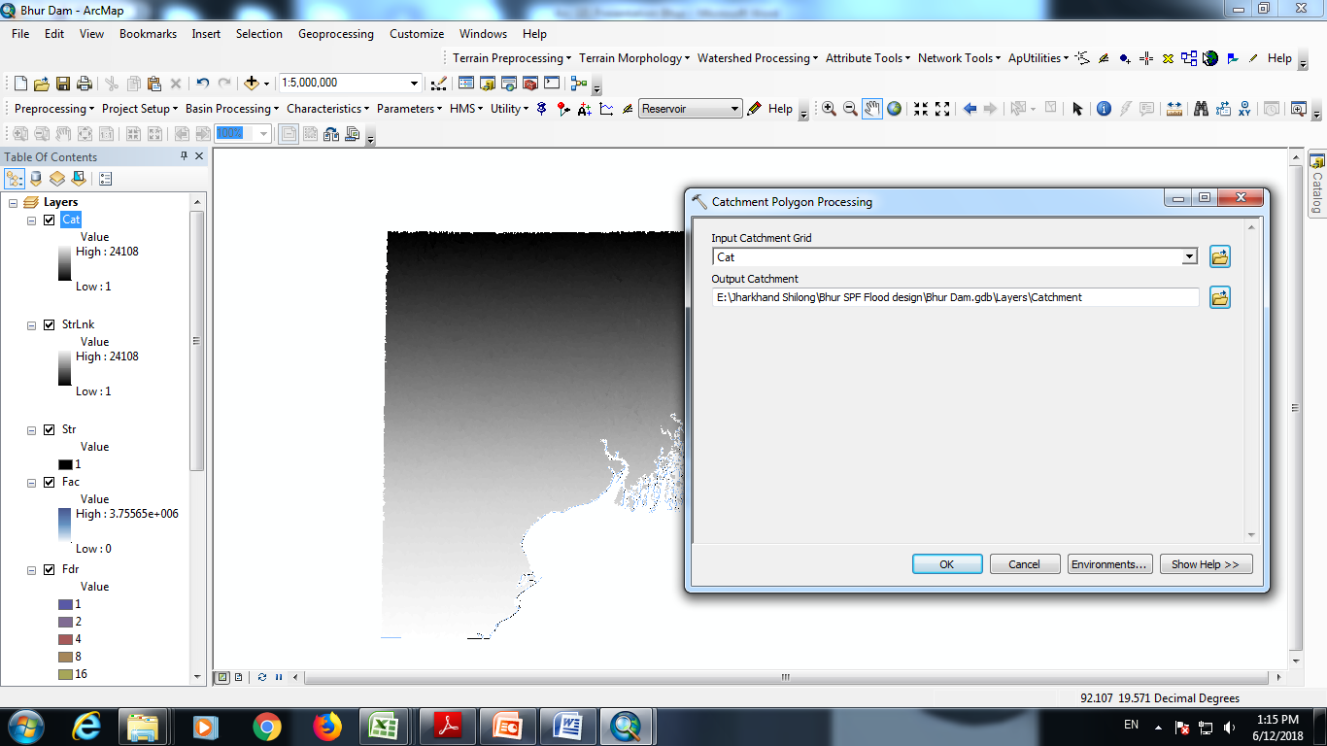
Catchment Polygon processing
Catchment Grids generated above are converted from Raster to Vector

Slide 24
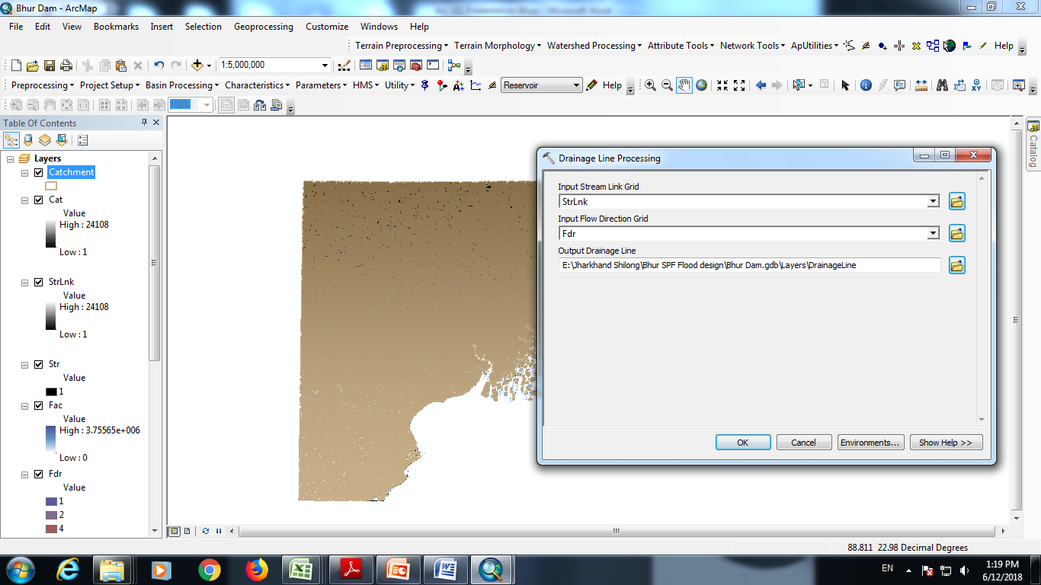
Drainage line processing
Stream Links generated are converted to Vector

Slide 25
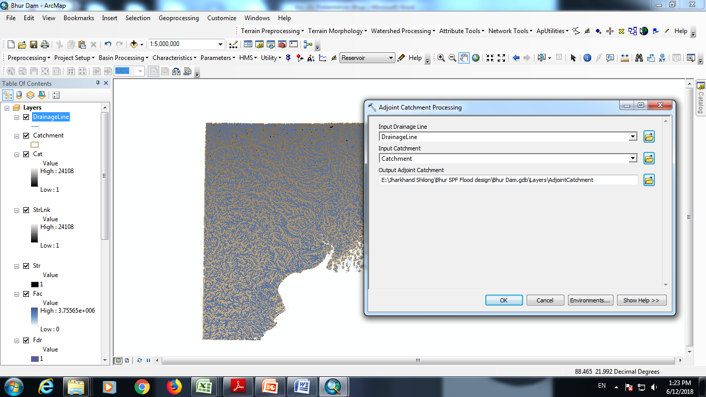
Adjoint catchment processing
Adjoint small catchments club together

Slide 26
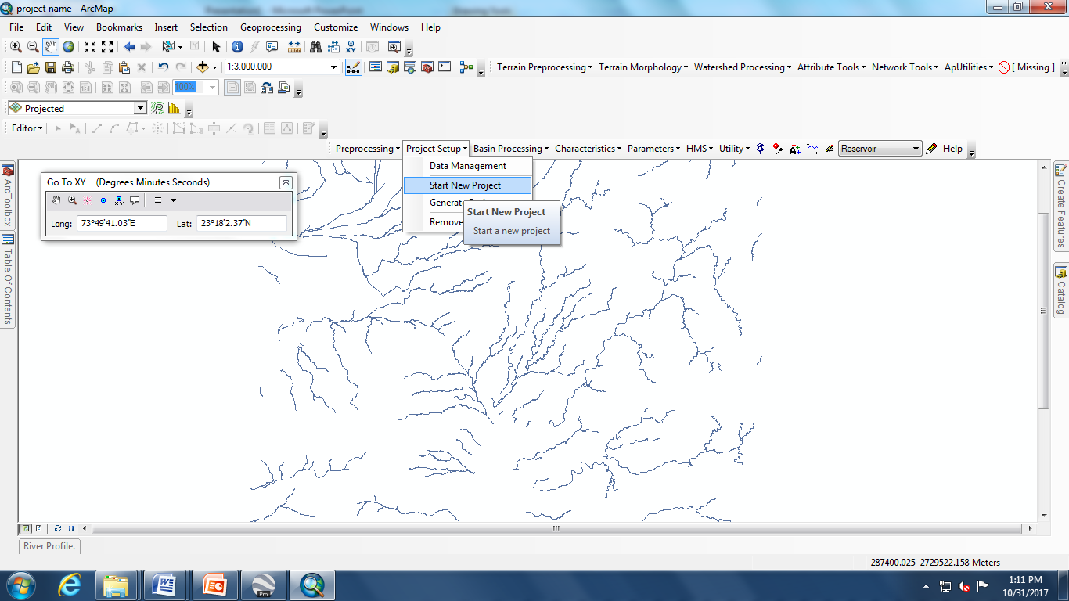
To Start New Project
Preprocessing steps completed and project specific steps started here after

Slide 27
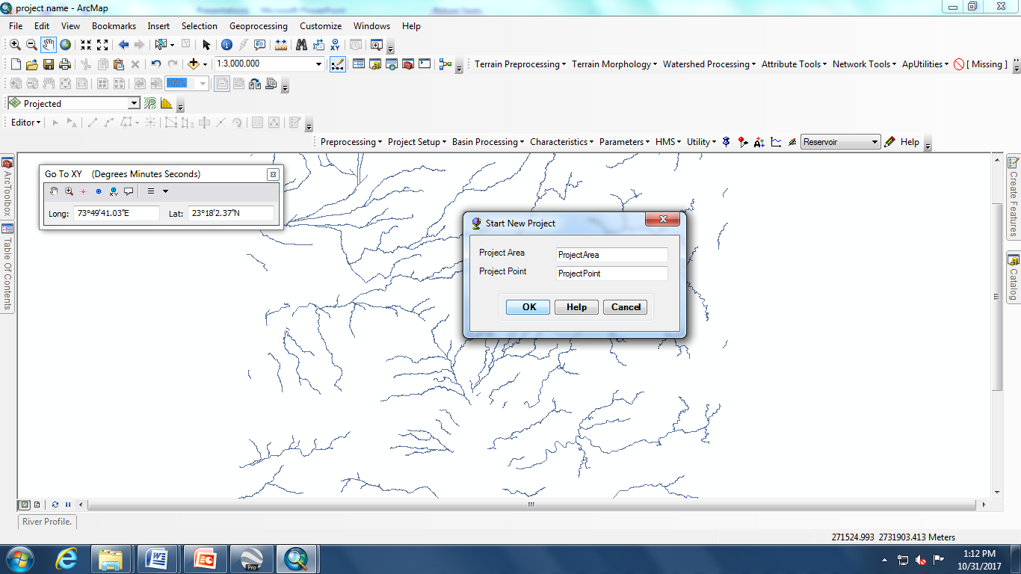
Start New Project
Check whether the project point lies inside the DEM or not using XY tool.

Slide 28
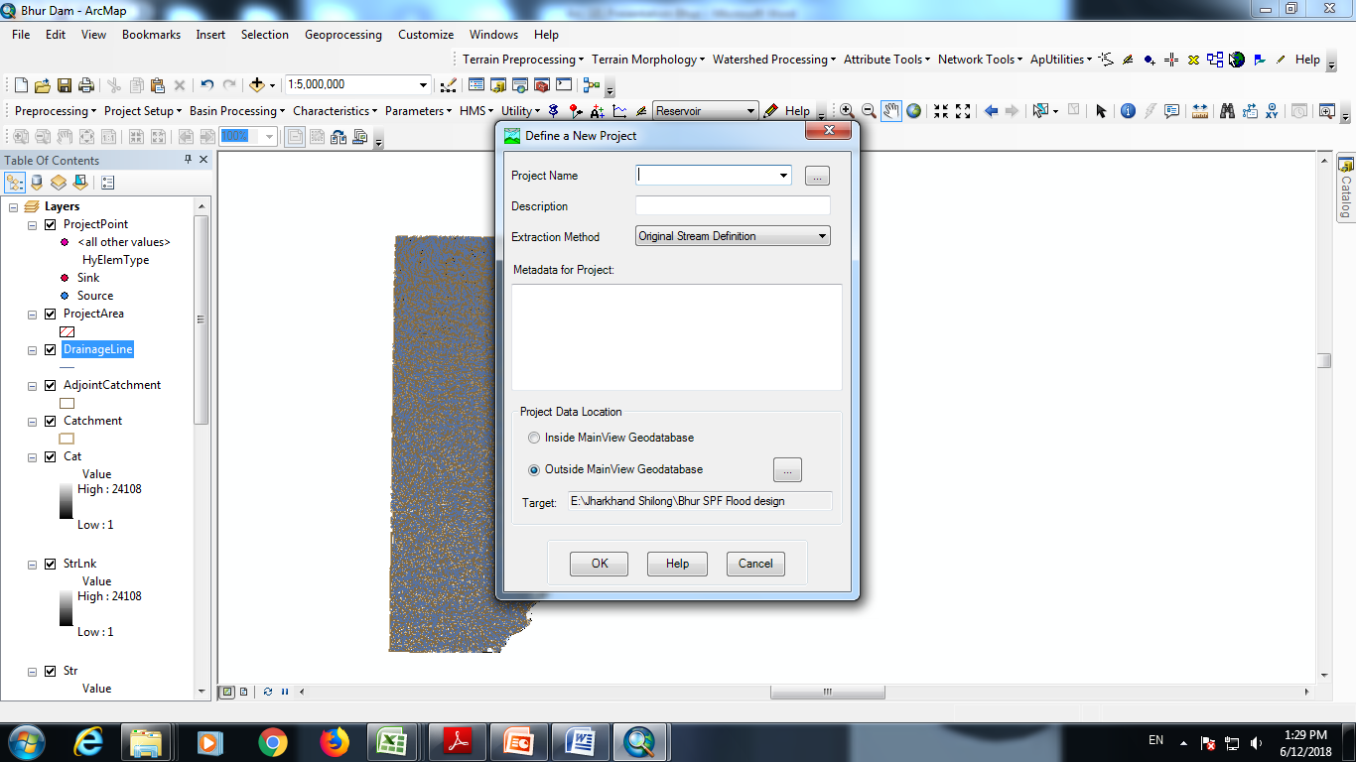
Define the project
Name your project

Slide 29
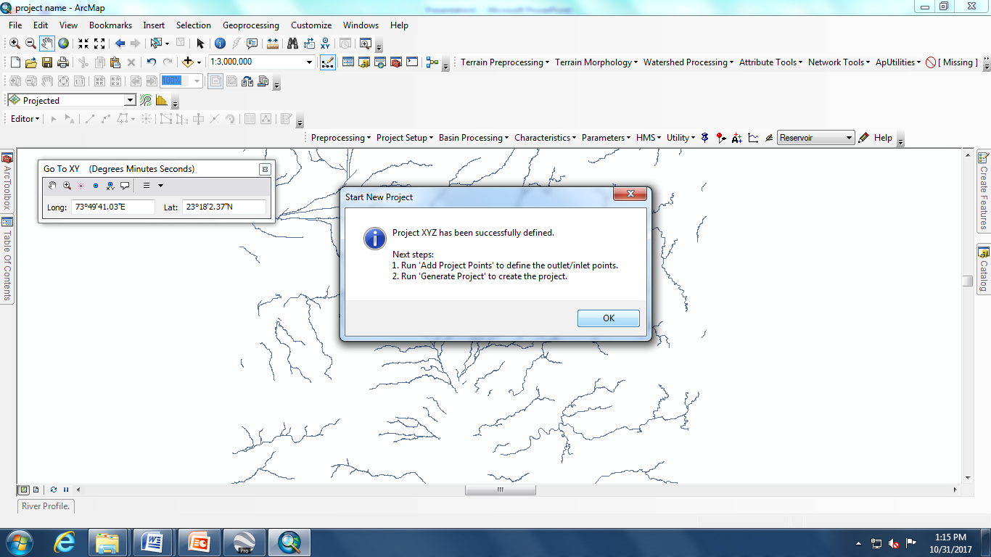
Start New Project

Slide 30
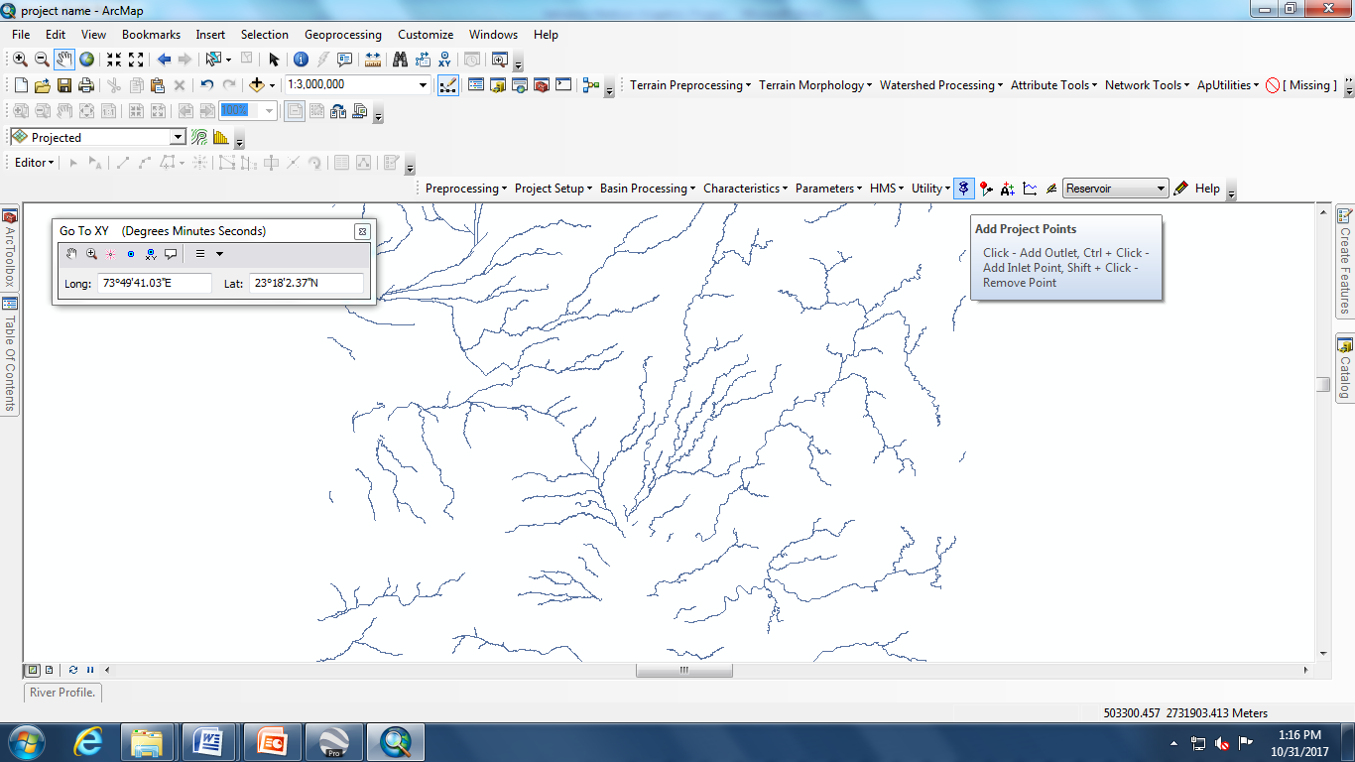
Now add project point (Locate the project location using ‘’GO TO XY’’, See next slides to locate the project point)

Slide 31
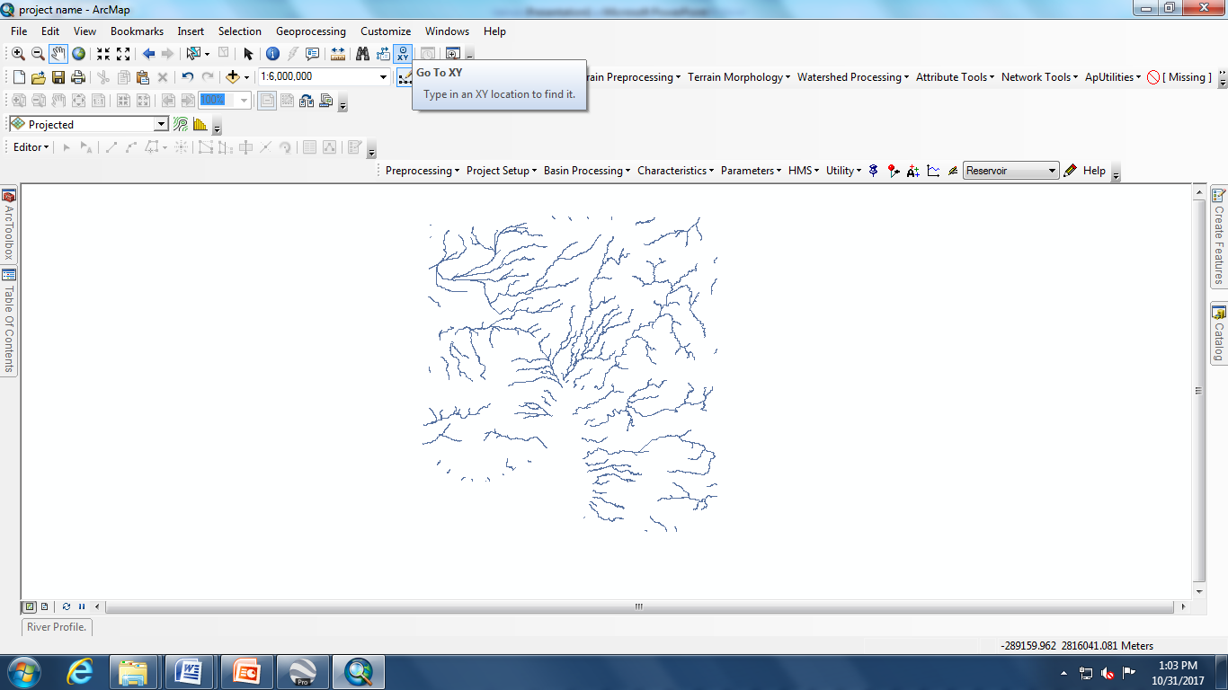
Go to XY and locate project

Slide 32
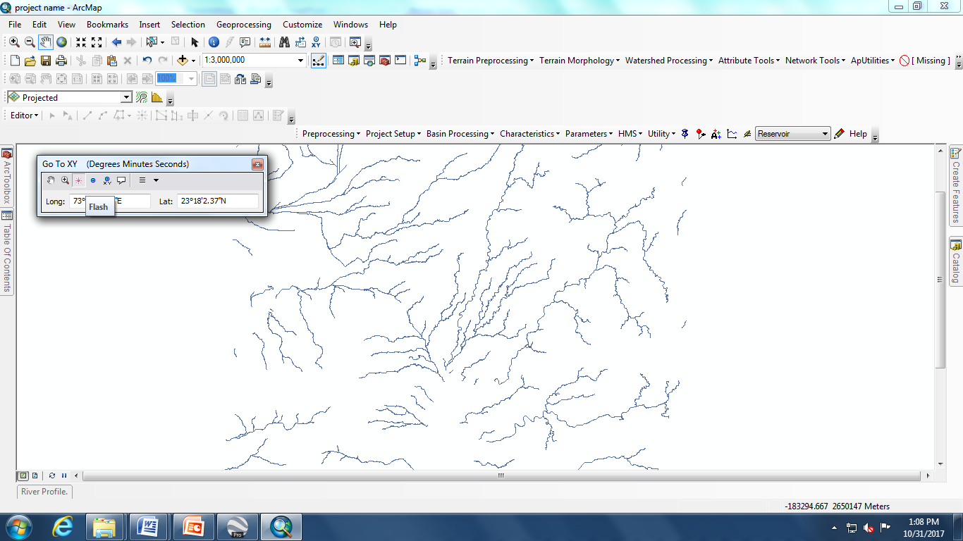
Add project coordinates(23°32’55.54” N & 85°08’3.93” E) and flash to locate the project point

Slide 33
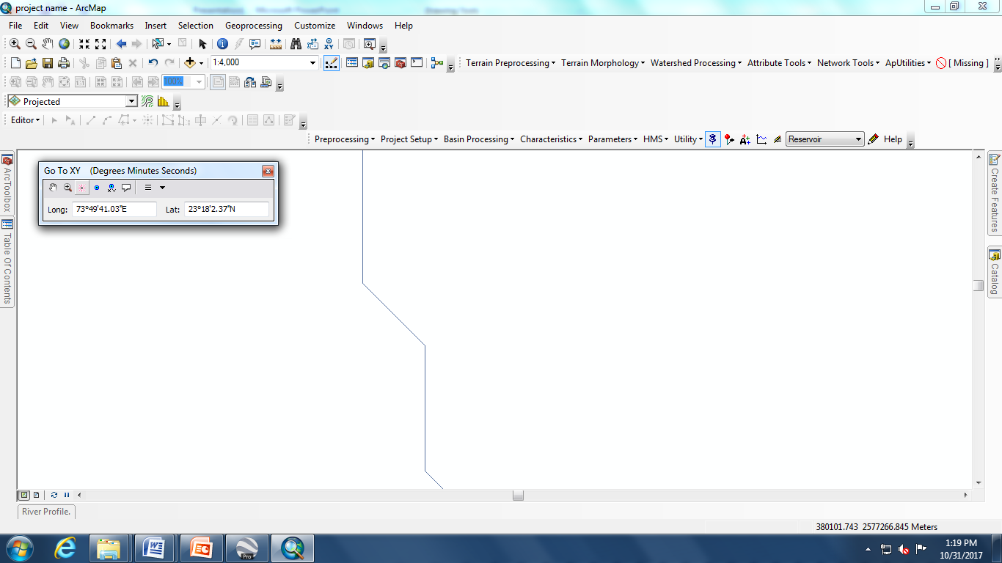
Zoom near Project Point to mark the project Point

Slide 34
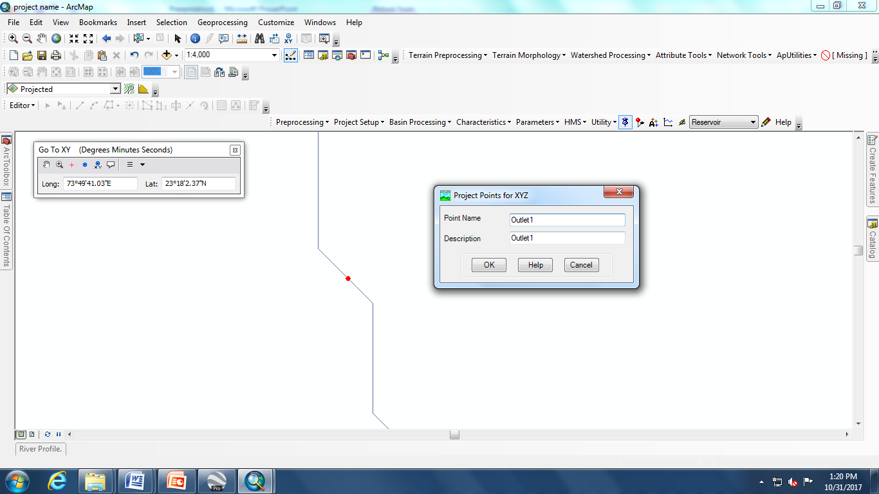
Project Points
Mark the project point on the stream, failing which catchment not delineated

Slide 35
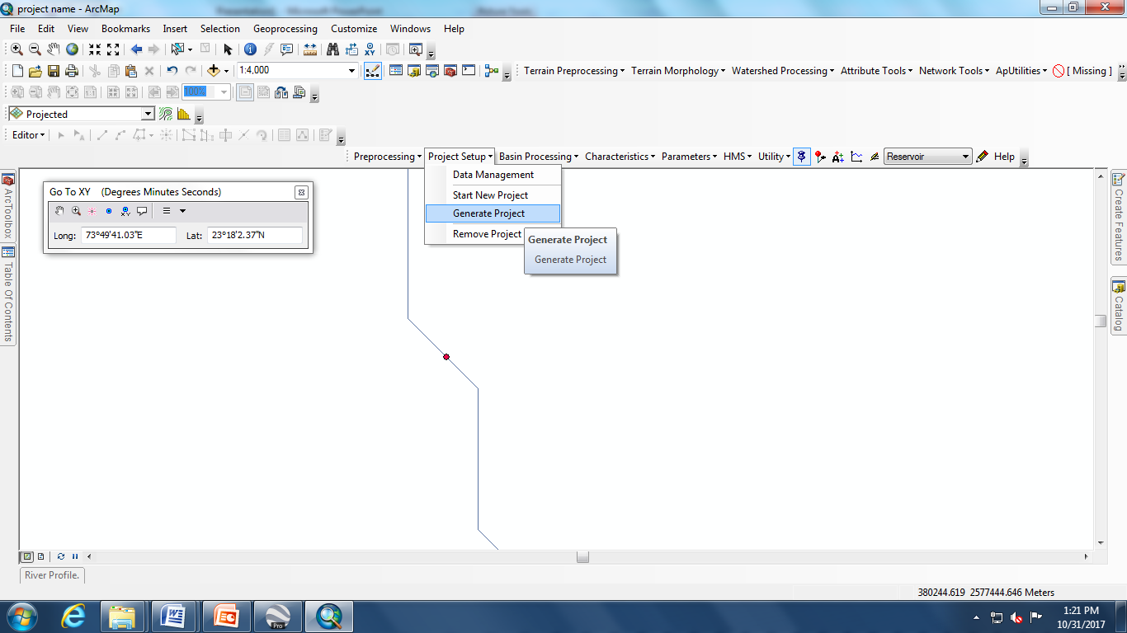
Generate Project

Slide 36
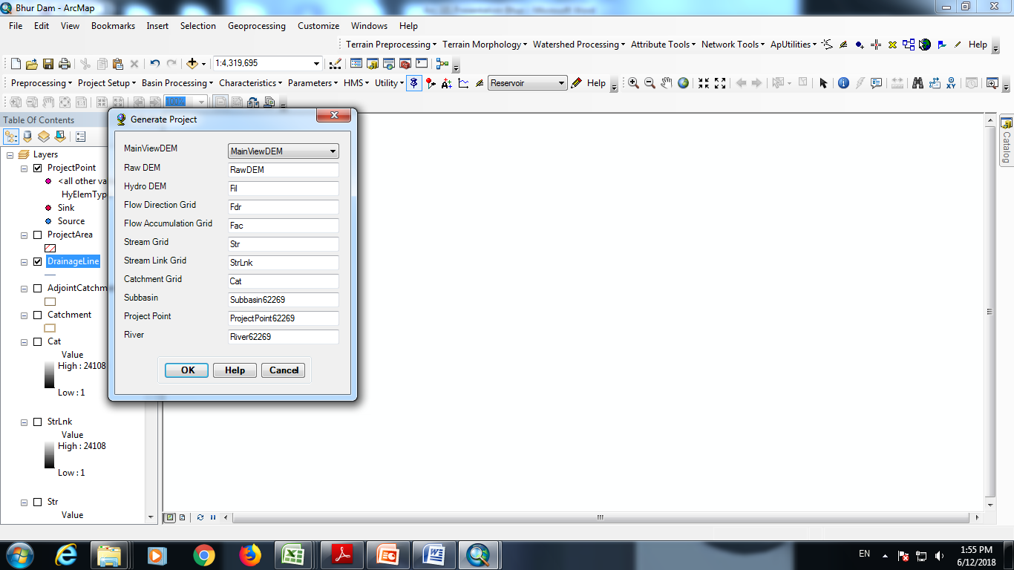
Catchment processing contd.......

Slide 37
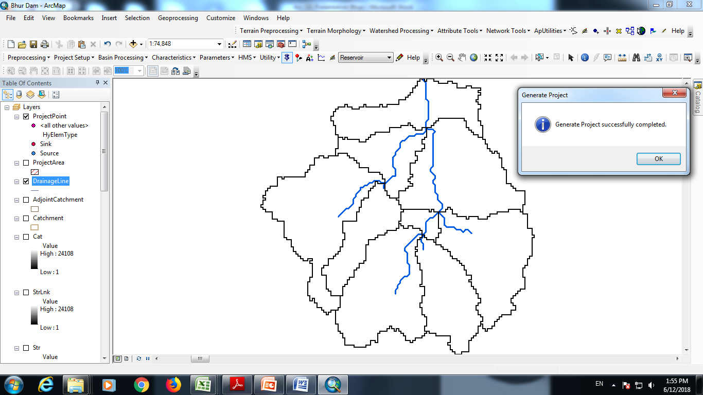
Delineated catchment

Slide 38
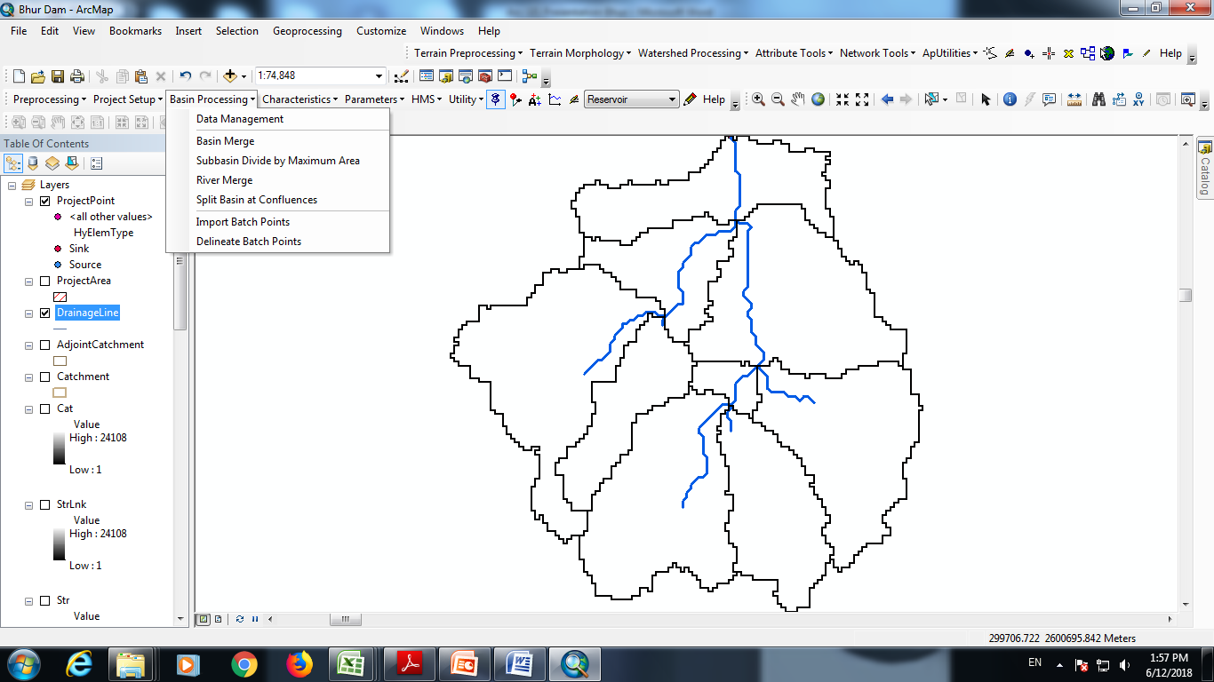
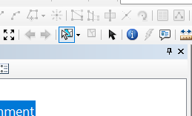
Basin Merge
Using select feature tool (Shown below) select whole catchment for basin merge

Slide 39
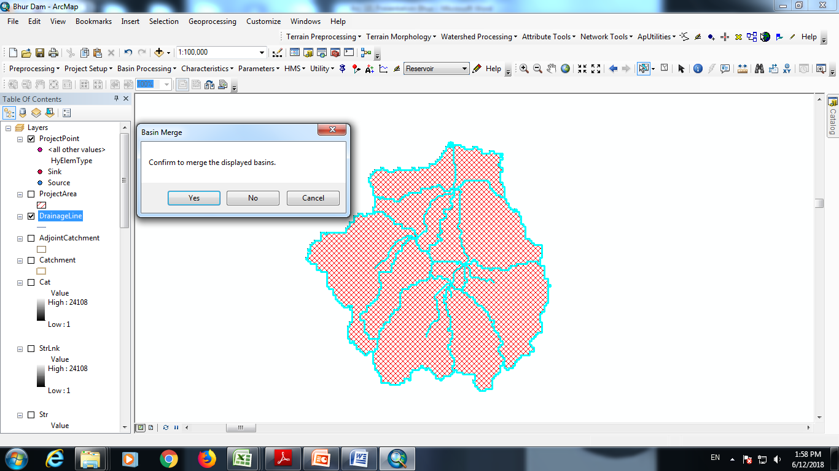
Basin Merge contd....
After selecting the basins, it looks like this.

Slide 40
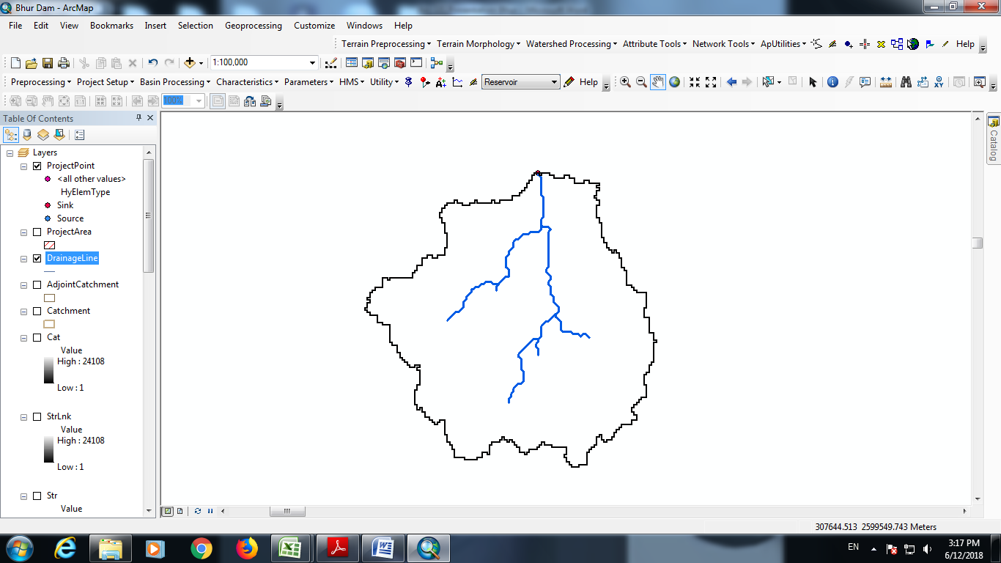
Merged Basin

Slide 41
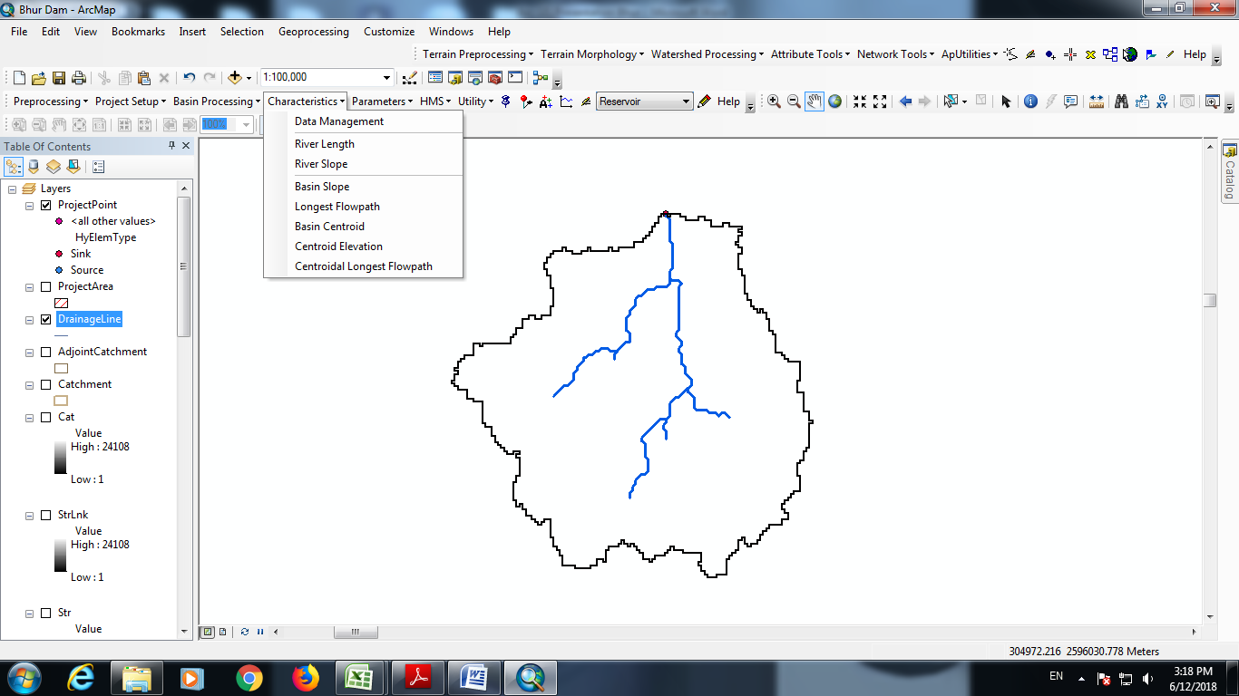
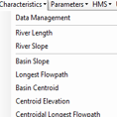
Go to Characteristics : perform River Length, River Slope, Longest Flow path, Basin Centroid, Centroidal Longest Flow path etc one by one.

Slide 42
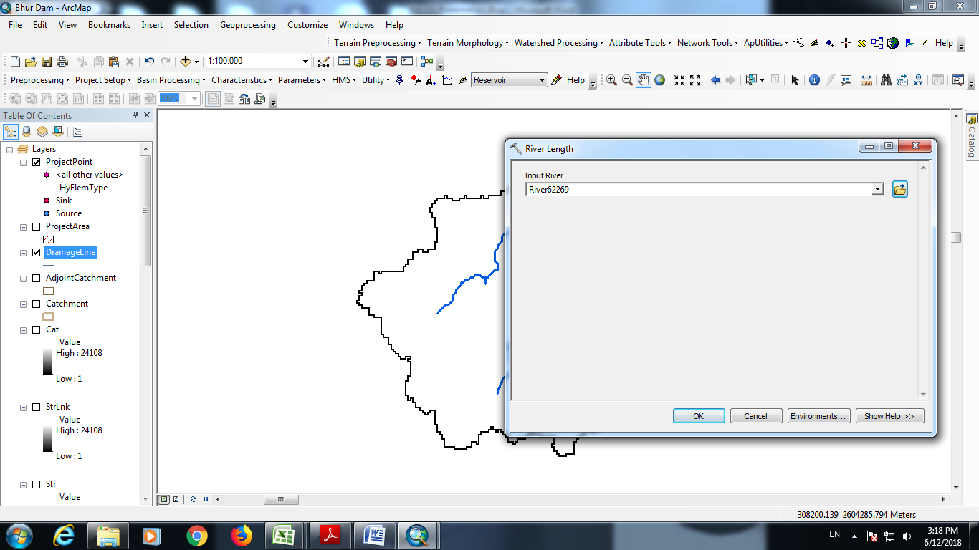
River length computation

Slide 43
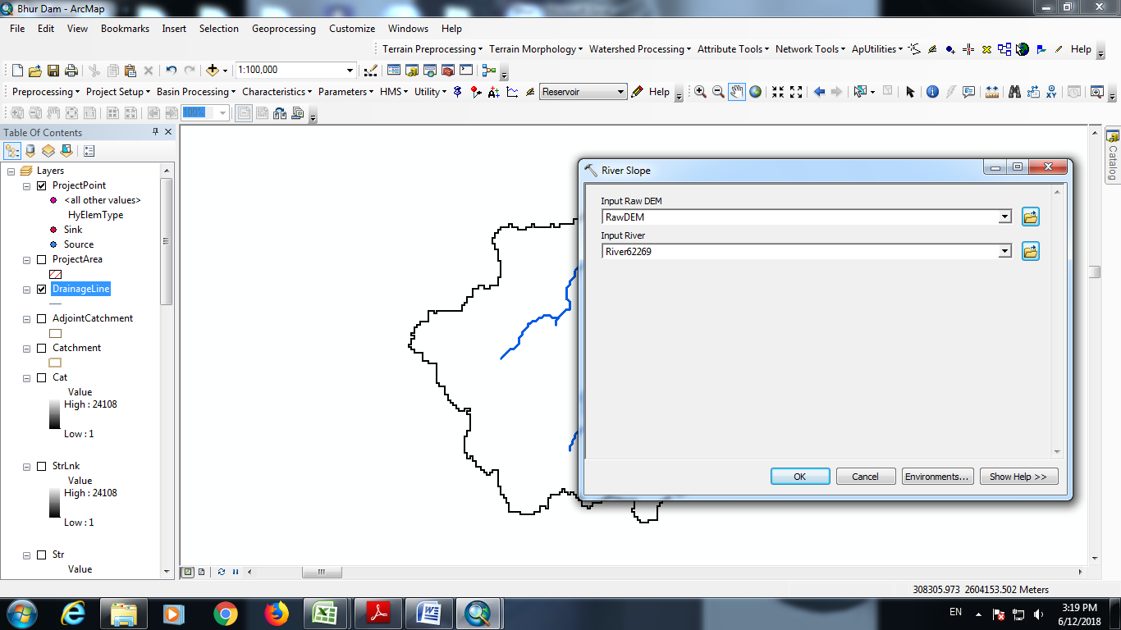
River slope computation

Slide 44
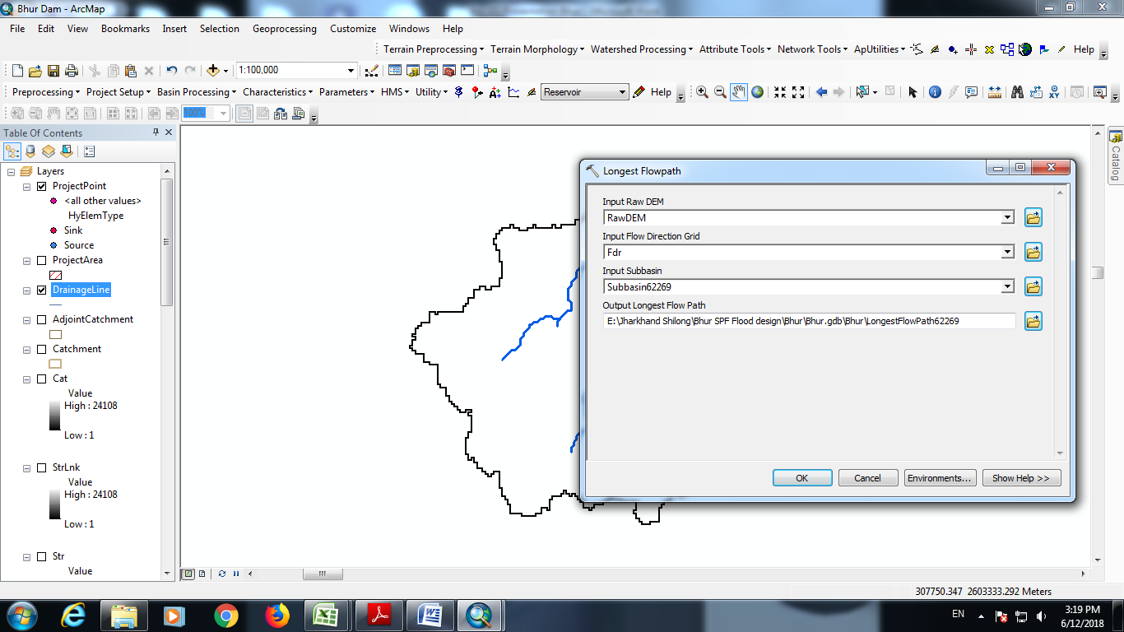
Longest flow path computation

Slide 45
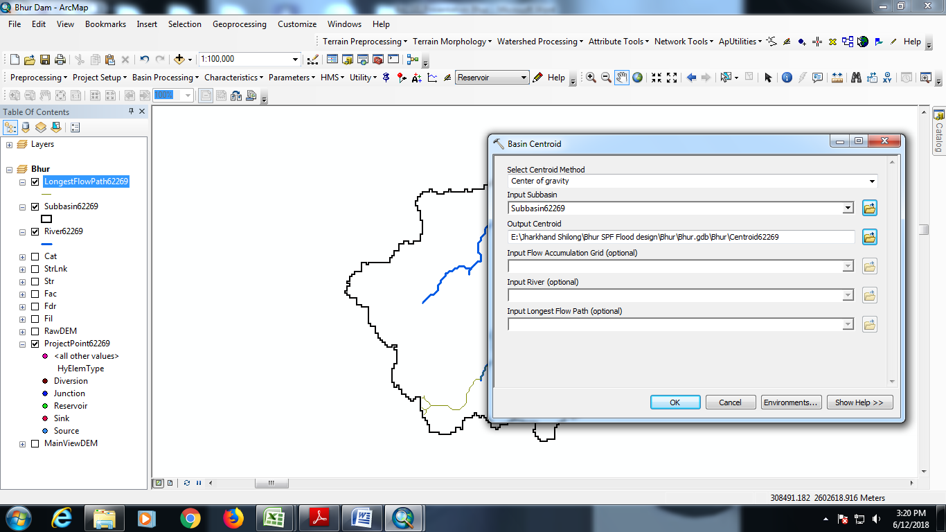
Basin centroid computation

Slide 46
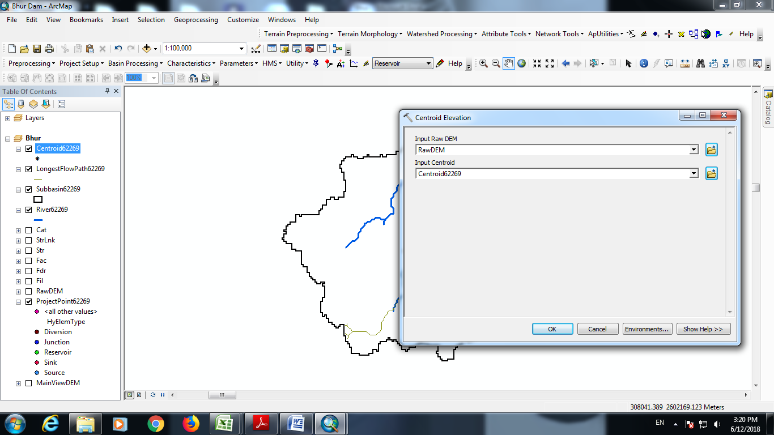
Centroid elevation computation

Slide 47
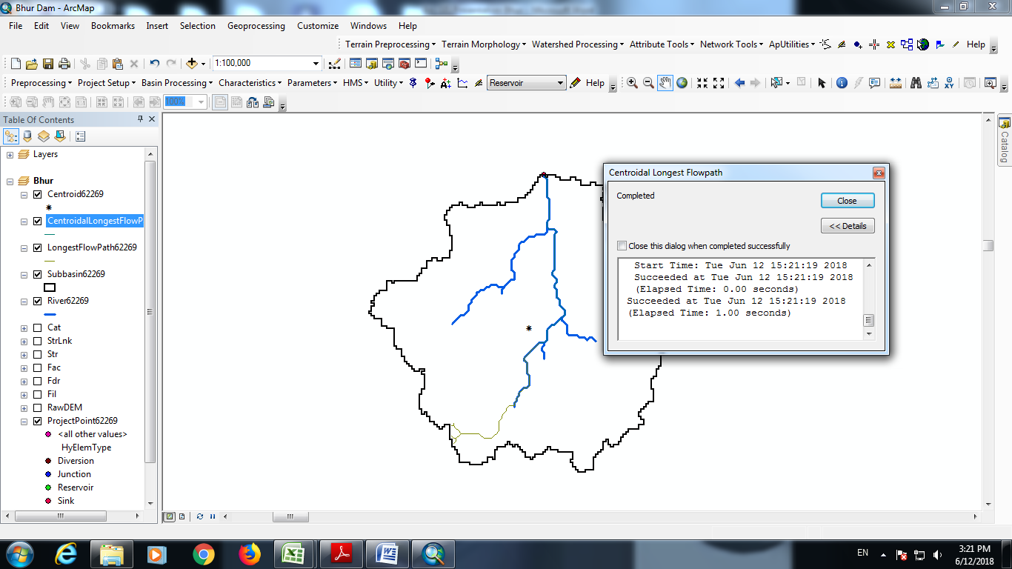
Centroidal longest flow path

Slide 48

Estimation of River Length, Basin Centroid, Longest River Path, Basin Centroid, Centroidal Longest Flow Path
After completion the above steps, to check the estimated lengths, we right click and open Attribute table

Slide 49

Seeing values from attribute table

Slide 50

Calculation of Slope

Slide 51



River Slope Profile
We careful in this step, while selecting Line2Profile Option.

Slide 52
Computation of Equivalent Slope
EQUIVALENT SLOPE
Chainage (km) | Reduced Level (m) | Height above Datum D_{i} (m) | Length of each segment L_{i} (km) | (D_{i}+D_{i-1})L_{i (km.m)}
59.6 | 120 | 0 | 0 | 0
45 | 156 | 36 | 14.6 | 525.6
40 | 207 | 87 | 5 | 1705.2
35 | 436 | 316 | 5 | 3160
34 | 553 | 433 | 1 | 2598
30 | 576 | 456 | 4 | 2280
27 | 613 | 493 | 3 | 3451
25 | 775 | 655 | 2 | 3275
23 | 983 | 863 | 2 | 3452
20 | 1032 | 912 | 3 | 4560
15 | 1161 | 1041 | 5 | 8328
14 | 1236 | 1116 | 1 | 6696
12 | 1589 | 1469 | 2 | 4407
10 | 1690 | 1570 | 2 | 6280
5 | 1879 | 1759 | 5 | 12313
0 | 2488 | 2368 | 5 | 23680
Longest River Length from outlet (L) |  |  | 59.6
Ʃ{(Di+D_{i-1})Li} |  |  |  | 86710.80
Equivalent stream slope Ʃ{(D_{i}+D_{i-1})Li}/L² |  |  | S_{eq} | 24.41 | m /km

Slide 53

Catchment Area Delineation (ArcGIS)
CA | 472 | sq. km
L | 59.6 | km
Lc | 26.2 | km
ESS | 24.41 | m/km

Slide 54
Thank You !
धन्यवाद !

