Slide 1
GRID Value of PMP and SPS from PMP Atlas of year 2015 Published by CWC in association with IMD
ISLY ISSAC
Deputy Director, Hydrology (S)
Central Water Commission

Slide 2
PMP Atlases
Central Water Commission in association with India Meteorological Department has prepared the PMP Atlases for various basins in the country.
These PMP Atlases have been prepared on GIS platform and cover all relevant details such as pattern of key storms along with their synoptic situations, observed rainfall statistics at various stations, return period rainfalls at various stations, spatial and temporal distribution of rainfalls etc. apart from grid wise PMP estimate for quick/direct assessment of applicable PMP/SPS for a catchment.

Slide 3
Basins which has been covered
Ganga Basin
Godavari basin
Krishna basin (Prepared by IMD in yr 2018)
Narmada, Tapi, Sabarmati, and Luni River Systems and Rivers of Saurashtra and Kutch Regions including Mahi
Mahanadi and Adjoining River Basins
West Flowing Rivers of Western Ghats (Kerala)
Cauvery and other East flowing rivers

Slide 4
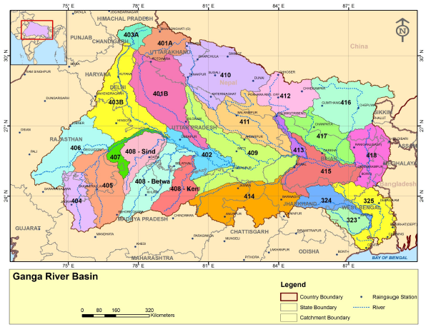
Ganga river basin

Slide 5
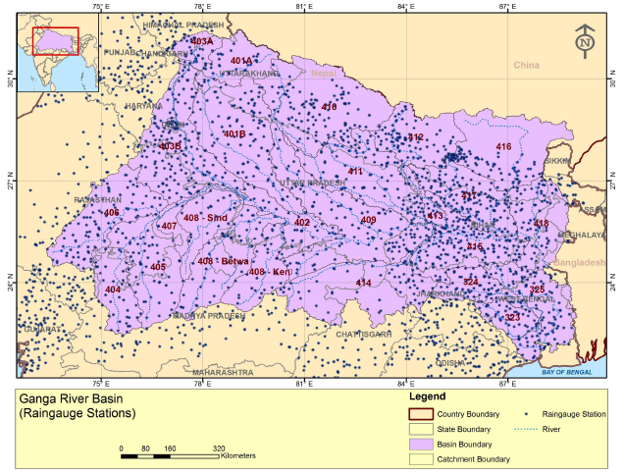
IMD Rain gauge stations

Slide 6
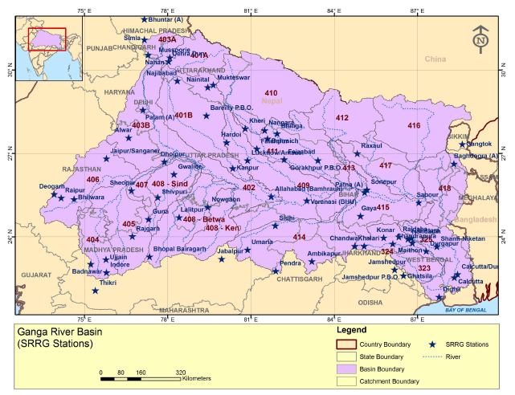
SRRG Stations

Slide 7
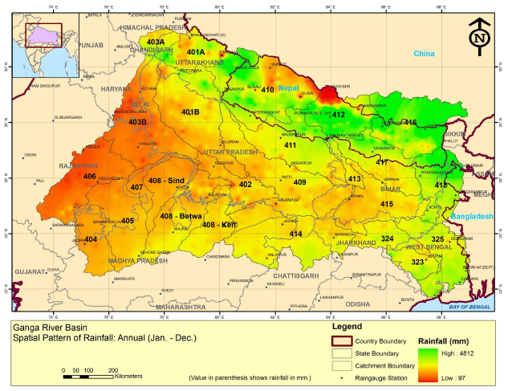
Spatial pattern of annual rainfall

Slide 8
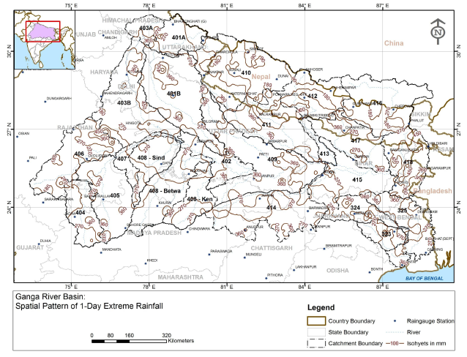
Spatial Pattern of 1D Extreme Rainfall

Slide 9
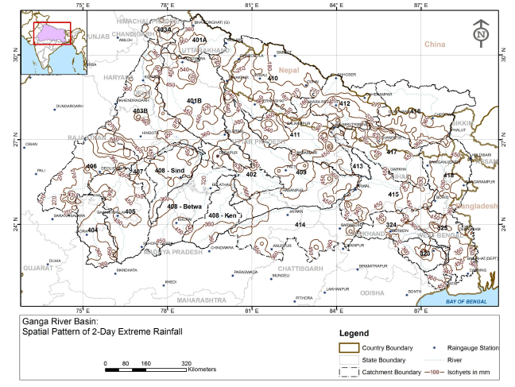
Spatial Pattern of 2D Extreme Rainfall

Slide 10
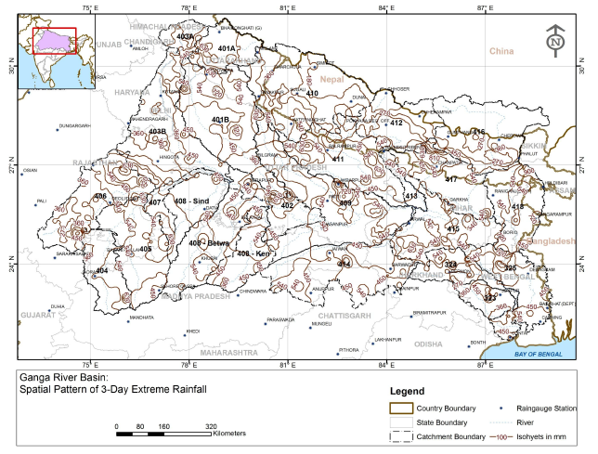
Spatial Pattern of 3D Extreme Rainfall

Slide 11
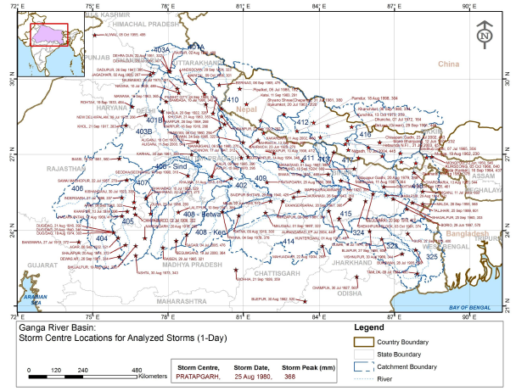
Location of 1Day Storms Centre

Slide 12
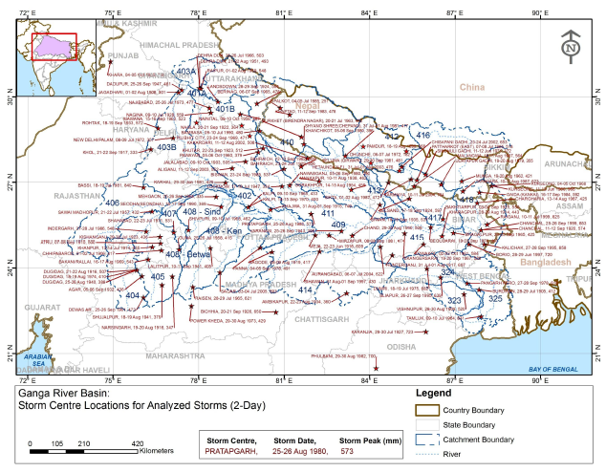
Location of 2Day Storms Centre

Slide 13
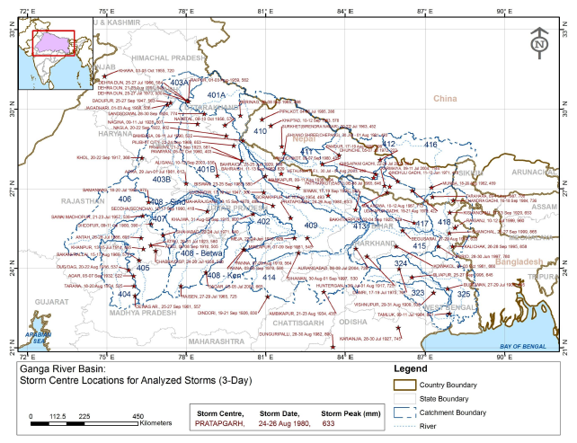
Location of 3Day Storms Centre

Slide 14
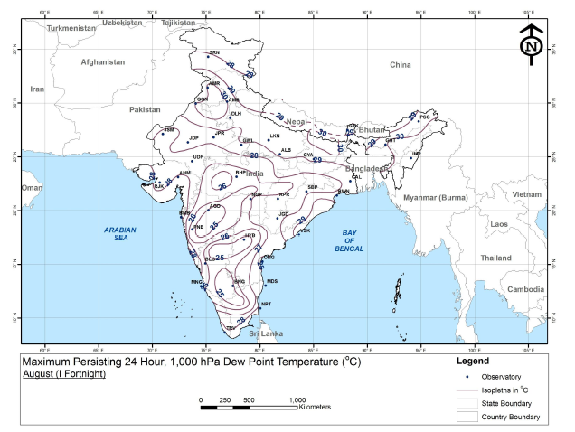
Max persisting dew point temp

Slide 15
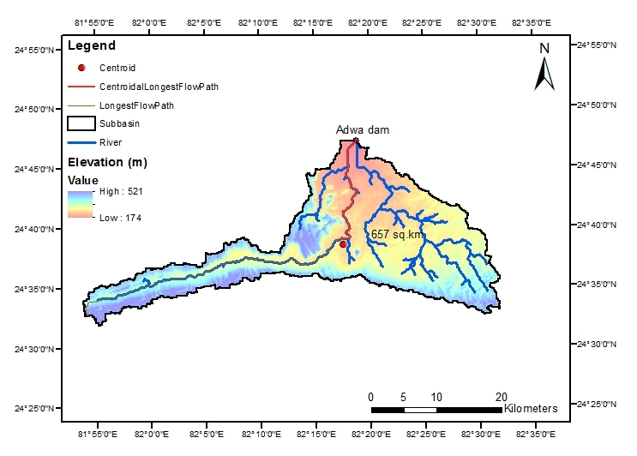
Adwa dam – CA Map (CG 24⁰37’N, 82⁰19’E)

Slide 16
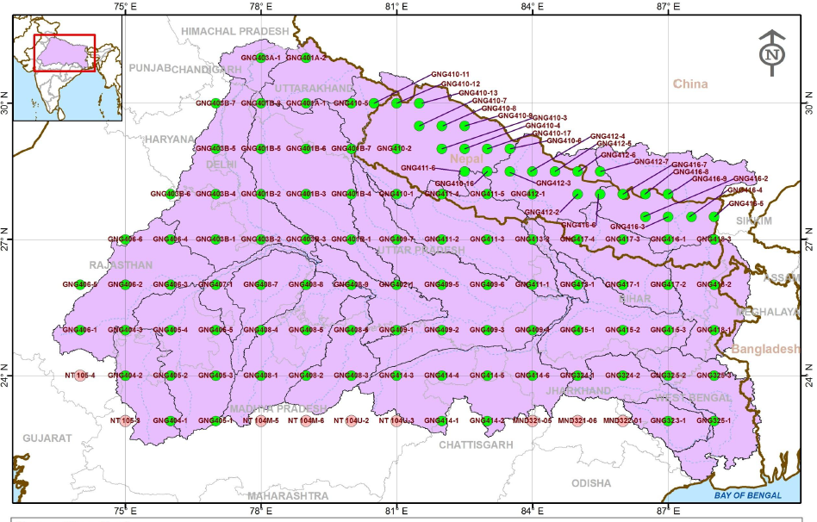
Grid Point Location in PMP Atlas

Slide 17
Adwa Dam Grid – GNG 409-2

Slide 18


Reading the SPS value for GNG409-2 Grid Point
2 Day PMP Value 1 day PMP Value
500 sq.km - 956 mm 500 sq.km - 642 mm
1000 sq.km - 923 mm 1000 sq.km - 617 mm
For 657 sq.km, 2 day SPS = 956 – (956-927) x (157/500) = 946 mm
For 657 sq.km, 1 day SPS = 642 – (642-617) x (157/500) = 634 mm

Slide 19
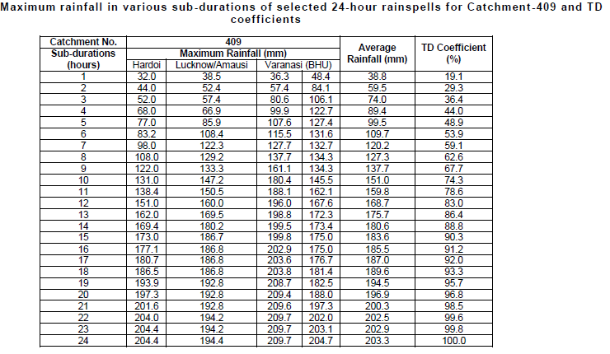
Time Distribution Coefficient

Slide 20
Thank you

