Slide 1
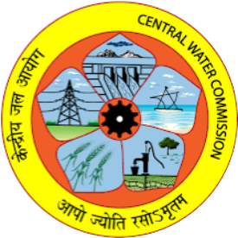
Introduction & Projection system in GIS, Source of DEM, DEM Resolution
By
Vijay Singh Meena, Deputy Director
Central Water Commission

Slide 2
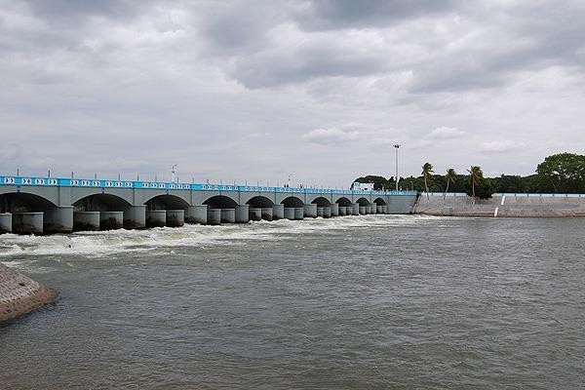
History of Dam Building in India
India has a long history of water management systems for efficient water storage and distribution, including traditional step wells, tanks, as well as construction of dams and canals.
The Chola dynasty is renowned for its contributions to dam construction. The Grand Anicut (Kallanai Dam) built on Kaveri River in Tamil Nadu in 150 AD is considered one of the oldest functional dams in the world.
Grand Anicut is a massive structure constructed with uneven stones to a length of 329 m and a width of 20 m across the mainstream of the river.
Grand Anicut (Kallanai Dam), 150 AD

Slide 3
Building Dams – Current Status
World wide top 10 large dam owning countries
Post-Independence in 1947, India embarked on a massive dam-building program to support agriculture, hydroelectric power generation, flood control, and water supply for growing urban populations.
India stands 3rd in terms of Large Dams worldwide having 6138 operational large dams and 143 under-construction large dams
Source: ICOLD & NRLD-2023

Slide 4
Operational Large Dams in India
In India, dams are owned, constructed and maintained by the State Governments, CPSUs and few Private Agencies.
States/UTs | No. of dams
Maharashtra | 2333
Madhya Pradesh | 1354
Gujarat | 487
Chhattisgarh | 339
Rajasthan | 310
Karnataka | 231
Odisha | 210
Telangana | 161
Uttar Pradesh | 151
States/UTs | No. of dams
Andhra Pradesh | 140
Tamil Nadu | 127
Kerala | 61
Jharkhand | 55
West Bengal | 36
Uttarakhand | 32
Bihar | 27
Himachal Pradesh | 23
Other States/UTs | 61
TOTAL | 6138
Source: NRLD- 2023

Slide 5
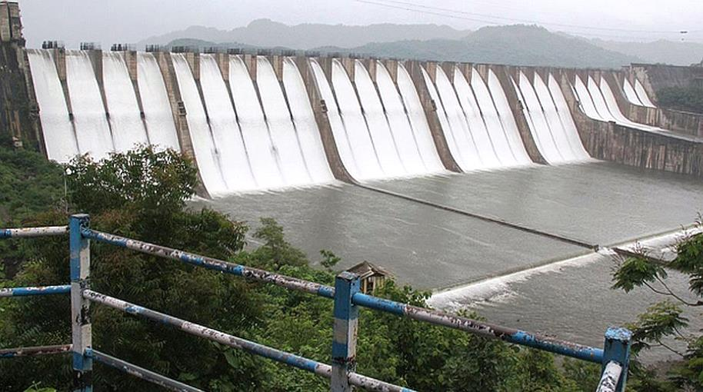
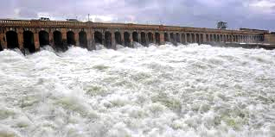
Age of Large Dams in India
26 To 50 YEARS
2666 dams
Upto 25 YEARS
51 To 100 YEARS
1898 dams
976 dams
> 100 YEARS
212 dams
Source: NRLD, 2023

Slide 6



Hydrological Safety of Dam: Why a priority concern for India?
Critical infrastructure constructed with large public investment
Unsafe dam constitutes a hazard to human life, ecology and public & private assets
Planning inadequacy, design flood capacity of old dams is not as per present standards
States/dam owners have not been able to provide sufficient budgets for O&M of dams and capacity building for Engineers
Climate change causing extreme hydrometeorological
events

Slide 7
Dam Failures in India
Earthen Dams (83%)
Concrete/Masonry Dams (17%)
Piping / Bad Workmanship
No. of Dam Failure Incidents →
Breaching failure due to flooding
Others
Decades →
Overtopping due to inadequate spillway capacity
The first dam failure was recorded in Madhya Pradesh in 1917
when the Tigra dam failed due to overtopping.
The worst dam disaster was the Machu dam (Gujarat) failure
in 1979, in which about 2,000 people were reported dead.
43 No. of reported dam failures
26 dams were of height less than 25 m
36 were Embankment Dams

Slide 8



Government of India initiatives in Dam Safety
1. Dam Safety Organizations(DSO), CWC
2. National Committee on Dam Safety (NCDS)
established in 1979 in CWC
working towards developing uniform dam safety protocols by laying down the standard guidelines/ manuals.
To assist the State Govts., and perform a coordinating and advisory role for States.
Setup in 1987 to evolve uniform, simplified dam safety procedures
Act as a forum for the exchange of views on issues about dam safety amongst various stakeholders
3. Dam Rehabilitation Programs
4. Dam Safety Act, 2021
Effective from 30th Dec 2021
Provide for surveillance, inspection, operation and maintenance of the specified dam for the prevention of dam failure-related disasters
Provide for the constitution of national and state-level bodies for implementing the Act.
Dam Safety Assurance and Rehabilitation Project (DSARP) (1991-99)
Dam Rehabilitation and Improvement Project (DRIP) Ph- I (2012-21)
DRIP Ph-II & III (2021-31)

Slide 9
Regulations under Section 54(2) of DSA, 2021
the form, manner and time interval for forwarding the analysis of readings to the State Dam Safety Organisation
the data requirements of hydro-meteorological stations in the vicinity of specified dams
the data requirements of seismological stations in the vicinity of specified dams
the suitable location and manner of collection, compliance, process and storage of data
the time interval of risk assessment studies to be carried out
time interval for updating the emergency action plan
the time interval for the comprehensive safety evaluation of specified dams
the mandatory review of design flood of existing specified dams
the mandatory site specific seismic parameter studies of existing specified dams
the measures necessary to ensure dam safety by every owner of dam other than specified dams
Source: Gazette Notification dated: 13.03.2024

Slide 10
Overview of Design Flood Estimation Study
What is Design Flood ?
The design flood refers to the flood event or flow condition used as the basis for designing hydraulic structures such as dams, bridges, culverts, and levees.
It is the flood for which the dam should be safe against overtopping and structural failure.

Slide 11
Return Period Flood
Design floods are often associated with a specific return period, which indicates the likelihood of the flood event occurring within a given timeframe. For example, a 100-year design flood has a 1% chance of occurring in any given year, while a 500-year design flood has a 0.2% chance of occurring annually.
Standard Project Flood ( SPF )
It is the flood that may be expected from the most severe combination of hydrological and meteorological factors that are considered reasonably characteristic of the region and is computed by using the Standard Project Storm (SPS).
Probable Maximum Flood ( PMF )
It is the flood that may be expected from the most severe combination of critical meteorological and hydrological condition that are reasonably possible in the region and is computed by using the Probable Maximum Storm which is an estimate of the physical upper limit to maximum precipitation for the basin. This is obtained from transposition studies of the storms that have occurred over the region and maximising them for the most critical atmospheric conditions.

Slide 12
Steps in Design Flood Estimation Study
1) Salient features of the project
Latitude & Longitude
Gross Storage
Hydraulic head
2) Criteria to select the design flood-
IS 11223-1985- for Dams
IS 6966.1-1989- For Barrages
IS 14815 -2000- For Diversion Structures

Slide 13
Criteria to select the design flood for Dams
Type of Dam | Hydraulic head (m) | Storage Capacity (million m³) | Inflow design flood
Small | 7.5-12 | 0.5-10 | 100 year
Intermediate | 12-30 | 10-60 | SPF
Large | > 30 | >60 | PMF

Slide 14
Steps in Design Flood Estimation Study
3) Physiographic parameters of Project
Catchment Area
Longest Flow Path
Centroidal Longest Flow Path
Equivalent Stream Slope
4) Methodology of Design Flood Estimation
Empirical Methods- Ryves Formula,
Dickens Formula, Inglis Formula
Flood Frequency Method
Hydro-meteorological Method

Slide 15
Steps in Design Flood Estimation Study
5) Estimation of Unit hydrograph for Catchment (for hydro-meteorological approach)
From Observed short duration concurrent rainfall –runoff data
SCS method, Clark Uh method etc.
From Flood Estimation Reports published by CWC
6) Design Storm Estimation
From PMP Atlas

Slide 16
Steps in Design Flood Estimation Study
7) Distribution of design storm
Time distribution coefficients -From PMP Atlas
8) Reverse Critical Sequencing of rainfall
9) Loss Rate and Base Flow- From FER
10) Convolution/ Channel Routing

Slide 17
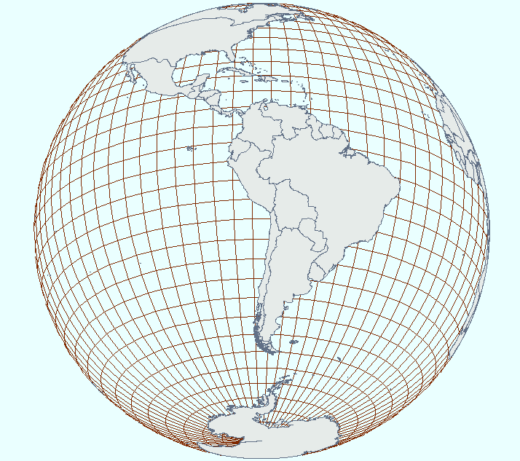
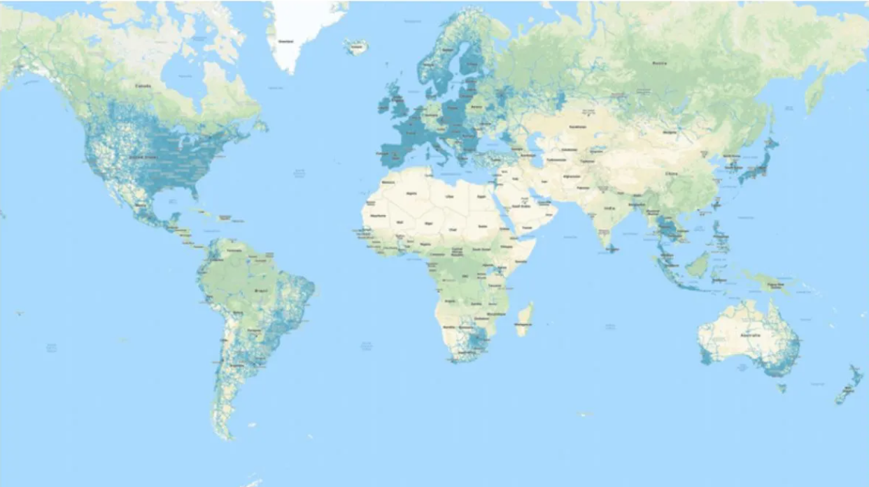
What is Projection??
It is the system of transformation of the spherical surface onto a plane surface. It is carried out by an orderly and systematic representation of the parallels of latitude and the meridians of longitude of the spherical earth or part of it on a plane surface on a conveniently chosen scale.

Slide 18
Need for map projection ??
The earth is a spheroid.
  The best model of the earth is a globe.
Drawbacks:
Not easy to carry nor minor details be shown on it
Not good for making planimetric measurement
(distance, area, angle)
Not able to study any area/region

Slide 19
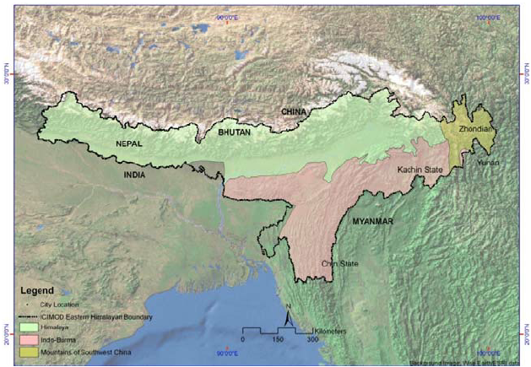
Need for map projection.....
Maps are flat
  good for making planimetric measurement
  (distance, area, angle)
  Scalable
  easy to carry

Slide 20
Limitations of map projections
How to transfer these lines of latitude and longitude on a flat sheet ?
To avoid distortions i.e.
  To maintain global properties:
  (i) Distance between any given points of a region;
  (ii) Shape of the region;
  (iii) Size or area of the region in accuracy;
  (iv) Direction of any one point of the region bearing to another point.

Slide 21
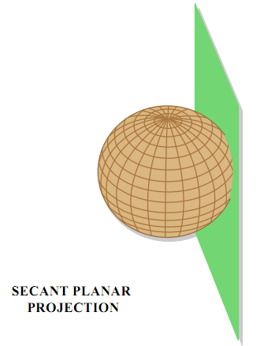
Classifications of Map Projections
Map Projections may be classified on the following bases:
  Drawing Techniques
  Developable Surface
  Global Properties, and
  Source of Light

Slide 22
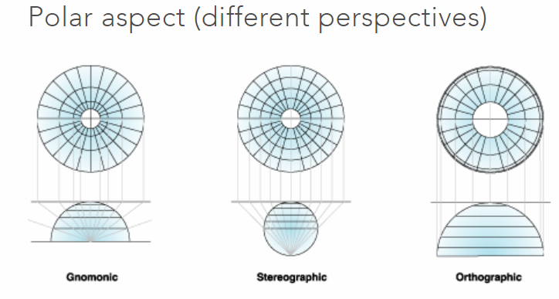
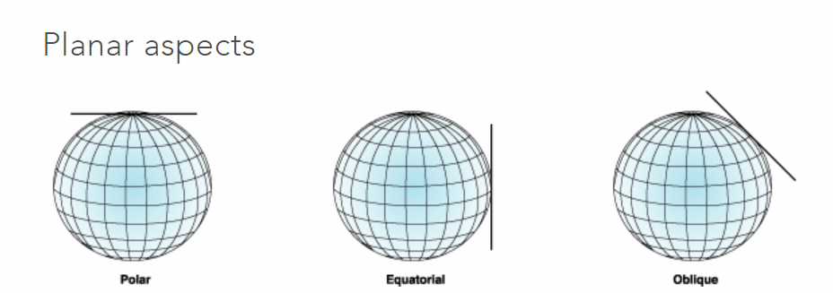
Based on Developable surface
On the basis of nature of developable surface, the projections are classified as
  Cylindrical,
  Conical and
  Zenithal/Azimuthal.

Slide 23
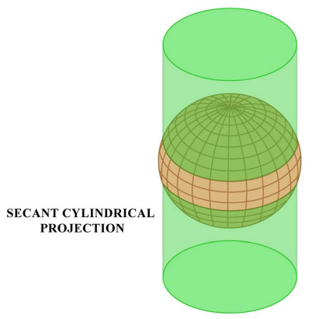
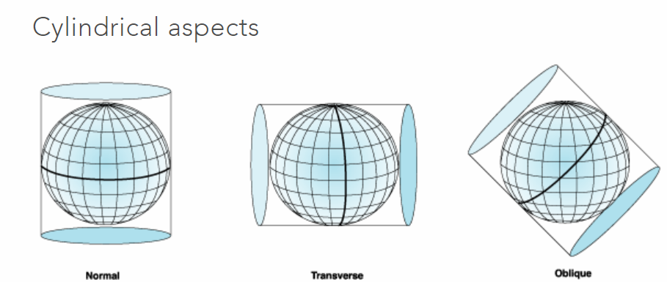
Cylindrical Projection
A paper-made cylinder covers the globe, and the parallels and meridians are projected on it. When the cylinder is cut open, it provides a cylindrical projection on the plane sheet.
Secant Cylindrical Projection
Earth intersects the cylinder on two small
circles.
All points along both circles have no
scale distortion.

Slide 24
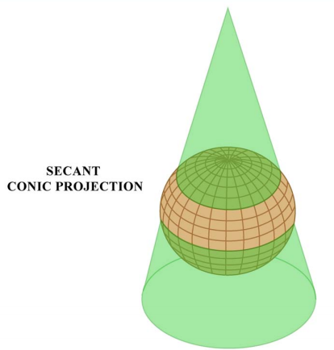
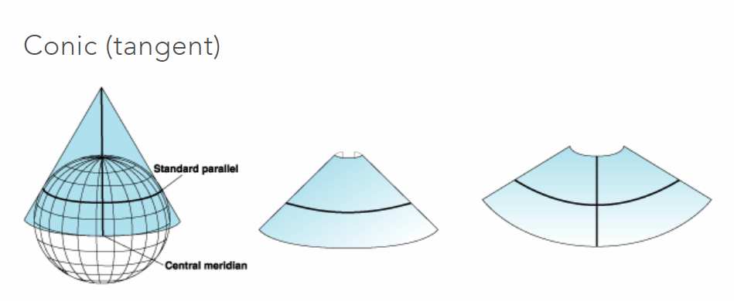
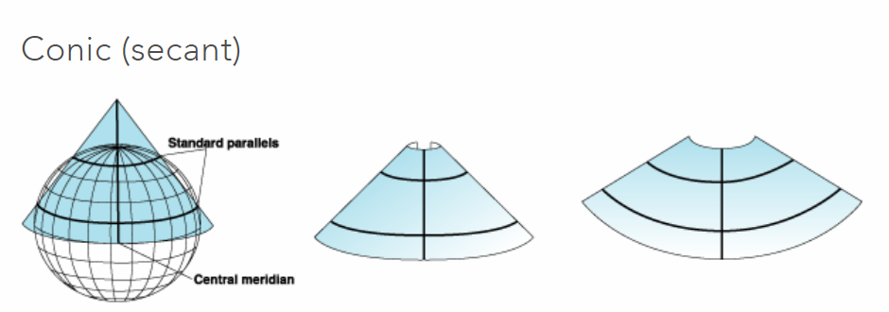
Conical Projection
A Conical projection is drawn by wrapping a cone round the globe and the shadow of graticule network is projected on it. When the cone is cut open, a projection is obtained on
a flat sheet.

Slide 25
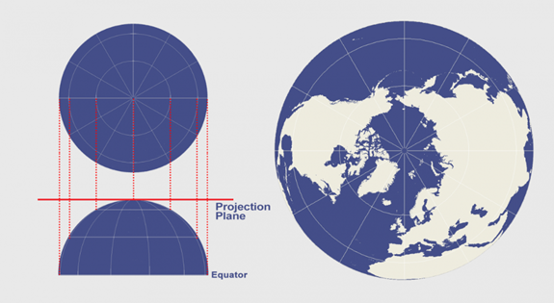
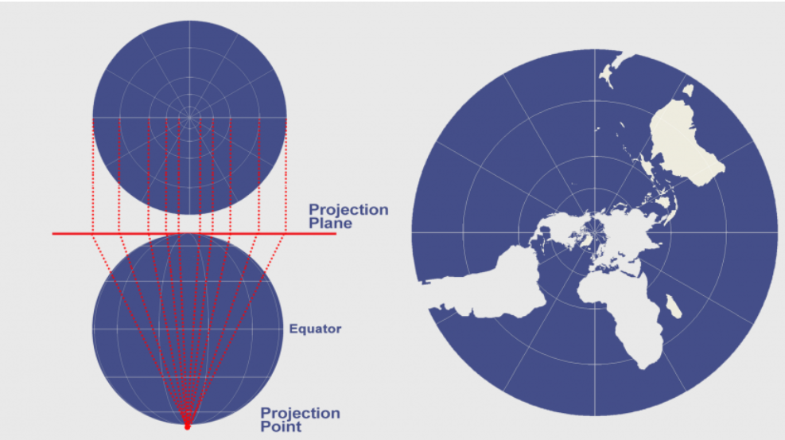
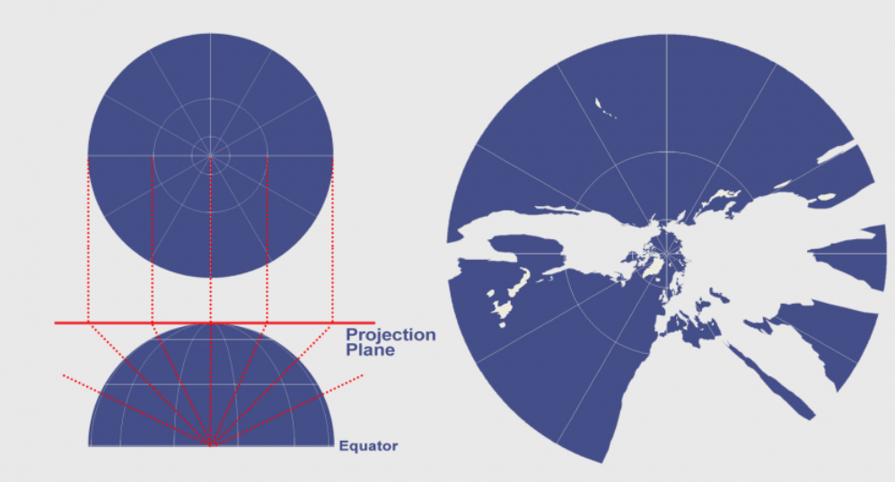
Azimuthal Projection
The azimuthal projection plots the surface of the Earth using a flat plane.
Some of the common perspective azimuthal projections include gnomonic, stereographic, and orthographic.
Orthographic projection distorts shape and area
Stereographic projection is conformal but the distortion of area and distance increases away from the center point of projection.
The Gnomonic projection isn’t equal area, equidistant, or conformal

Slide 26
Scale distortion
Scale near intersections with surface are accurate
Scale between intersections is too small
Scale outside of intersections is too large and gets excessively large the further one goes beyond the intersections

Slide 27
What is a coordinate system?
A coordinate system is a reference system used to represent the locations of geographic features, imagery, and observations such as GPS locations within a common geographic framework.

Slide 28
Types of coordinate systems
There are two common types of coordinate systems used in GIS:
A global or spherical coordinate system such as latitude–longitude. These are often referred to as geographic coordinate systems.
A projected coordinate system based on a map projection such as transverse Mercator, Albers equal area, or Robinson, all of which (along with numerous other map projection models) provide various mechanisms to project maps of the earth's spherical surface onto a two-dimensional Cartesian coordinate plane. Projected coordinate systems are sometimes referred to as map projections.

Slide 29
What is datUM?
A datum provides a frame of reference for measuring locations on the surface of the earth. It defines the origin and orientation of latitude and longitude lines.
Whenever you change the datum, or more correctly, the geographic coordinate system, the coordinate values of your data will change. Here are the coordinates in degrees/minutes/seconds (DMS) of a control point in Redlands, California, on the North American Datum of 1983 (NAD 1983 or NAD83):
34 01 43.77884 -117 12 57.75961
Here's the same point on the North American Datum of 1927 (NAD 1927 or NAD27):
34 01 43.72995 -117 12 54.61539
The longitude value differs by approximately 3 seconds, while the latitude value differs by about 0.05 seconds.

Slide 30
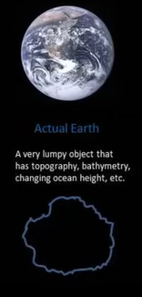
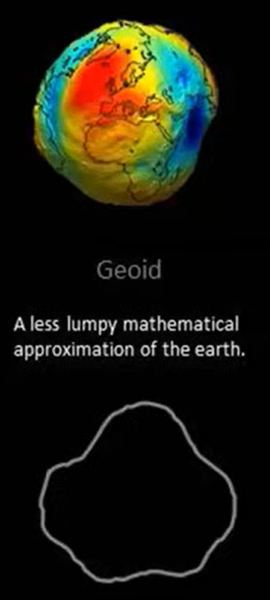
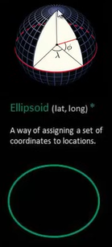
Ellipsoidal surface which envelops most of the earth surface is the WGS 1984 datum

Slide 31
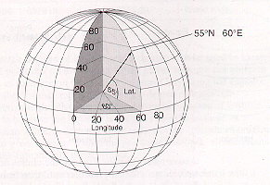
WGS 84 Global Co-ordinate system
WGS stands for World Geodetic System
It is a latest Geocentric Datum, considering center of mass of earth as its origin
Lat/long system measures angles on spherical surfaces
60⁰ east of PM
55⁰ north of equator
Geographic (geodetic) latitude : Angle measured in the meridian plane between the equatorial (x, y)-plane and the surface normal at P
Geographic (geodetic) longitude : Angle measured in the equatorial plane between the zero meridian (X-axis) and the meridian plane of P
The WGS 84 meridian of zero longitude is 102 metres east of the Greenwich meridian at the latitude of the Royal Observatory.

Slide 32
UTM Projection
Acronym of Universe Transverse Mercator
The UTM system divides the earth into 60 zones each 6 degrees of longitude wide
UTM zones extend from a latitude of 80° S to 84° N
In UTM zones are numbered 1 through 60, starting at the international date line (anti Meridian), longitude 180° and proceeding east.
Zone 1 extends from 180° W to 174° W and is centered on 177° W
A square grid is superimposed on each zone. It's aligned so that vertical grid lines are parallel to the center of the zone, called the central meridian.
UTM grid coordinates are expressed as a distance in meters to the east, referred to as the "easting", and a distance in meters to the north, referred to as the "northing".

Slide 33
UTM projection………
Conformal projection (shapes are preserved)
Cylindrical surface
Each zone having one central meridian
Zones are 6 degrees of longitude wide
Scale distortion is 0.9996 along the central meridian of a zone
There is no scale distortion along the the standard meridians
Scale is no more than 0.1% in the zone
Scale distortion gets to unacceptable levels beyond the edges of the zones

Slide 34
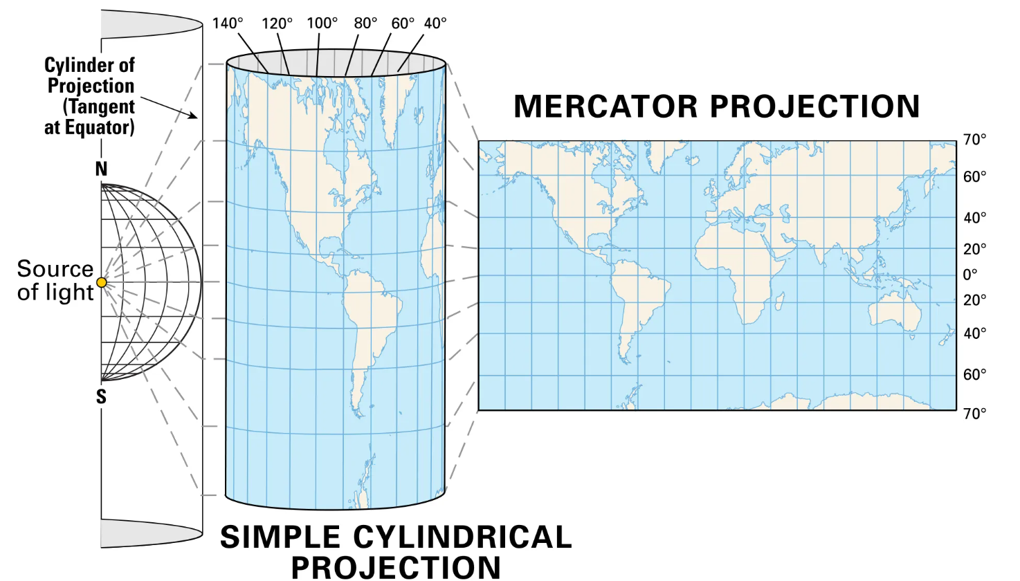

Slide 35
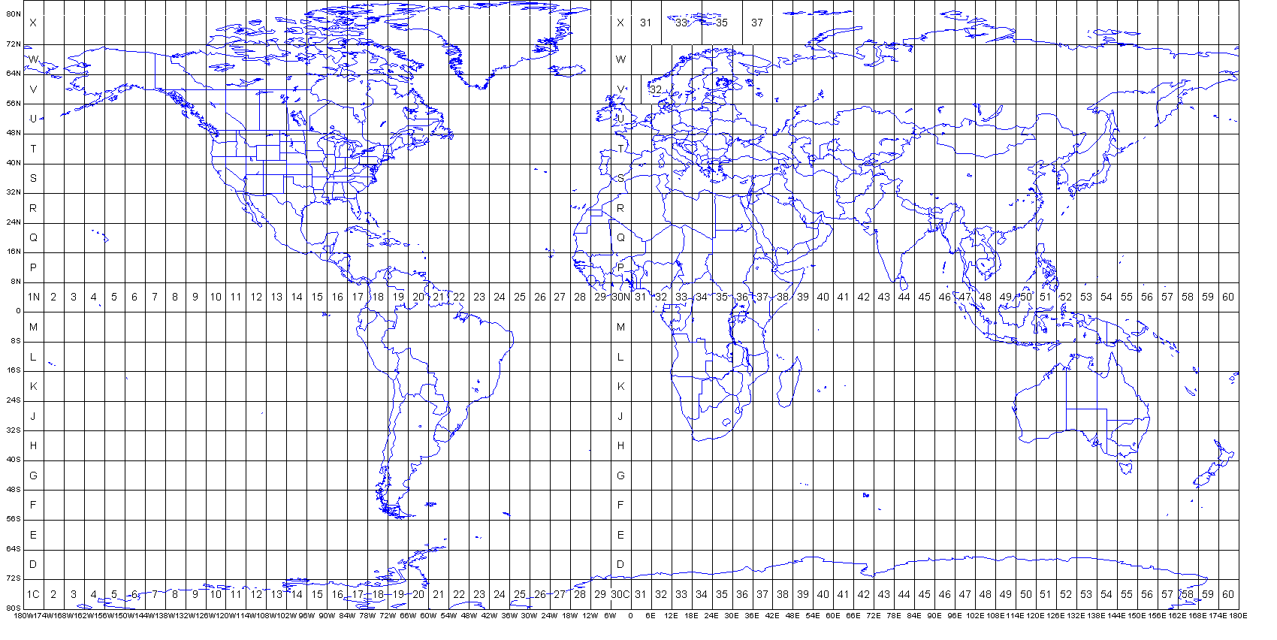
UTM projection………

Slide 36
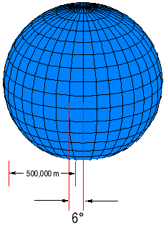
UTM projection………
Eastings:
The central meridian is assigned an easting value of 500,000 meters
Minimum and maximum easting values are: 166,000 m E and 834,000 m E at the equator.
Northings
UTM northing coordinates are measured relative to the equator
For locations north of the equator the equator is assigned the northing value of 0 meters North
To avoid negative numbers, locations south of the equator are made with the equator assigned a value of 10,000,000 meters North.
Maximum northing value is about 9300000 m at latitude 84N and about 1100000 m at 80S.

Slide 37

digital elevation data sets
There are several ways of modelling elevation:
Major among these are:
  Digital Surface Model (DSM),
  Digital Terrain Model (DTM), and
  Digital Elevation Model (DEM).

Slide 38
Digital SURFACE Model
(DSM) is an elevation model that displays surface height.
It displays any existing surface shapes like tree height, buildings, structures and any object on the ground.
A DSM is particularly useful in 3D modelling of telecommunications, smart city, urban planning and aviation.
DSMs can be obtained from stereoscopic satellite images, stereoscopic digital aerial photographs with different resolutions, and LiDAR (Light Detection and Ranging) technology.

Slide 39
Digital Terrain Model
DTM typically augments a DEM, by including vector features of the natural terrain, such as rivers and ridges. A DTM may be interpolated to generate a DEM, but not vice versa.
Vegetation, buildings and other man made features are removed.
DTM becomes powerful tool in earth and engineering sciences.
Photogrammetric processing of aerial and space stereo images is commonly used to create DTMs.

Slide 40
Digital Elevation Model
DEM is a gridded raster data and a three-dimensional representation of a terrain, which filters out and excludes terrain vector features (i.e. streams, break lines, and ridges) and all ground objects, both built (power lines, buildings, and towers) and natural (trees and other types of vegetation)
DEMs can be generated from remotely sensed data collected by satellites, drones, and planes and commonly through laser scanning (LiDAR), geodetic surveying, or radar interferometry (InSAR).

Slide 41
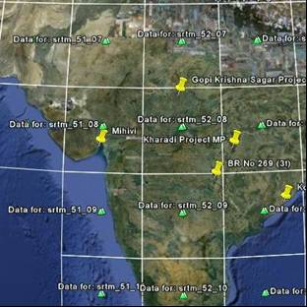
Sources for Elevation data set (DEM)
Digital Elevation Model of different specifications are freely available and can be download from the link given below:
For 90m SRTM DEM
90 m DEM available as 5 degree x 5 degree tiles, in geographic coordinate system - WGS84 datum-raster data model
https://srtm.csi.cgiar.org/srtmdata/
For 30 m SRTM DEM may be download from the link below after registration
https://earthexplorer.usgs.gov/

Slide 42
Thank you

